Slide 1

The world in a grain of sand
Cornie van Huyssteen
6 November 2018

Slide 2
Dedication
My Lord and saviour
My family
My mentors
My colleagues
My students

Slide 3
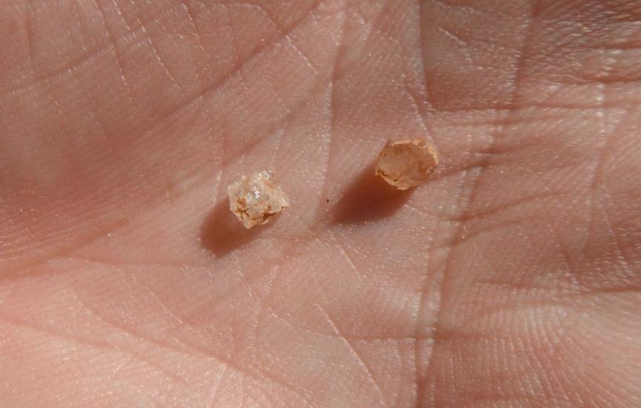
A grain of sand
Kruger National Park (2013)

Slide 4
Introduction
Humans classify their environment to:
create order
make it more understandable
aid recollection
communicate

Slide 5
Soil Classification
International systems:
  USDA Soil Taxonomy
  World Reference Base for Soil Resources
National system:
  Soil Classification: A Taxonomic System for South Africa
    Colour defined horizons:
      grey E horizon
      yellow brown apedal B horizon
      red apedal B horizon

Slide 6
Colour defined horizons
Perceived hydrological order:
  red → driest
  yellow → intermediate
  grey → wettest
dry
wet
hematite
goethite
quartz
red apedal B
E horizon
G horizon
soft plinthic B
yellow brown apedal B

Slide 7
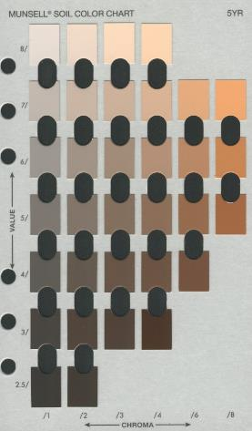
Colour definitions
Grey
Yellow
Red

Slide 8
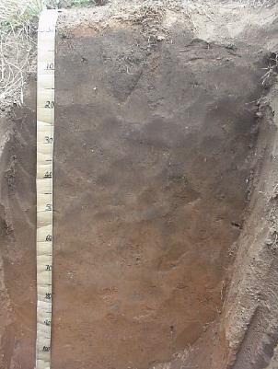
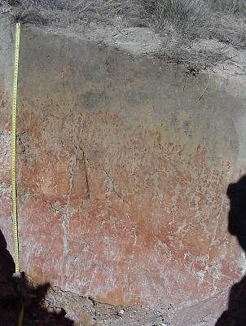
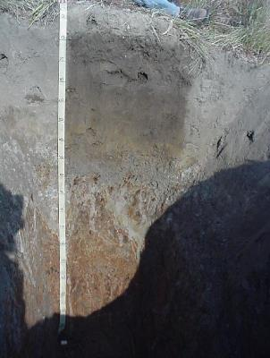
Soil forms
P210 (Bloemdal)
P204 (Longlands)
P226 (Kroonstad)

Slide 9
Aerobic respiration
CH₂O + H₂O
O₂ + 4e⁻ + 4H⁺
organic matter
energy
CO₂ + 4e⁻ + 4H⁺
2 H₂O

Slide 10
Anaerobic respiration
CH₂O + H₂O
Fe₂O₃ + 2e⁻ + 6H⁺
(insoluble)
organic matter
less energy
CO₂ + 4e⁻ + 4H⁺
2Fe²⁺ + 3H₂O
(soluble)

Slide 11
Fe determines colour
Aerobic (oxidised)
Fe³⁺
Soil particle
Fe³⁺ coating
Quartz
Anaerobic (reduced)
Fe²⁺
Fe²⁺
Soil particle
Fe²⁺
Fe²⁺
Fe²⁺

Slide 12
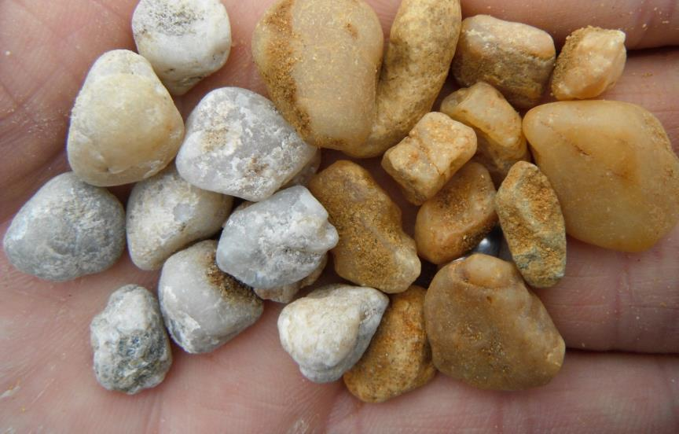
Fe determines colour
Fluvisol in Hungary (2011)

Slide 13
Reduction sequence
Oxygen reduction
4e⁻ + 4H⁺ + O₂ ↔ 2H₂O (+500 mV)
Denitrification
10e⁻ + 12H⁺ + 2NO₃⁻ ↔ N₂ + 6H₂O (+350 mV)
Manganese reduction
2e⁻ + 4H⁺ + MnO₂ ↔ Mn²⁺ + 2H₂O (+300 mV)
Iron reduction
2e⁻ + 6H⁺ + Fe₂O₃ ↔ 2Fe²⁺ + 3H₂O (+200 mV)
Sulphate reduction
8e⁻ + 10H⁺ + SO₄²⁻ ↔ H₂S + 4H₂O (-75 mV)
Swamp gas production
8e⁻ + 8H⁺ + CO₂ ↔ CH₄ + 2H₂O (-185 mV)
H₂ formation
2e⁻ + 2H⁺ ↔ H₂ (-185 mV)

Slide 14
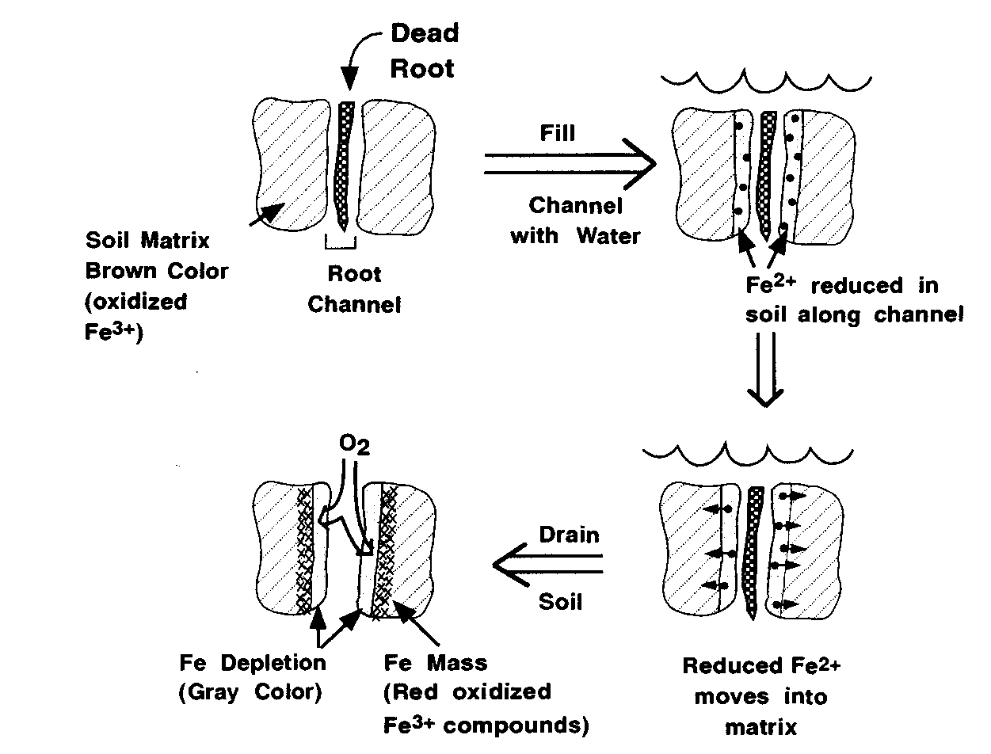
Stagnic colour pattern

Slide 15
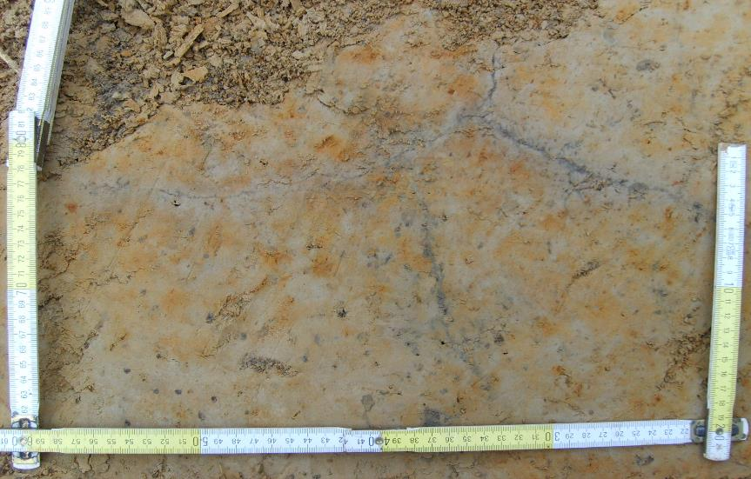
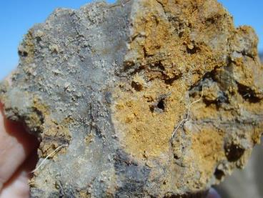
Stagnic colour pattern
Stagnosol in Norway (2010)

Slide 16
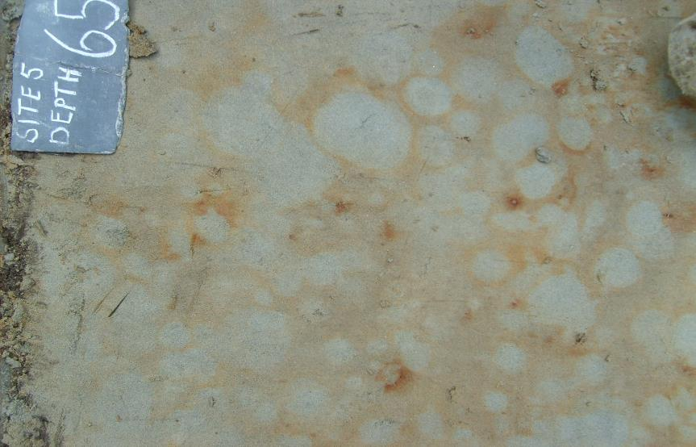
Stagnic colour pattern
Stagnosol in Norway (2010)

Slide 17
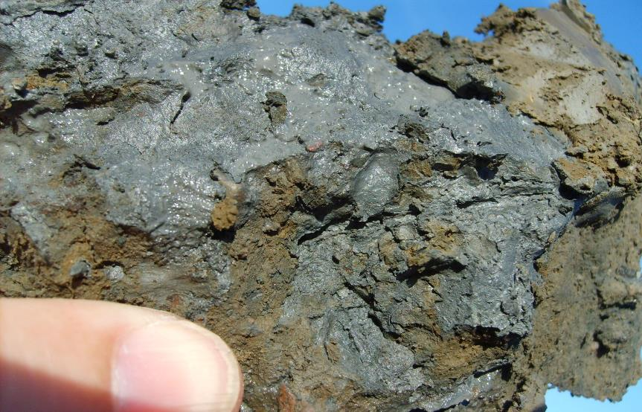
Stagnic colour pattern
Stagnosol in Norway (2010)

Slide 18
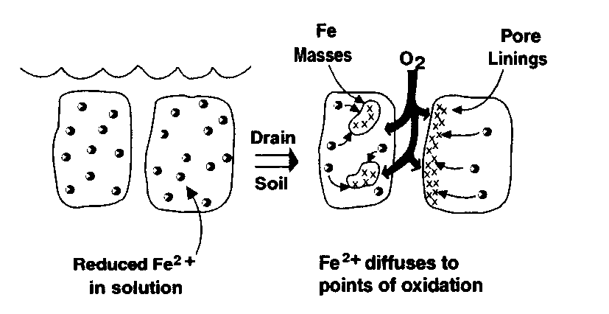
Gleyic colour pattern

Slide 19
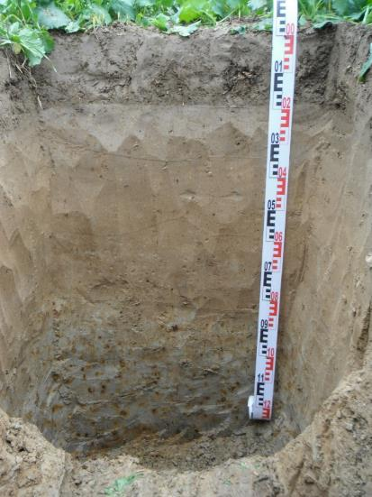
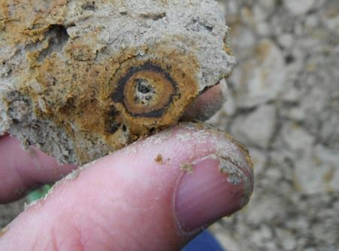
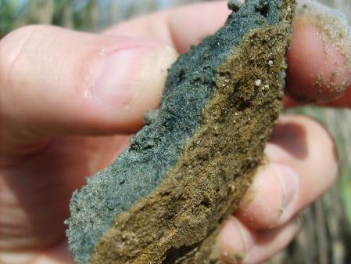
Gleyic colour pattern
Gleysol in Poland (2011)
Gleysol in Hungary (2011)
Notes:
Katja

Slide 20
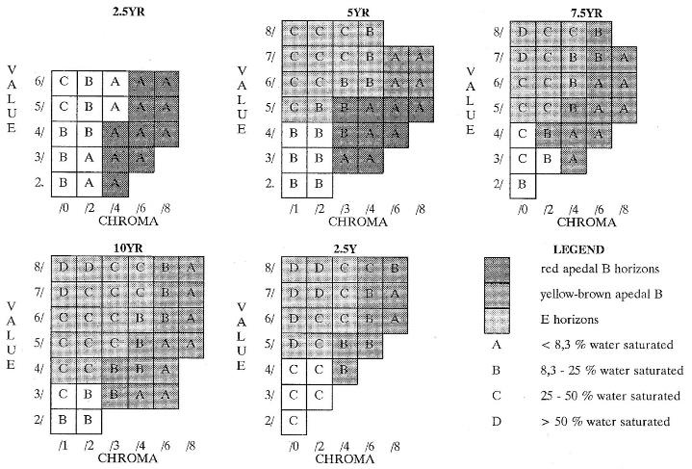
Munsell colour definitions
Duration of free water (%) = 2,35 x Hue_{dry} + 5,79 x Value_{dry} - 7,31 x Chroma_{dry} - 27,89
Notes:
Colour definitions of red apedal B, yellow-brown apedal Band E horizons (Soil Classification Working Group, 1991) with durations of saturation predicted with equation 7.3. (Van Huyssteen, 1995)

Slide 21
Weatherley
METHODOLOGY:
  28 profiles
    described in detail
    sampled & analysed in 100 mm intervals
    bulk density & porosity
  Neutron water meter measurements
    weekly for six years (1997 - 2002)

Slide 22
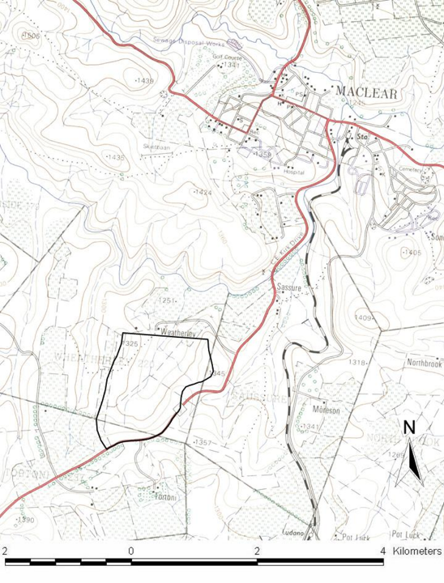
Notes:
The Weatherley catchment, 4 km south of Maclear on the road to Ugie

Slide 23
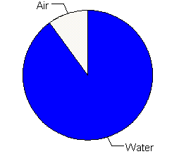
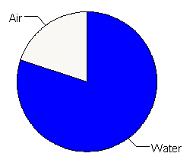
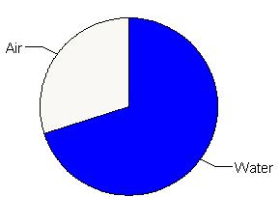
Degree of water saturation (S_{0.7})
Air
Air
10 %
Air
20 %
30 %
80 %
70 %
90 %
Water
Water
Water

Slide 24
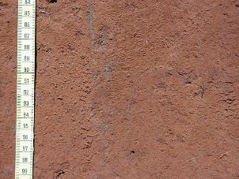
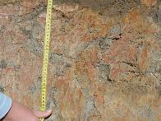
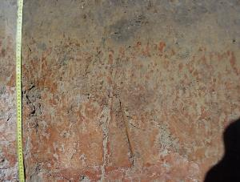

Slide 25
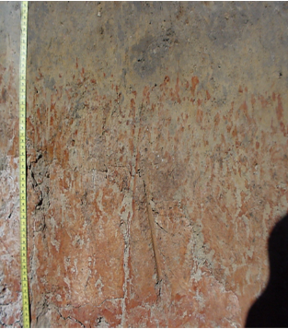
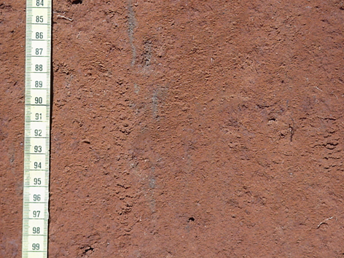

AD_{s>0.7} per horizon
orthic A
E horizons
G horizons
red apedal B
neocutanic B
soft plinthic B
Unspecified wet
yellow brown apedal B

Slide 26
Florisbad

Slide 27
Florisbad
Oxidised
Reduced
rH = 2(Eh/59 + pH)

Slide 28
Application
  Hydropedology
  Wetland delineation
    Urban development
    Mining EIAs
  Irrigation scheduling
  Water table soils
  Soil classification

Slide 29
Hydropedology
Midslope
Footslope
Valley bottom
Midslope
Footslope
Valley
bottom
Hu
We
Ka
Hu
We
Ka
A
B

Slide 30
Wetlands
  Saturated with water in growing season
    Determines vegetation type
    Leads to distinct soil morphology
      Termed redox morphology
    Evidence of saturation in rooting depth
      Grey soil matrix colours
      Mottling
Notes:
The main aim of research in the Weatherley catchment is the characterization and modelling of catchment water yield.
The relationship between soil water regime and soil morphology, however, received little attention - a prerequisite for knowledge transfer to other catchements.
Ib this regard it is especially the red apedal B, yellow brow apedal B, E, soft plinthic B, G, horizons as well as unspecified material with signs of wetness, that is of extreme importance.
This will aid in the improved definition of hydrological response units, improved pedotransfer in other catchments and aid in the improvement of soil classification.
There is also a vast quantity of data available in this catchment that begs to be explored.

Slide 31
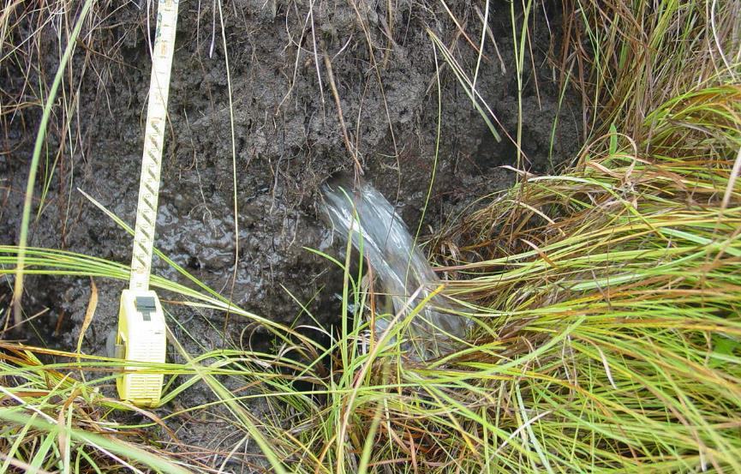
Wetlands
Weatherley (2002)

Slide 32
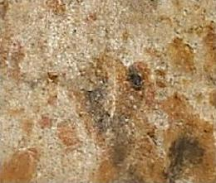
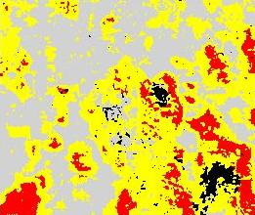

Image analysis
Notes:
The main aim of research in the Weatherley catchment is the characterization and modelling of catchment water yield.
The relationship between soil water regime and soil morphology, however, received little attention - a prerequisite for knowledge transfer to other catchements.
Ib this regard it is especially the red apedal B, yellow brow apedal B, E, soft plinthic B, G, horizons as well as unspecified material with signs of wetness, that is of extreme importance.
This will aid in the improved definition of hydrological response units, improved pedotransfer in other catchments and aid in the improvement of soil classification.
There is also a vast quantity of data available in this catchment that begs to be explored.

Slide 33
Rift valley fever
Viral zoonotic disease
Affects domestic and wild animals and humans
Outbreaks every ca. 10 years
  Aligned to rainfall cycle?
Transmitted by infected Aedes mosquitos
High abortion and mortality rates in livestock
Virus estivates in mosquito larvae in wetlands?

Slide 34
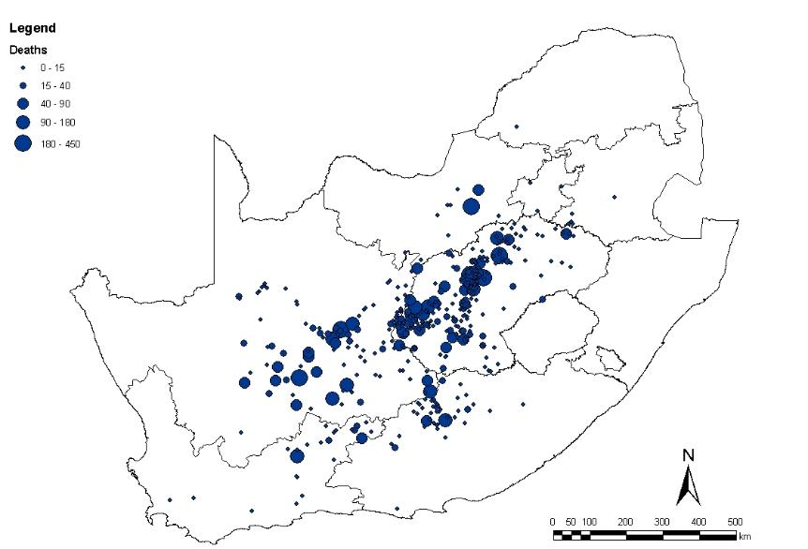
RVF sheep mortality (2010)

Slide 35
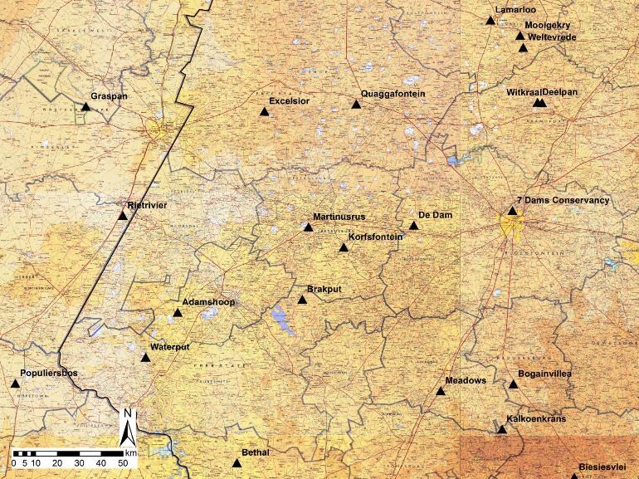
RFV study sites

Slide 36
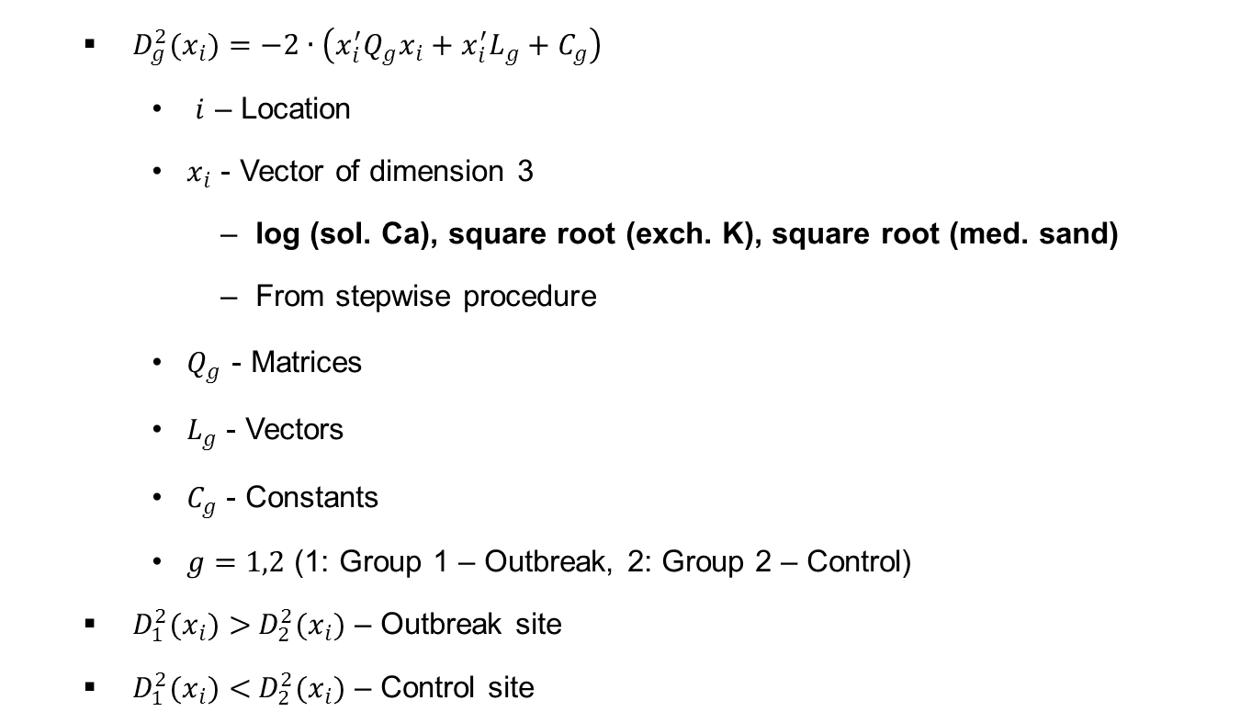
Prediction of RVF outbreak site
  ${ D_{g}^{2}(x}_{i})=−2∙\left(x_{i}^{′}Q_{g}x_{i}+{x_{i}^{′}L}_{g}+C_{g}\right)$
    $i$ – Location
    $x_{i}$ - Vector of dimension 3
      log (sol. Ca), square root (exch. K), square root (med. sand)
      From stepwise procedure
    $Q_{g}$ - Matrices
    $L_{g}$ - Vectors
    $C_{g}$ - Constants
    $g=1,2$ (1: Group 1 – Outbreak, 2: Group 2 – Control)
  ${ D_{1}^{2}(x}_{i})>{ D_{2}^{2}(x}_{i})$ – Outbreak site
  ${ D_{1}^{2}(x}_{i})<{ D_{2}^{2}(x}_{i})$ – Control site
Notes:
With discriminant analysis a formula was produced which could be used to calculated whether the area could be a possible outbreak site.

Slide 37

One Health

Slide 38










RVF partners
This project is sponsored by the U.S. Department of Defense, Defense Threat Reduction Agency. The content of the information does not necessarily reflect the position or the policy of the federal government, and no official endorsement should be inferred.

Slide 39
Iphakade at the UFS
  Since 2009
  Initiated at UFS by Marian Tredoux
  Initially collaboration between Germany & SA
  Funded in SA by DST
  Administrated by Prof. Maarten de Witt (NMU)
  Disbursed to various university collaborators

Slide 40
Iphakade totals at UFS
  ca. R14 100 000 over 10 years
  6 Departments
  17 Lecturers
  180 students
  Focus on Hons., M.Sc. & Ph.D. students
  Approximately:
    50% black; 50% white
    40% female; 60% male

Slide 41
The Future
To propose ancillary criteria to relate SAT to WRB
To modify SAT diagnostics to better relate to WRB
To propose morphological diagnostics for the WRB

Slide 42
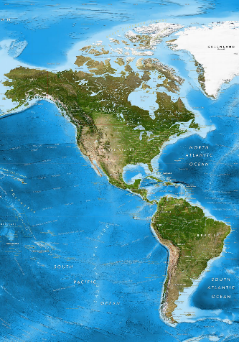
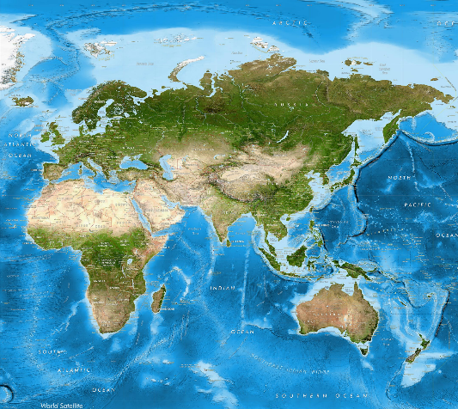
The world
Tallinn
2017
Petrosavodsk 2004
Trondheim 2010
Gödöllő 2010
Yakutsk
2013
Wexford
2014
Minneapolis 2015
Ulm
2013
Potsdam
2012
Lincoln
2012
State College 2006
Philadelphia 2006
Wageningen 1995
Wroclaw
2011
Rome
2013
Torun
2018
San Diego 1998
Texas A&M 2012
Cluj
2018
Jeju
2014
Blacksburg 2018
Rio
2018
Santiago 2008
Walvis Bay 2002
Brisbane
2010
Florianapolis 2013

Slide 43
Conclusion
Soil colour:
  reflects soil hydrology
  can therefore be used to infer water behaviour
  applied in:
    hydropedology
    wetland delineation
    irrigation scheduling
    water table soils
    soil classification
Must be willing to see the world in a grain of sand

Slide 44
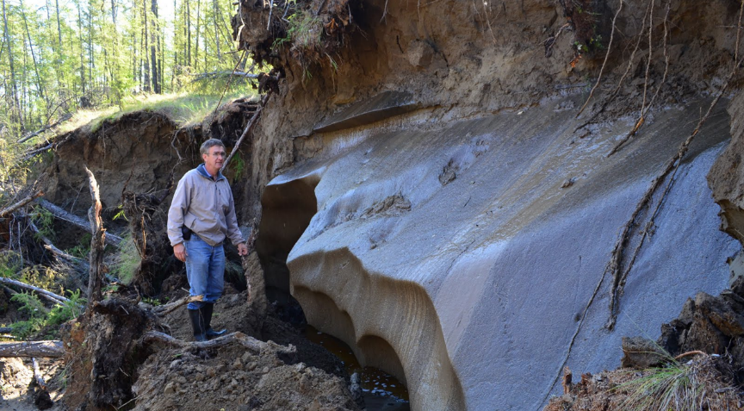
Thank you!

