Slide 1
ADDENDUM

Slide 2
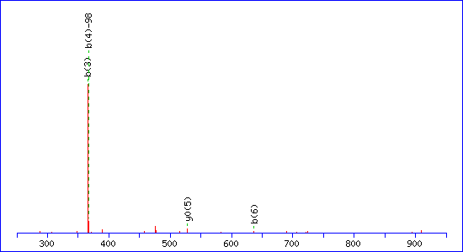
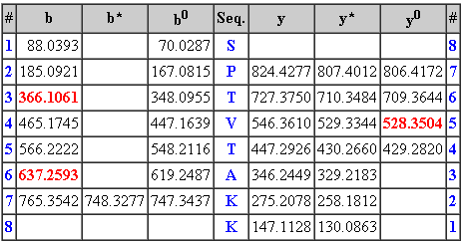
MS/MS Fragmentation of SPTVTAKK
Found in H1_YEAST, Histone H1 OS=Saccharomyces cerevisiae (strain ATCC 204508 / S288c) GN=HHO1 PE=1 SV=1
Match to Query 214: 909.767343 from(910.774619,1+)
Title: File: 191113.wiff, Sample: Logarthmic phase, Elution: 55.429 min
Data file c:\temp\masF9.tmp
Monoisotopic mass of neutral peptide Mr(calc): 910.4525
Variable modifications:
T3 : Phospho (ST), with neutral losses 0.0000(shown in table), 97.9769
Ions Score: 6 Expect: 1.7e+02
Matches (Bold Red): 4/50 fragment ions using 8 most intense peaks

Slide 3
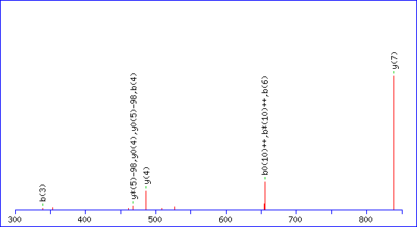
MS/MS Fragmentation of APKKSTTKTTSKGKKPATSK
Found in H1_YEAST, Histone H1 OS=Saccharomyces cerevisiae (strain ATCC 204508 / S288c) GN=HHO1 PE=1 SV=1
Match to Query 732: 2516.220618 from(839.747482,3+)
Title: File: 191113.wiff, Sample: Log 2 (sample number 4), Elution: 40.393 minData file c:\temp\masFC.tmp

Slide 4
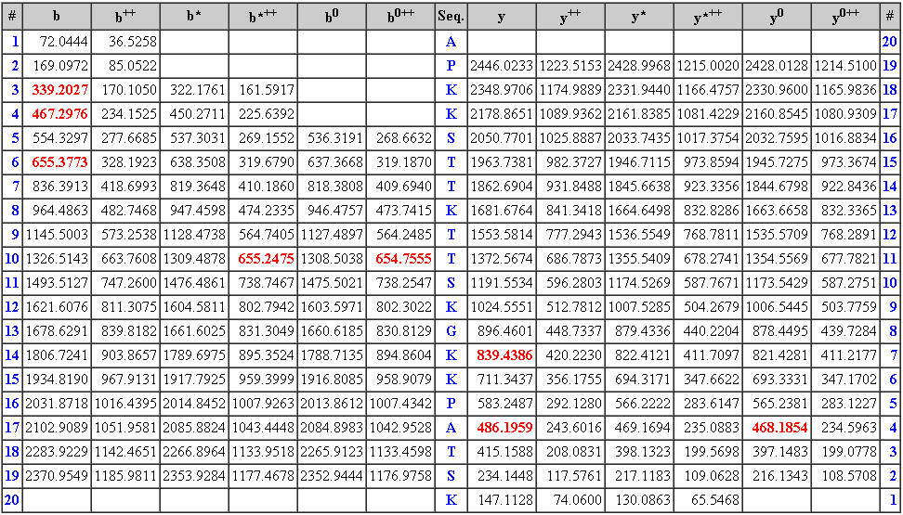
Monoisotopic mass of neutral peptide Mr(calc): 2516.0531
Variable modifications:
K3 : Acetyl (K) T7 : Phospho (ST), with neutral losses 0.0000(shown in table), 97.9769
T9 : Phospho (ST), with neutral losses 0.0000(shown in table), 97.9769
T10 : Phospho (ST), with neutral losses 0.0000(shown in table), 97.9769
S11 : Phospho (ST), with neutral losses 0.0000(shown in table), 97.9769
T18 : Phospho (ST), with neutral losses 0.0000(shown in table), 97.9769
Ions Score: 25 Expect: 11
Matches (Bold Red): 10/394 fragment ions using 7 most intense peaks

Slide 5
MS/MS Fragmentation of APKKSTTKTTSKGKKPATSK
Found in H1_YEAST, Histone H1 OS=Saccharomyces cerevisiae (strain ATCC 204508 / S288c) GN=HHO1 PE=1 SV=1
Match to Query 732: 2516.220618 from(839.747482,3+)
Title: File: 191113.wiff, Sample: Log 2, Elution: 40.393 min
Data file c:\temp\masFC.tmp

Slide 6
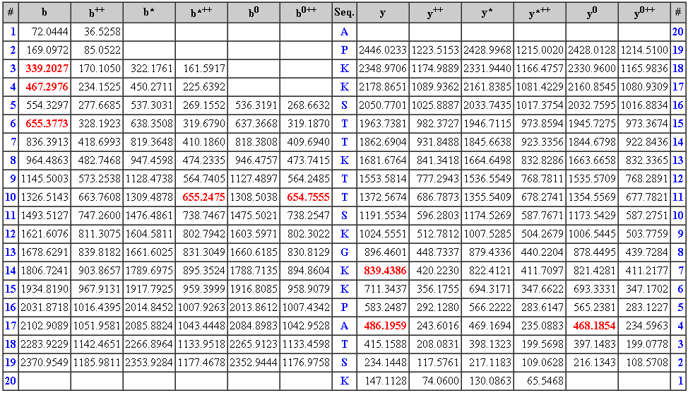
Monoisotopic mass of neutral peptide Mr(calc): 2516.0531
Variable modifications:
K3 : Acetyl (K) T7 : Phospho (ST), with neutral losses 0.0000(shown in table), 97.9769
T9 : Phospho (ST), with neutral losses 0.0000(shown in table), 97.9769
T10 : Phospho (ST), with neutral losses 0.0000(shown in table), 97.9769
S11 : Phospho (ST), with neutral losses 0.0000(shown in table), 97.9769
T18 : Phospho (ST), with neutral losses 0.0000(shown in table), 97.9769
Ions Score: 25 Expect: 11
Matches (Bold Red): 10/394 fragment ions using 7 most intense peaks

Slide 7
Hho1p peptides
ASSPSSLTYK
QAATSVSATASK
KASSPSSLTYK
K.GVEAGDFEQPK.G

Slide 8
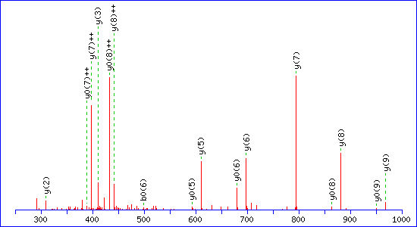
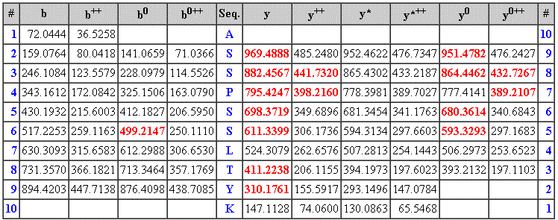
Monoisotopic mass of neutral peptide Mr(calc): 1039.5186
Ions Score: 51 Expect: 0.0085
Matches (Bold Red): 16/84 fragment ions using 35 most intense peaks
MS/MS Fragmentation of ASSPSSLTYK
Found in H1_YEAST, Histone H1 OS=Saccharomyces cerevisiae (strain ATCC 204508/ S288c) GN=HHO1 PE=1 SV=1
Match to Query 330: 1039.283348 from(520.648950,2+)
Title: File: 191113.wiff, Sample: Logarthmic phase 1, Elution: 53.356 to 53.614 min
Data file c:\temp\masF9.tmp

Slide 9
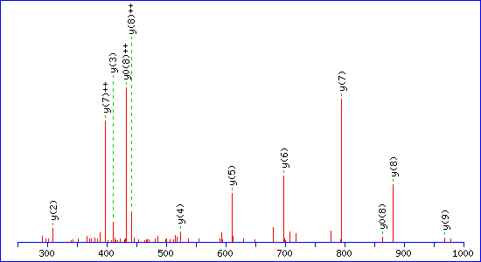
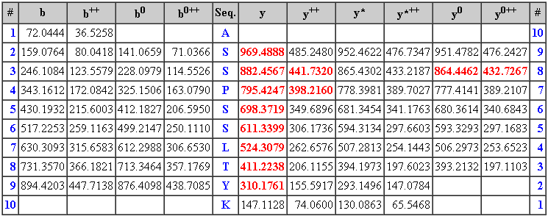
MS/MS Fragmentation of ASSPSSLTYK
Found in H1_YEAST, Histone H1 OS=Saccharomyces cerevisiae (strain ATCC 204508 / S288c) GN=HHO1 PE=1 SV=1
Match to Query 362: 1039.277900 from(520.646226,2+)
Title: File: 191113.wiff, Sample: Log phase 2, Elution: 32.947 to 33.179 min
Data file c:\temp\masFC.tmp
Monoisotopic mass of neutral peptide Mr(calc): 1039.5186
Ions Score: 63 Expect: 0.00044
Matches (Bold Red): 12/84 fragment ions using 13 most intense peaks

Slide 10
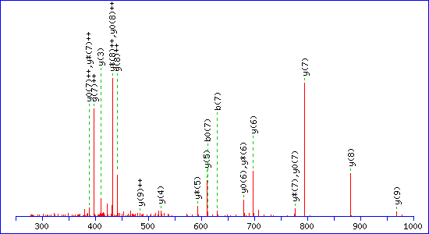
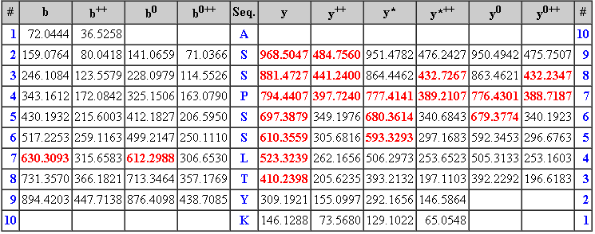
MS/MS Fragmentation of ASSPSSLTYK
Found in H1_YEAST, Histone H1 OS=Saccharomyces cerevisiae (strain ATCC 204508 / S288c) GN=HHO1 PE=1 SV=1
Match to Query 432: 1039.248062 from(520.631307,2+)
Title: File: 191113.wiff, Sample: Stationary 1 (sample number 1), Elution: 47.836 to 49.178 min
Data file c:\temp\mas100.tmp
Monoisotopic mass of neutral peptide Mr(calc): 1038.5345
Variable modifications: C-term : Amidated (C-term)
Ions Score: 46 Expect: 0.0071
Matches (Bold Red): 21/84 fragment ions using 39 most intense peaks

Slide 11
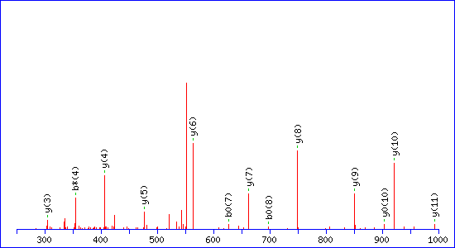
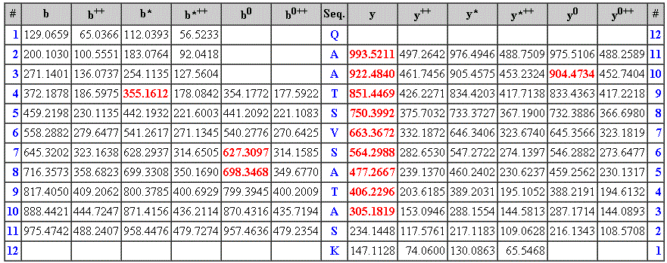
MS/MS Fragmentation of QAATSVSATASK
Found in H1_YEAST, Histone H1 OS=Saccharomyces cerevisiae (strain ATCC 204508 / S288c) GN=HHO1 PE=1 SV=1
Match to Query 371: 1120.348366 from(561.181459,2+)
Title: File: 191113.wiff, Sample: Logarthmic phase1, Elution: 26.514 to 26.736 min
Data file c:\temp\masF9.tmp
Monoisotopic mass of neutral peptide Mr(calc): 1120.5724
Ions Score: 69 Expect: 0.00012
Matches (Bold Red): 13/124 fragment ions using 23 most intense peaks

Slide 12
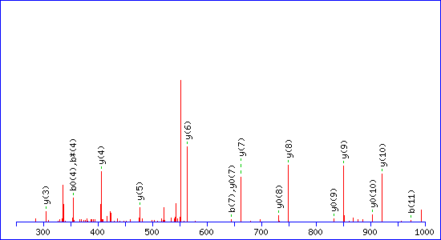
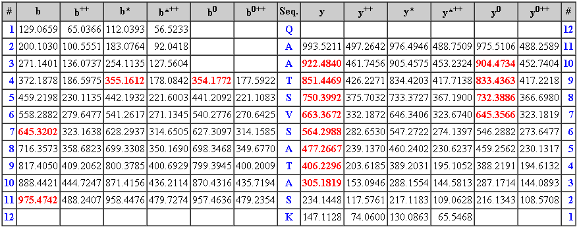
MS/MS Fragmentation of QAATSVSATASK
Found in H1_YEAST, Histone H1 OS=Saccharomyces cerevisiae (strain ATCC 204508 / S288c) GN=HHO1 PE=1 SV=1
Match to Query 403: 1120.293764 from(561.154158,2+)
Title: File: 191113.wiff, Sample: Log 2, Elution: 23.384 to 24.143 min
Data file c:\temp\masFC.tmp
Monoisotopic mass of neutral peptide Mr(calc): 1120.5724
Ions Score: 57 Expect: 0.0016
Matches (Bold Red): 16/124 fragment ions using 28 most intense peaks

Slide 13
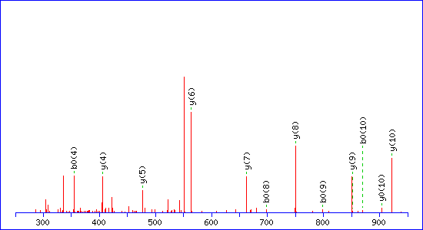
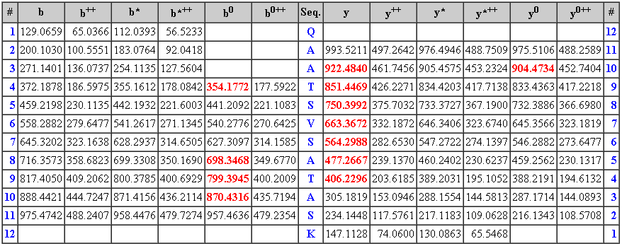
MS/MS Fragmentation of QAATSVSATASK
Found in H1_YEAST, Histone H1 OS=Saccharomyces cerevisiae (strain ATCC 204508 / S288c) GN=HHO1 PE=1 SV=1
Match to Query 471: 1120.251870 from(561.133211,2+)
Title: File: 191113.wiff, Sample: Stationary phase 1, Elution: 29.549 to 30.652 min
Data file c:\temp\mas100.tmp
Monoisotopic mass of neutral peptide Mr(calc): 1120.5724
Ions Score: 31 Expect: 0.62
Matches (Bold Red): 12/124 fragment ions using 28 most intense peaks

Slide 14
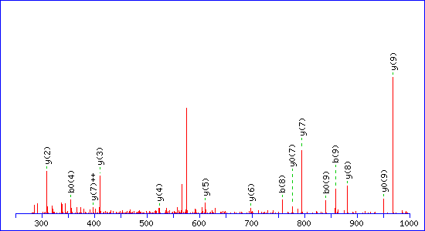
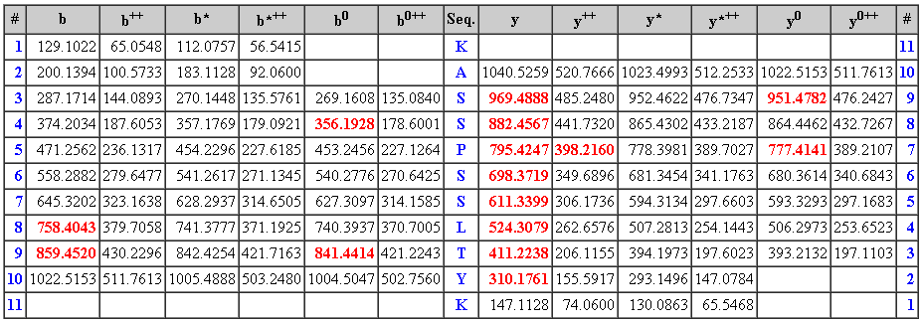
MS/MS Fragmentation of KASSPSSLTYK
Found in H1_YEAST, Histone H1 OS=Saccharomyces cerevisiae (strain ATCC 204508 / S288c) GN=HHO1 PE=1 SV=1
Match to Query 391: 1167.282274 from(584.648413,2+)
Title: File: 191113.wiff, Sample: Log 1 (sample number 3), Elution: 29.915 to 30.184 min
Data file c:\temp\masF9.tmp
Monoisotopic mass of neutral peptide Mr(calc): 1167.6135
Ions Score: 52 Expect: 0.0062
Matches (Bold Red): 15/112 fragment ions using 34 most intense peaks

Slide 15
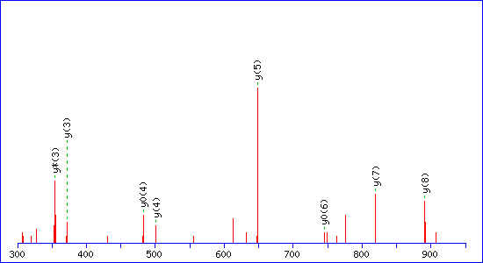
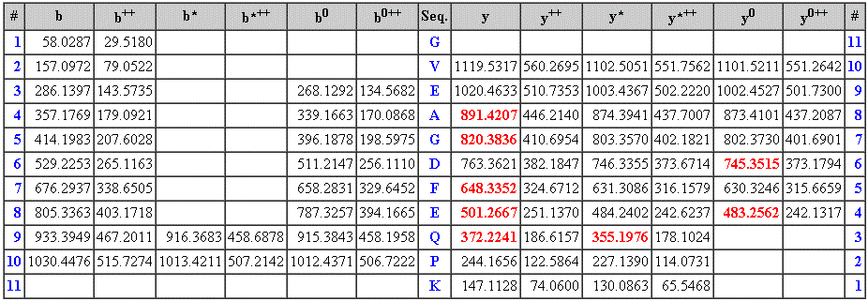
MS/MS Fragmentation of GVEAGDFEQPK
Found in H1_YEAST, Histone H1 OS=Saccharomyces cerevisiae (strain ATCC 204508 / S288c) GN=HHO1 PE=1 SV=1
Match to Query 430: 1176.217426 from(589.115989,2+)
Title: File: 191113.wiff, Sample: Log 2, Elution: 51.176 min
Data file c:\temp\masFC.tmp
Monoisotopic mass of neutral peptide Mr(calc): 1175.5459
Ions Score: 33 Expect: 0.46
Matches (Bold Red): 8/94 fragment ions using 17 most intense peaks

Slide 16
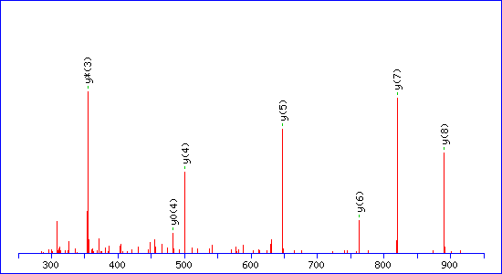
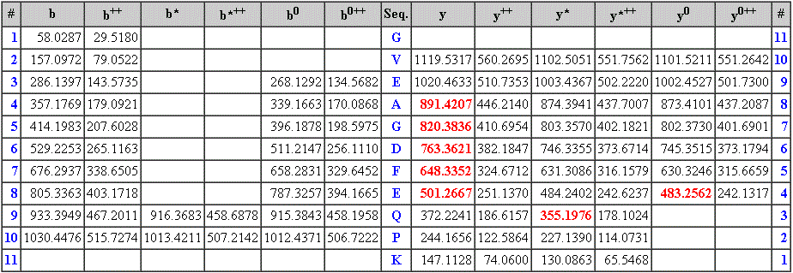
Monoisotopic mass of neutral peptide Mr(calc): 1175.5459
Ions Score: 50 Expect: 0.0089
Matches (Bold Red): 7/94 fragment ions using 7 most intense peaks
MS/MS Fragmentation of GVEAGDFEQPK
Found in H1_YEAST, Histone H1 OS=Saccharomyces cerevisiae (strain ATCC 204508 / S288c) GN=HHO1 PE=1 SV=1
Match to Query 485: 1175.113434 from(588.563993,2+)
Title: File: 191113.wiff, Sample: Stat, Elution: 58.412 to 59.849 min
Data file c:\temp\mas100.tmp

Slide 17
Acid purification of Hho1p

Slide 18
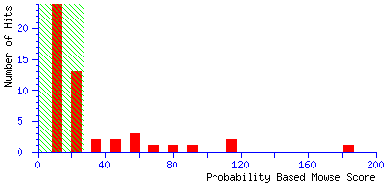
http://cbio.ufs.ac.za/mascot/cgi/master_results.pl?file=../data/20091007/F001451.dat
Individual ions scores > 27 indicate identity or extensive homology (p<0.05).
Histone H1 - Saccharomyces cerevisiae (Baker's yeast)
Mass: 27786 Score: 111 Queries matched: 7 emPAI: 0.47
Sequence | Score | Mr(calc): | Mr(obs) | Delta | Expect
DYLFNSAIK | 37 | 1069.5444 | 1070.661252 | 1.1169 | 0.017
CVENGELVQPK | 36 | 1214.5965 | 1214.271466 | -0.3250 | 0.0058
ASNFDLYFNNAIK | 53 | 1515.7358 | 1515.668834 | -0.0669 | 0.00033
TSSNFDYLFNSAIK | 77 | 1605.7675 | 1605.796432 | 0.0290 | 4.7e-07

Slide 19
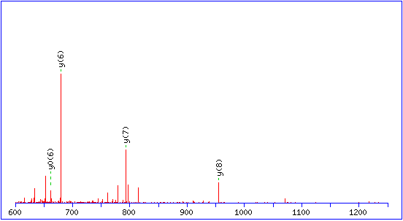
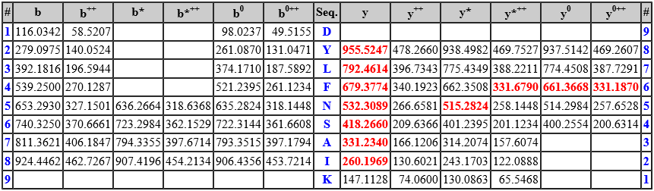
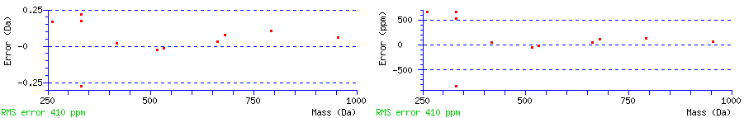
MS/MS Fragmentation of DYLFNSAIK
Found in H1_YEAST, Histone H1 - Saccharomyces cerevisiae (Baker's yeast)
Match to Query 78: 1070.661252 from(536.337902,2+)
Title: File: Sys check.wiff, Sample: 071009 Pankaj sample trypsin (sample number 4), Elution: 26.772 min, Period: 1, Cycle(s): 226 (Experiment 5) (Charge not auto determined)
Data file c:\temp\mas163.tmp
Monoisotopic mass of neutral peptide Mr(calc): 1069.5444 Ions Score: 37 Expect: 0.017 Matches (Bold Red): 11/82 fragment ions using 22 most intense peaks

Slide 20
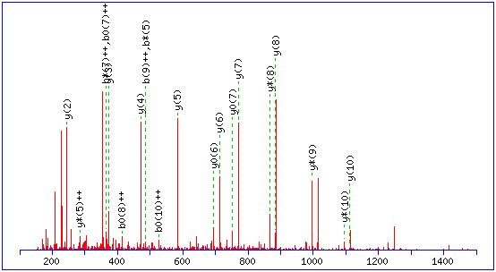
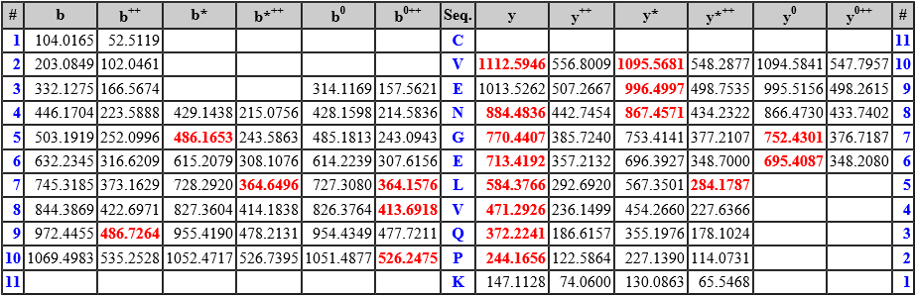
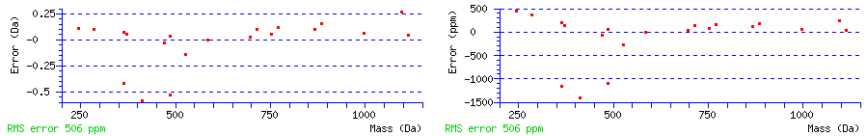
MS/MS Fragmentation of CVENGELVQPK
Found in H1_YEAST, Histone H1 - Saccharomyces cerevisiae (Baker's yeast)
Match to Query 97: 1214.271466 from(608.143009,2+)
Title: File: Sys check.wiff, Sample: 071009 Pankaj sample trypsin (sample number 4), Elution: 18.846 min, Period: 1, Cycle(s): 160 (Experiment 3) (Charge not auto determined)
Data file c:\temp\mas163.tmp
Monoisotopic mass of neutral peptide Mr(calc): 1214.5965 Ions Score: 36 Expect: 0.0058 Matches (Bold Red): 20/100 fragment ions using 59 most intense peaks

Slide 21
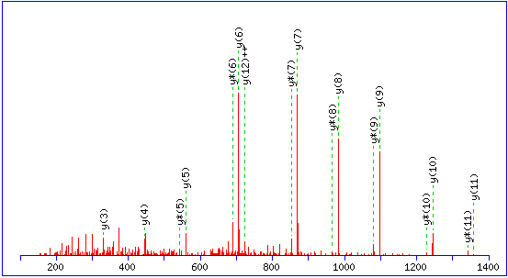
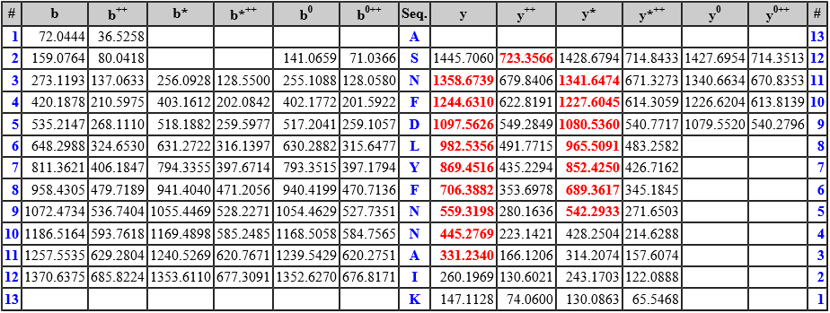
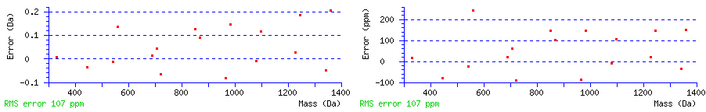
MS/MS Fragmentation of ASNFDLYFNNAIK
Found in H1_YEAST, Histone H1 - Saccharomyces cerevisiae (Baker's yeast)
Match to Query 159: 1515.668834 from(758.841693,2+)
Title: File: Sys check.wiff, Sample: 071009 Pankaj sample trypsin (sample number 4), Elution: 24.292 min, Period: 1, Cycle(s): 206 (Experiment 3)
Data file c:\temp\mas163.tmp
Monoisotopic mass of neutral peptide Mr(calc): 1515.7358 Ions Score: 53 Expect: 0.00033 Matches (Bold Red): 17/122 fragment ions using 38 most intense peaks

Slide 22
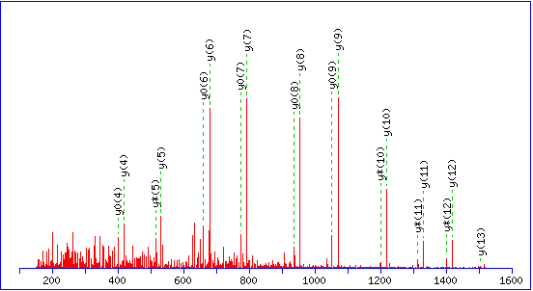
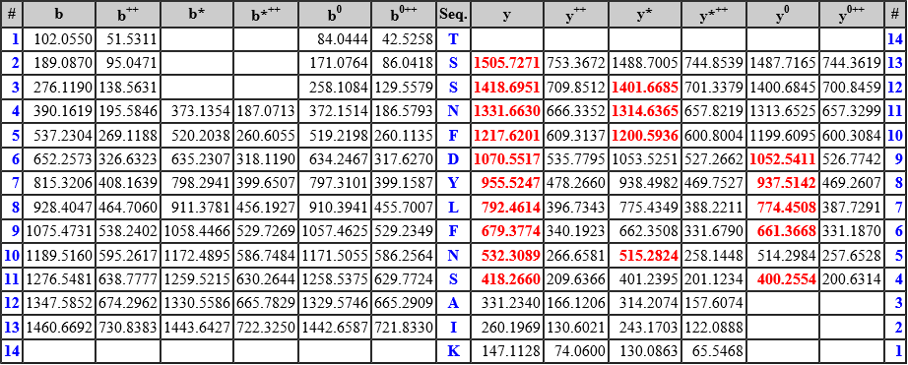
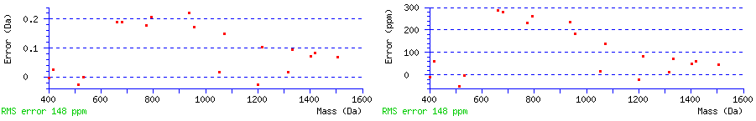
MS/MS Fragmentation of TSSNFDYLFNSAIK
Found in H1_YEAST, Histone H1 - Saccharomyces cerevisiae (Baker's yeast)
Match to Query 166: 1605.796432 from(803.905492,2+)
Title: File: Sys check.wiff, Sample: 071009 Pankaj sample trypsin (sample number 4), Elution: 26.487 to 27.338 min, Period: 1, Cycle(s): 224, 226, 231 (Experiment 3)
Data file c:\temp\mas163.tmp
Monoisotopic mass of neutral peptide Mr(calc): 1605.7675 Ions Score: 77 Expect: 4.7e-07 Matches (Bold Red): 19/144 fragment ions using 28 most intense peaks

Slide 23
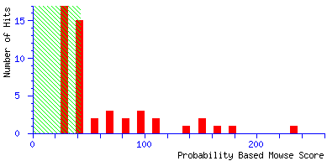
http://cbio.ufs.ac.za/mascot/cgi/master_results.pl?file=..%2Fdata%2F20091007%2FF001452.dat&REPTYPE=peptide&_sigthreshold=0.05&REPORT=AUTO&_noerrortolerant=0&_server_mudpit_switch=99999999&_ignoreionsscorebelow=0&_showsubsets=0&_showpopups=TRUE&_sortunassigned=scoredown&_requireboldred=0
Individual ions scores > 42 indicate identity or extensive homology (p<0.05).
Histone H1 - Saccharomyces cerevisiae (Baker's yeast)
Mass: 27786 Score: 165 Queries matched: 12 emPAI: 0.47
Sequence | Score | Mr(calc): | Mr(obs) | Delta | Expect
ELIIEGLTALK | 40 | 1198.7173 | 1197.674786 | -1.0425 | 0.12
CVENGELVQPK | 36 | 1214.5965 | 1214.271466 | -0.3250 | 0.19
ASNFDLYFNNAIK | 53 | 1515.7358 | 1515.668834 | -0.0669 | 0.0016
TSSNFDYLFNSAIK | 91 | 1605.7675 | 1605.744408 | -0.0231 | 6.5e-07

Slide 24
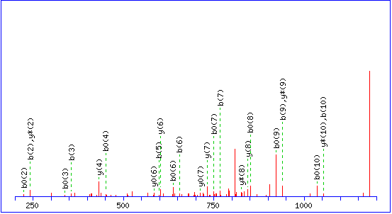
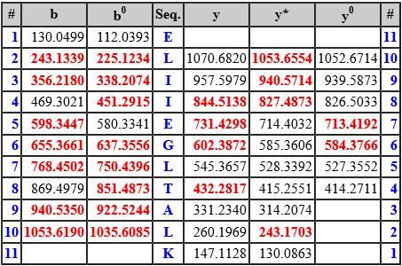
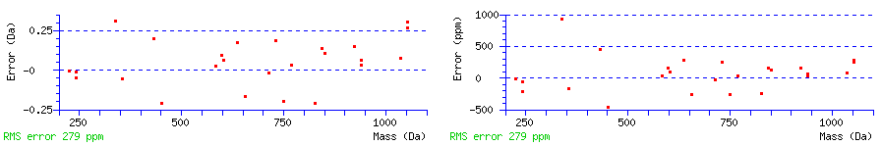
MS/MS Fragmentation of ELIIEGLTALK
Found in H1_YEAST, Histone H1 - Saccharomyces cerevisiae (Baker's yeast)
Match to Query 167: 1197.674786 from(1198.682062,1+)
Title: File: Sys check.wiff, Sample: 071009 Pankaj sample trypsin (sample number 4), Elution: 28.192 min, Period: 1, Cycle(s): 238 (Experiment 5) (Charge not auto determined)
Data file c:\temp\mas166.tmp
Monoisotopic mass of neutral peptide Mr(calc): 1198.7173 Ions Score: 40 Expect: 0.12 Matches (Bold Red): 25/47 fragment ions using 52 most intense peaks

Slide 25

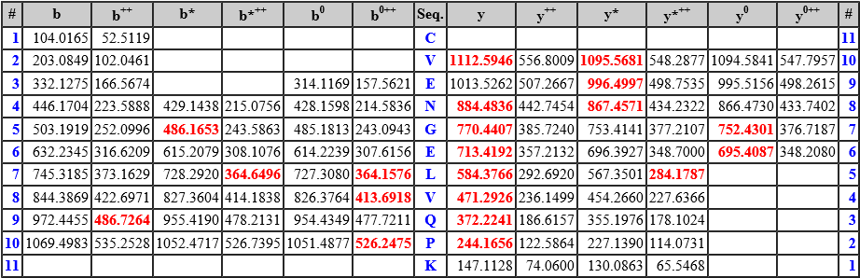
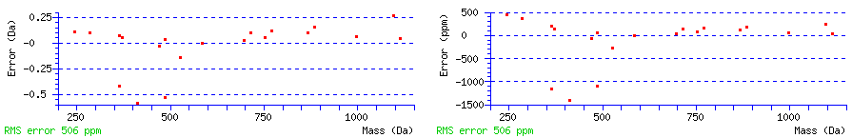
MS/MS Fragmentation of CVENGELVQPK
Found in H1_YEAST, Histone H1 - Saccharomyces cerevisiae (Baker's yeast)
Match to Query 173: 1214.271466 from(608.143009,2+)
Title: File: Sys check.wiff, Sample: 071009 Pankaj sample trypsin (sample number 4), Elution: 18.846 min, Period: 1, Cycle(s): 160 (Experiment 3) (Charge not auto determined)
Data file c:\temp\mas166.tmp
Monoisotopic mass of neutral peptide Mr(calc): 1214.5965 Ions Score: 36 Expect: 0.19 Matches (Bold Red): 20/100 fragment ions using 59 most intense peaks

Slide 26

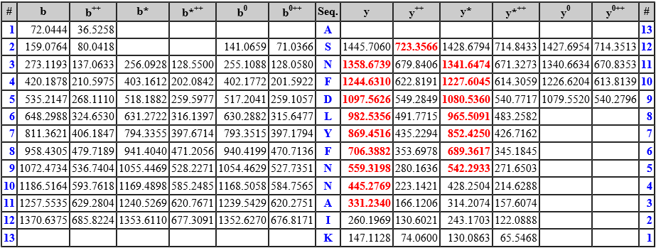
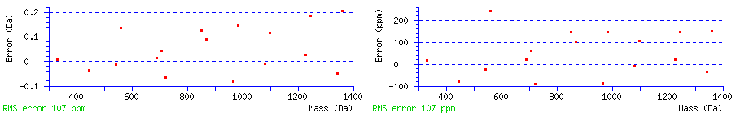
MS/MS Fragmentation of ASNFDLYFNNAIK
Found in H1_YEAST, Histone H1 - Saccharomyces cerevisiae (Baker's yeast)
Match to Query 289: 1515.668834 from(758.841693,2+)
Title: File: Sys check.wiff, Sample: 071009 Pankaj sample trypsin (sample number 4), Elution: 24.292 min, Period: 1, Cycle(s): 206 (Experiment 3)
Data file c:\temp\mas166.tmp
Monoisotopic mass of neutral peptide Mr(calc): 1515.7358 Ions Score: 53 Expect: 0.0016 Matches (Bold Red): 17/122 fragment ions using 38 most intense peaks

Slide 27
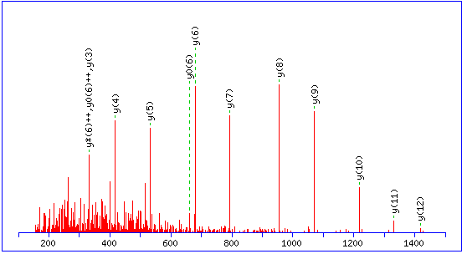
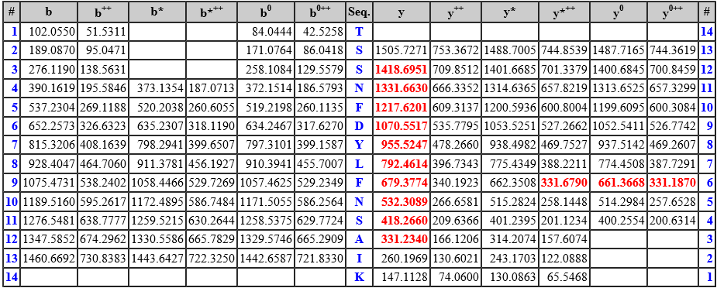
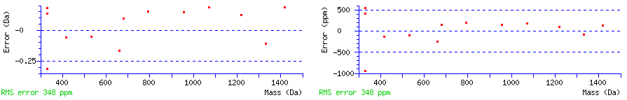
MS/MS Fragmentation of TSSNFDYLFNSAIK
Found in H1_YEAST, Histone H1 - Saccharomyces cerevisiae (Baker's yeast)
Match to Query 304: 1605.744408 from(803.879480,2+)
Title: File: Sys check.wiff, Sample: 071009 Pankaj sample trypsin (sample number 4), Elution: 30.635 to 33.2 min, Period: 1, Cycle(s): 269 (Experiment 3), 258, 279 (Experiment 4)
Data file c:\temp\mas166.tmp
Monoisotopic mass of neutral peptide Mr(calc): 1605.7675 Ions Score: 91 Expect: 6.5e-07 Matches (Bold Red): 13/144 fragment ions using 19 most intense peaks

Slide 28
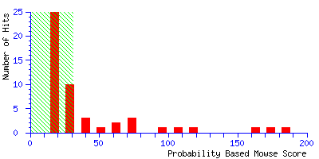
http://cbio.ufs.ac.za/mascot/cgi/master_results.pl?file=..%2Fdata%2F20091007%2FF001453.dat&REPTYPE=peptide&_sigthreshold=0.05&REPORT=AUTO&_noerrortolerant=0&_server_mudpit_switch=99999999&_ignoreionsscorebelow=0&_showsubsets=0&_showpopups=TRUE&_sortunassigned=scoredown&_requireboldred=0
Individual ions scores > 31 indicate identity or extensive homology (p<0.05).
Histone H1 - Saccharomyces cerevisiae (Baker's yeast)
Mass: 27786 Score: 185 Queries matched: 20 emPAI: 0.90
Sequence | Score | Mr(calc): | Mr(obs) | Delta | Expect
DYLFNSAIK | 37 | 1069.5444 | 1070.661252 | 1.1169 | 0.024
ELIIEGLTALK | 40 | 1198.7173 | 1197.674786 | -1.0425 | 0.0095
ELIIEGLTALK | 36 | 1198.7173 | 1198.823348 | 0.1061 | 0.018
CVENGELVQPK | 36 | 1214.5965 | 1214.271466 | -0.3250 | 0.016
ASNFDLYFNNAIK | 53 | 1515.7358 | 1515.668834 | -0.0669 | 0.00054
TSSNFDYLFNSAIK | 91 | 1605.7675 | 1605.744408 | -0.0231 | 5.2e-08
ENYPIVGSASNFDLYFNNAIK | 60 | 2376.1274 | 2376.144306 | 0.0170 | 4.2e-05

Slide 29
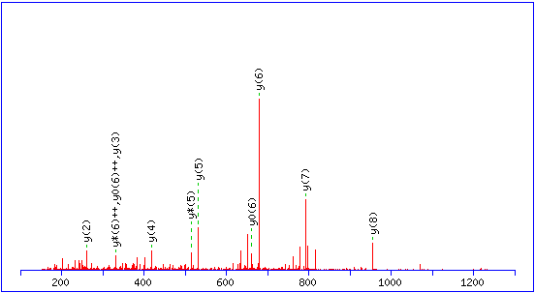

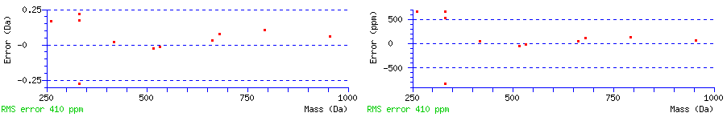
MS/MS Fragmentation of DYLFNSAIK
Found in H1_YEAST, Histone H1 - Saccharomyces cerevisiae (Baker's yeast)
Match to Query 145: 1070.661252 from(536.337902,2+)
Title: File: Sys check.wiff, Sample: 071009 Pankaj sample trypsin (sample number 4), Elution: 26.772 min, Period: 1, Cycle(s): 226 (Experiment 5) (Charge not auto determined)
Data file c:\temp\mas16C.tmp
Monoisotopic mass of neutral peptide Mr(calc): 1069.5444 Ions Score: 37 Expect: 0.024 Matches (Bold Red): 11/82 fragment ions using 22 most intense peaks

Slide 30



MS/MS Fragmentation of ELIIEGLTALK
Found in H1_YEAST, Histone H1 - Saccharomyces cerevisiae (Baker's yeast)
Match to Query 176: 1197.674786 from(1198.682062,1+)
Title: File: Sys check.wiff, Sample: 071009 Pankaj sample trypsin (sample number 4), Elution: 28.192 min, Period: 1, Cycle(s): 238 (Experiment 5) (Charge not auto determined)
Data file c:\temp\mas16C.tmp
Monoisotopic mass of neutral peptide Mr(calc): 1198.7173 Ions Score: 40 Expect: 0.0095 Matches (Bold Red): 25/47 fragment ions using 52 most intense peaks

Slide 31



MS/MS Fragmentation of ELIIEGLTALK
Found in H1_YEAST, Histone H1 - Saccharomyces cerevisiae (Baker's yeast)
Match to Query 179: 1198.823348 from(600.418950,2+)
Title: File: Sys check.wiff, Sample: 071009 Pankaj sample trypsin (sample number 4), Elution: 32.247 to 33.578 min, Period: 1, Cycle(s): 282 (Experiment 4), 271, 281 (Experiment 5)
Data file c:\temp\mas16C.tmp
Monoisotopic mass of neutral peptide Mr(calc): 1198.7173 Ions Score: 36 Expect: 0.018 Matches (Bold Red): 22/94 fragment ions using 56 most intense peaks

Slide 32



MS/MS Fragmentation of CVENGELVQPK
Found in H1_YEAST, Histone H1 - Saccharomyces cerevisiae (Baker's yeast)
Match to Query 184: 1214.271466 from(608.143009,2+)
Title: File: Sys check.wiff, Sample: 071009 Pankaj sample trypsin (sample number 4), Elution: 18.846 min, Period: 1, Cycle(s): 160 (Experiment 3) (Charge not auto determined)
Data file c:\temp\mas16C.tmp
Monoisotopic mass of neutral peptide Mr(calc): 1214.5965 Ions Score: 36 Expect: 0.016 Matches (Bold Red): 20/100 fragment ions using 59 most intense peaks

Slide 33



MS/MS Fragmentation of ASNFDLYFNNAIK
Found in H1_YEAST, Histone H1 - Saccharomyces cerevisiae (Baker's yeast)
Match to Query 305: 1515.668834 from(758.841693,2+)
Title: File: Sys check.wiff, Sample: 071009 Pankaj sample trypsin (sample number 4), Elution: 24.292 min, Period: 1, Cycle(s): 206 (Experiment 3)
Data file c:\temp\mas16C.tmp
Monoisotopic mass of neutral peptide Mr(calc): 1515.7358 Ions Score: 53 Expect: 0.00054 Matches (Bold Red): 17/122 fragment ions using 38 most intense peaks

Slide 34



MS/MS Fragmentation of TSSNFDYLFNSAIK
Found in H1_YEAST, Histone H1 - Saccharomyces cerevisiae (Baker's yeast)
Match to Query 325: 1605.744408 from(803.879480,2+)
Title: File: Sys check.wiff, Sample: 071009 Pankaj sample trypsin (sample number 4), Elution: 30.635 to 33.2 min, Period: 1, Cycle(s): 269 (Experiment 3), 258, 279 (Experiment 4)
Data file c:\temp\mas16C.tmp
Monoisotopic mass of neutral peptide Mr(calc): 1605.7675 Ions Score: 91 Expect: 5.2e-08 Matches (Bold Red): 13/144 fragment ions using 19 most intense peaks

Slide 35



MS/MS Fragmentation of ENYPIVGSASNFDLYFNNAIK
Found in H1_YEAST, Histone H1 - Saccharomyces cerevisiae (Baker's yeast)
Match to Query 501: 2376.144306 from(793.055378,3+)
Title: File: Sys check.wiff, Sample: 071009 Pankaj sample trypsin (sample number 4), Elution: 36.921 to 37.142 min, Period: 1, Cycle(s): 309, 311 (Experiment 4)
Data file c:\temp\mas16C.tmp
Monoisotopic mass of neutral peptide Mr(calc): 2376.1274
Variable modifications: N17 : Deamidated (NQ) Ions Score: 60 Expect: 4.2e-05 Matches (Bold Red): 34/222 fragment ions using 62 most intense peaks

Slide 36

http://cbio.ufs.ac.za/mascot/cgi/master_results.pl?file=../data/20091007/F001454.dat
Individual ions scores > 42 indicate identity or extensive homology (p<0.05)
Histone H1 - Saccharomyces cerevisiae (Baker's yeast)
Mass: 27786 Score: 190 Queries matched: 19 emPAI: 0.67
Sequence | Score | Mr(calc): | Mr(obs) | Delta | Expect
ELIIEGLTALK | 40 | 1198.7173 | 1197.674786 | -1.0425 | 0.12
CVENGELVQPK | 36 | 1214.5965 | 1214.271466 | -0.3250 | 0.19
ASNFDLYFNNAIK | 53 | 1515.7358 | 1515.668834 | -0.0669 | 0.0017
TSSNFDYLFNSAIK | 91 | 1605.7675 | 1605.744408 | -0.0231 | 6.5e-07
ENYPIVGSASNFDLYFNNAIK | 26 | 2375.1433 | 2374.336485 | -0.8069 | 1.2
ENYPIVGSASNFDLYFNNAIK | 60 | 2376.1274 | 2376.144306 | 0.0170 | 0.0003

Slide 37



MS/MS Fragmentation of TSSNFDYLFNSAIK
Found in H1_YEAST, Histone H1 - Saccharomyces cerevisiae (Baker's yeast)
Match to Query 368: 1605.744408 from(803.879480,2+)
Title: File: Sys check.wiff, Sample: 071009 Pankaj sample trypsin (sample number 4), Elution: 30.635 to 33.2 min, Period: 1, Cycle(s): 269 (Experiment 3), 258, 279 (Experiment 4)
Data file c:\temp\mas177.tmp
Monoisotopic mass of neutral peptide Mr(calc): 1605.7675 Ions Score: 91 Expect: 6.5e-07 Matches (Bold Red): 13/144 fragment ions using 19 most intense peaks

Slide 38


MS/MS Fragmentation of ASNFDLYFNNAIK
Found in H1_YEAST, Histone H1 - Saccharomyces cerevisiae (Baker's yeast)
Match to Query 342: 1515.668834 from(758.841693,2+)
Title: File: Sys check.wiff, Sample: 071009 Pankaj sample trypsin (sample number 4), Elution: 24.292 min, Period: 1, Cycle(s): 206 (Experiment 3)
Data file c:\temp\mas177.tmp
Monoisotopic mass of neutral peptide Mr(calc): 1515.7358 Ions Score: 53 Expect: 0.0017 Matches (Bold Red): 17/122 fragment ions using 38 most intense peaks

Slide 39



MS/MS Fragmentation of ELIIEGLTALK
Found in H1_YEAST, Histone H1 - Saccharomyces cerevisiae (Baker's yeast)
Match to Query 200: 1197.674786 from(1198.682062,1+)
Title: File: Sys check.wiff, Sample: 071009 Pankaj sample trypsin (sample number 4), Elution: 28.192 min, Period: 1, Cycle(s): 238 (Experiment 5) (Charge not auto determined)
Data file c:\temp\mas177.tmp
Monoisotopic mass of neutral peptide Mr(calc): 1198.7173 Ions Score: 40 Expect: 0.12 Matches (Bold Red): 25/47 fragment ions using 52 most intense peaks

Slide 40



MS/MS Fragmentation of CVENGELVQPK
Found in H1_YEAST, Histone H1 - Saccharomyces cerevisiae (Baker's yeast)
Match to Query 209: 1214.271466 from(608.143009,2+)
Title: File: Sys check.wiff, Sample: 071009 Pankaj sample trypsin (sample number 4), Elution: 18.846 min, Period: 1, Cycle(s): 160 (Experiment 3) (Charge not auto determined)
Data file c:\temp\mas177.tmp
Monoisotopic mass of neutral peptide Mr(calc): 1214.5965 Ions Score: 36 Expect: 0.19 Matches (Bold Red): 20/100 fragment ions using 59 most intense peaks

Slide 41



MS/MS Fragmentation of ENYPIVGSASNFDLYFNNAIK
Found in H1_YEAST, Histone H1 - Saccharomyces cerevisiae (Baker's yeast)
Match to Query 581: 2374.336485 from(792.452771,3+)
Title: File: Sys check.wiff, Sample: 071009 Pankaj sample trypsin (sample number 4), Elution: 39.117 min, Period: 1, Cycle(s): 328 (Experiment 5) (Charge not auto determined)
Data file c:\temp\mas177.tmp

Slide 42



MS/MS Fragmentation of ENYPIVGSASNFDLYFNNAIK
Found in H1_YEAST, Histone H1 - Saccharomyces cerevisiae (Baker's yeast)
Match to Query 582: 2376.144306 from(793.055378,3+)
Title: File: Sys check.wiff, Sample: 071009 Pankaj sample trypsin (sample number 4), Elution: 36.921 to 37.142 min, Period: 1, Cycle(s): 309, 311 (Experiment 4)
Data file c:\temp\mas177.tmp
Monoisotopic mass of neutral peptide Mr(calc): 2376.1274
Variable modifications: N17 : Deamidated (NQ) Ions Score: 60 Expect: 0.0003
Matches (Bold Red): 34/222 fragment ions using 62 most intense peaks

Slide 43

http://cbio.ufs.ac.za/mascot/cgi/master_results.pl?file=../data/20091007/F001455.dat
Individual ions scores > 31 indicate identity or extensive homology (p<0.05).
Histone H1 - Saccharomyces cerevisiae (Baker's yeast)
Mass: 27786 Score: 202 Queries matched: 25 emPAI: 0.90
Sequence | Score | Mr(calc): | Mr(obs) | Delta | Expect
DYLFNSAIK | 37 | 1069.5444 | 1070.661252 | 1.1169 | 0.031
ELIIEGLTALK | 36 | 98.7173 | 1198.823348 | 0.1061 | 0.018
CVENGELVQPK | 36 | 1214.5965 | 1214.271466 | -0.3250 | 0.016
ASNFDLYFNNAIK | 53 | 1515.7358 | 1515.668834 | -0.0669 | 0.00085
TSSNFDYLFNSAIK | 91 | 1605.7675 | 1605.744408 | -0.0231 | 5.2e-08
ENYPIVGSASNFDLYFNNAIK | 26 | 2375.1433 | 2374.336485 | -0.8069 | 0.091

Slide 44



MS/MS Fragmentation of DYLFNSAIK
Found in H1_YEAST, Histone H1 - Saccharomyces cerevisiae (Baker's yeast)
Match to Query 201: 1070.661252 from(536.337902,2+)
Title: File: Sys check.wiff, Sample: 071009 Pankaj sample trypsin (sample number 4), Elution: 26.772 min, Period: 1, Cycle(s): 226 (Experiment 5) (Charge not auto determined)
Data file c:\temp\mas17C.tmp
Monoisotopic mass of neutral peptide Mr(calc): 1069.5444 Ions Score: 37 Expect: 0.031 Matches (Bold Red): 11/82 fragment ions using 22 most intense peaks

Slide 45



MS/MS Fragmentation of ELIIEGLTALK
Found in H1_YEAST, Histone H1 - Saccharomyces cerevisiae (Baker's yeast)
Match to Query 245: 1198.823348 from(600.418950,2+)
Title: File: Sys check.wiff, Sample: 071009 Pankaj sample trypsin (sample number 4), Elution: 32.247 to 33.578 min, Period: 1, Cycle(s): 282 (Experiment 4), 271, 281 (Experiment 5)
Data file c:\temp\mas17C.tmp
Monoisotopic mass of neutral peptide Mr(calc): 1198.7173 Ions Score: 36 Expect: 0.018 Matches (Bold Red): 22/94 fragment ions using 56 most intense peaks

Slide 46



MS/MS Fragmentation of CVENGELVQPK
Found in H1_YEAST, Histone H1 - Saccharomyces cerevisiae (Baker's yeast)
Match to Query 252: 1214.271466 from(608.143009,2+)
Title: File: Sys check.wiff, Sample: 071009 Pankaj sample trypsin (sample number 4), Elution: 18.846 min, Period: 1, Cycle(s): 160 (Experiment 3) (Charge not auto determined)
Data file c:\temp\mas17C.tmp
Monoisotopic mass of neutral peptide Mr(calc): 1214.5965 Ions Score: 36 Expect: 0.016 Matches (Bold Red): 20/100 fragment ions using 59 most intense peaks

Slide 47



MS/MS Fragmentation of ASNFDLYFNNAIK
Found in H1_YEAST, Histone H1 - Saccharomyces cerevisiae (Baker's yeast)
Match to Query 401: 1515.668834 from(758.841693,2+)
Title: File: Sys check.wiff, Sample: 071009 Pankaj sample trypsin (sample number 4), Elution: 24.292 min, Period: 1, Cycle(s): 206 (Experiment 3)
Data file c:\temp\mas17C.tmp
Monoisotopic mass of neutral peptide Mr(calc): 1515.7358 Ions Score: 53 Expect: 0.00085 Matches (Bold Red): 17/122 fragment ions using 38 most intense peaks

Slide 48



MS/MS Fragmentation of TSSNFDYLFNSAIK
Found in H1_YEAST, Histone H1 - Saccharomyces cerevisiae (Baker's yeast)
Match to Query 432: 1605.744408 from(803.879480,2+)
Title: File: Sys check.wiff, Sample: 071009 Pankaj sample trypsin (sample number 4), Elution: 30.635 to 33.2 min, Period: 1, Cycle(s): 269 (Experiment 3), 258, 279 (Experiment 4)
Data file c:\temp\mas17C.tmp
Monoisotopic mass of neutral peptide Mr(calc): 1605.7675 Ions Score: 91 Expect: 5.2e-08 Matches (Bold Red): 13/144 fragment ions using 19 most intense peaks

Slide 49



MS/MS Fragmentation of ENYPIVGSASNFDLYFNNAIK
Found in H1_YEAST, Histone H1 - Saccharomyces cerevisiae (Baker's yeast)
Match to Query 686: 2374.336485 from(792.452771,3+)
Title: File: Sys check.wiff, Sample: 071009 Pankaj sample trypsin (sample number 4), Elution: 39.117 min, Period: 1, Cycle(s): 328 (Experiment 5) (Charge not auto determined)
Data file c:\temp\mas17C.tmp
Monoisotopic mass of neutral peptide Mr(calc): 2375.1433 Ions Score: 26 Expect: 0.091 Matches (Bold Red): 18/222 fragment ions using 33 most intense peaks

Slide 50

http://cbio.ufs.ac.za/mascot/cgi/master_results.pl?file=..%2Fdata%2F20091007%2FF001456.dat&REPTYPE=peptide&_sigthreshold=0.05&REPORT=AUTO&_noerrortolerant=0&_server_mudpit_switch=99999999&_ignoreionsscorebelow=0&_showsubsets=0&_showpopups=TRUE&_sortunassigned=scoredown&_requireboldred=0
Individual ions scores > 31 indicate identity or extensive homology (p<0.05).
Histone H1 - Saccharomyces cerevisiae (Baker's yeast)
Mass: 27786 Score: 202 Queries matched: 27 emPAI: 0.90
Sequence | Score | Mr(calc): | Mr(obs) | Delta | Expect
DYLFNSAIK | 37 | 1069.5444 | 1070.661252 | 1.1169 | 0.033
ELIIEGLTALK | 40 | 1198.7173 | 1197.674786 | -1.0425 | 0.0095
ELIIEGLTALK | 36 | 1198.7173 | 1198.823348 | 0.1061 | 0.018
CVENGELVQPK | 36 | 1214.5965 | 1214.271466 | -0.3250 | 0.016
CVENGELVQPK | 55 | 1215.5805 | 1216.287920 | 0.7074 | 0.00034
ASNFDLYFNNAIK | 53 | 1515.7358 | 1515.668834 | -0.0669 | 0.00089
TSSNFDYLFNSAIK | 91 | 1605.7675 | 1605.744408 | -0.0231 | 5.2e-08
TSSNFDYLFNSAIK | 44 | 1621.7624 | 1621.657220 | -0.1052 | 0.0058
ENYPIVGSASNFDLYFNNAIK | 26 | 2375.1433 | 2374.336485 | -0.8069 | 0.091

Slide 51



MS/MS Fragmentation of DYLFNSAIK
Found in H1_YEAST, Histone H1 - Saccharomyces cerevisiae (Baker's yeast)
Match to Query 221: 1070.661252 from(536.337902,2+)
Title: File: Sys check.wiff, Sample: 071009 Pankaj sample trypsin (sample number 4), Elution: 26.772 min, Period: 1, Cycle(s): 226 (Experiment 5) (Charge not auto determined)
Data file c:\temp\mas1AB.tmp
Monoisotopic mass of neutral peptide Mr(calc): 1069.5444 Ions Score: 37 Expect: 0.033 Matches (Bold Red): 11/82 fragment ions using 22 most intense peaks

Slide 52



MS/MS Fragmentation of ELIIEGLTALK
Found in H1_YEAST, Histone H1 - Saccharomyces cerevisiae (Baker's yeast)
Match to Query 269: 1197.674786 from(1198.682062,1+)
Title: File: Sys check.wiff, Sample: 071009 Pankaj sample trypsin (sample number 4), Elution: 28.192 min, Period: 1, Cycle(s): 238 (Experiment 5) (Charge not auto determined)
Data file c:\temp\mas1AB.tmp
Monoisotopic mass of neutral peptide Mr(calc): 1198.7173 Ions Score: 40 Expect: 0.0095 Matches (Bold Red): 25/47 fragment ions using 52 most intense peaks

Slide 53



MS/MS Fragmentation of ELIIEGLTALK
Found in H1_YEAST, Histone H1 - Saccharomyces cerevisiae (Baker's yeast)
Match to Query 272: 1198.823348 from(600.418950,2+)
Title: File: Sys check.wiff, Sample: 071009 Pankaj sample trypsin (sample number 4), Elution: 32.247 to 33.578 min, Period: 1, Cycle(s): 282 (Experiment 4), 271, 281 (Experiment 5)
Data file c:\temp\mas1AB.tmp
Monoisotopic mass of neutral peptide Mr(calc): 1198.7173 Ions Score: 36 Expect: 0.018 Matches (Bold Red): 22/94 fragment ions using 56 most intense peaks

Slide 54


MS/MS Fragmentation of CVENGELVQPK
Found in H1_YEAST, Histone H1 - Saccharomyces cerevisiae (Baker's yeast)
Match to Query 281: 1214.271466 from(608.143009,2+)
Title: File: Sys check.wiff, Sample: 071009 Pankaj sample trypsin (sample number 4), Elution: 18.846 min, Period: 1, Cycle(s): 160 (Experiment 3) (Charge not auto determined)
Data file c:\temp\mas1AB.tmp
Monoisotopic mass of neutral peptide Mr(calc): 1214.5965 Ions Score: 36 Expect: 0.016 Matches (Bold Red): 20/100 fragment ions using 59 most intense peaks

Slide 55



MS/MS Fragmentation of CVENGELVQPK
Found in H1_YEAST, Histone H1 - Saccharomyces cerevisiae (Baker's yeast)
Match to Query 283: 1216.287920 from(609.151236,2+)
Title: File: Sys check.wiff, Sample: 071009 Pankaj sample trypsin (sample number 4), Elution: 18.719 min, Period: 1, Cycle(s): 159 (Experiment 3) (Charge not auto determined)
Data file c:\temp\mas1AB.tmp
Monoisotopic mass of neutral peptide Mr(calc): 1215.5805
Variable modifications: N4 : Deamidated (NQ) Ions Score: 55 Expect: 0.00034 Matches (Bold Red): 7/100 fragment ions using 26 most intense peaks

Slide 56



MS/MS Fragmentation of ASNFDLYFNNAIK
Found in H1_YEAST, Histone H1 - Saccharomyces cerevisiae (Baker's yeast)
Match to Query 437: 1515.668834 from(758.841693,2+)
Title: File: Sys check.wiff, Sample: 071009 Pankaj sample trypsin (sample number 4), Elution: 24.292 min, Period: 1, Cycle(s): 206 (Experiment 3)
Data file c:\temp\mas1AB.tmp
Monoisotopic mass of neutral peptide Mr(calc): 1515.7358 Ions Score: 53 Expect: 0.00089 Matches (Bold Red): 17/122 fragment ions using 38 most intense peaks

Slide 57



MS/MS Fragmentation of TSSNFDYLFNSAIK
Found in H1_YEAST, Histone H1 - Saccharomyces cerevisiae (Baker's yeast)
Match to Query 469: 1605.744408 from(803.879480,2+)
Title: File: Sys check.wiff, Sample: 071009 Pankaj sample trypsin (sample number 4), Elution: 30.635 to 33.2 min, Period: 1, Cycle(s): 269 (Experiment 3), 258, 279 (Experiment 4)
Data file c:\temp\mas1AB.tmp
Monoisotopic mass of neutral peptide Mr(calc): 1605.7675 Ions Score: 91 Expect: 5.2e-08 Matches (Bold Red): 13/144 fragment ions using 19 most intense peaks

Slide 58



MS/MS Fragmentation of TSSNFDYLFNSAIK
Found in H1_YEAST, Histone H1 - Saccharomyces cerevisiae (Baker's yeast)
Match to Query 482: 1621.657220 from(811.835886,2+)
Title: File: Sys check.wiff, Sample: 071009 Pankaj sample trypsin (sample number 4), Elution: 27.809 min, Period: 1, Cycle(s): 235 (Experiment 3)
Data file c:\temp\mas1AB.tmp
Monoisotopic mass of neutral peptide Mr(calc): 1621.7624
Variable modifications: Y7 : Oxidation (Y) Ions Score: 44 Expect: 0.0058 Matches (Bold Red): 11/144 fragment ions using 23 most intense peaks

Slide 59



MS/MS Fragmentation of ENYPIVGSASNFDLYFNNAIK
Found in H1_YEAST, Histone H1 - Saccharomyces cerevisiae (Baker's yeast)
Match to Query 740: 2374.336485 from(792.452771,3+)
Title: File: Sys check.wiff, Sample: 071009 Pankaj sample trypsin (sample number 4), Elution: 39.117 min, Period: 1, Cycle(s): 328 (Experiment 5) (Charge not auto determined)
Data file c:\temp\mas1AB.tmp
Monoisotopic mass of neutral peptide Mr(calc): 2375.1433 Ions Score: 26 Expect: 0.091 Matches (Bold Red): 18/222 fragment ions using 33 most intense peaks

Slide 60

http://cbio.ufs.ac.za/mascot/cgi/master_results.pl?file=..%2Fdata%2F20091007%2FF001457.dat&REPTYPE=peptide&_sigthreshold=0.05&REPORT=AUTO&_noerrortolerant=0&_server_mudpit_switch=99999999&_ignoreionsscorebelow=0&_showsubsets=0&_showpopups=TRUE&_sortunassigned=scoredown&_requireboldred=0
Individual ions scores > 41 indicate identity or extensive homology (p<0.05).
Histone H1 - Saccharomyces cerevisiae (Baker's yeast)
Mass: 27786 Score: 202 Queries matched: 23 emPAI: 0.67
Sequence | Score | Mr(calc): | Mr(obs) | Delta | Expect
ELIIEGLTALK | 40 | 1198.7173 | 1197.674786 | -1.0425 | 0.12
ELIIEGLTALK | 36 | 1198.7173 | 1198.823348 | 0.1061 | 0.23
CVENGELVQPK | 36 | 1214.5965 | 1214.271466 | -0.3250 | 0.19
CVENGELVQPK | 55 | 1215.5805 | 1216.287920 | 0.7074 | 0.00079
ASNFDLYFNNAIK | 53 | 1515.7358 | 1515.668834 | -0.0669 | 0.002
TSSNFDYLFNSAIK | 91 | 1605.7675 | 1605.744408 | -0.0231 | 6.5e-07
TSSNFDYLFNSAIK | 87 | 1605.7675 | 1605.796432 | 0.0290 | 1.6e-06
TSSNFDYLFNSAIK | 63 | 1605.7675 | 1605.991878 | 0.2244 | 0.00033
TSSNFDYLFNSAIK | 97 | 1606.7515 | 1606.675462 | -0.0760 | 7.5e-08
ENYPIVGSASNFDLYFNNAIK | 37 | 2375.1433 | 2375.115537 | -0.0278 | 0.081
ENYPIVGSASNFDLYFNNAIK | 60 | 2376.1274 | 2376.144306 | 0.0170 | 0.00034
ENYPIVGSASNFDLYFNNAIK | 56 | 2388.1750 | 2387.293560 | -0.8814 | 0.00092

Slide 61



MS/MS Fragmentation of ELIIEGLTALK
Found in H1_YEAST, Histone H1 - Saccharomyces cerevisiae (Baker's yeast)
Match to Query 275: 1197.674786 from(1198.682062,1+)
Title: File: Sys check.wiff, Sample: 071009 Pankaj sample trypsin (sample number 4), Elution: 28.192 min, Period: 1, Cycle(s): 238 (Experiment 5) (Charge not auto determined)
Data file c:\temp\mas1AF.tmp
Monoisotopic mass of neutral peptide Mr(calc): 1198.7173 Ions Score: 40 Expect: 0.12 Matches (Bold Red): 25/47 fragment ions using 52 most intense peaks

Slide 62



MS/MS Fragmentation of ELIIEGLTALK
Found in H1_YEAST, Histone H1 - Saccharomyces cerevisiae (Baker's yeast)
Match to Query 278: 1198.823348 from(600.418950,2+)
Title: File: Sys check.wiff, Sample: 071009 Pankaj sample trypsin (sample number 4), Elution: 32.247 to 33.578 min, Period: 1, Cycle(s): 282 (Experiment 4), 271, 281 (Experiment 5)
Data file c:\temp\mas1AF.tmp
Monoisotopic mass of neutral peptide Mr(calc): 1198.7173 Ions Score: 36 Expect: 0.23 Matches (Bold Red): 22/94 fragment ions using 56 most intense peaks

Slide 63



MS/MS Fragmentation of CVENGELVQPK
Found in H1_YEAST, Histone H1 - Saccharomyces cerevisiae (Baker's yeast)
Match to Query 287: 1214.271466 from(608.143009,2+)
Title: File: Sys check.wiff, Sample: 071009 Pankaj sample trypsin (sample number 4), Elution: 18.846 min, Period: 1, Cycle(s): 160 (Experiment 3) (Charge not auto determined)
Data file c:\temp\mas1AF.tmp
Monoisotopic mass of neutral peptide Mr(calc): 1214.5965 Ions Score: 36 Expect: 0.19 Matches (Bold Red): 20/100 fragment ions using 59 most intense peaks

Slide 64



MS/MS Fragmentation of CVENGELVQPK
Found in H1_YEAST, Histone H1 - Saccharomyces cerevisiae (Baker's yeast)
Match to Query 289: 1216.287920 from(609.151236,2+)
Title: File: Sys check.wiff, Sample: 071009 Pankaj sample trypsin (sample number 4), Elution: 18.719 min, Period: 1, Cycle(s): 159 (Experiment 3) (Charge not auto determined)
Data file c:\temp\mas1AF.tmp
Monoisotopic mass of neutral peptide Mr(calc): 1215.5805
Variable modifications: N4 : Deamidated (NQ) Ions Score: 55 Expect: 0.00079
Matches (Bold Red): 7/100 fragment ions using 26 most intense peaks

Slide 65



MS/MS Fragmentation of ASNFDLYFNNAIK
Found in H1_YEAST, Histone H1 - Saccharomyces cerevisiae (Baker's yeast)
Match to Query 446: 1515.668834 from(758.841693,2+)
Title: File: Sys check.wiff, Sample: 071009 Pankaj sample trypsin (sample number 4), Elution: 24.292 min, Period: 1, Cycle(s): 206 (Experiment 3)
Data file c:\temp\mas1AF.tmp
Monoisotopic mass of neutral peptide Mr(calc): 1515.7358 Ions Score: 53 Expect: 0.002 Matches (Bold Red): 17/122 fragment ions using 38 most intense peaks

Slide 66



MS/MS Fragmentation of TSSNFDYLFNSAIK
Found in H1_YEAST, Histone H1 - Saccharomyces cerevisiae (Baker's yeast)
Match to Query 478: 1605.744408 from(803.879480,2+)
Title: File: Sys check.wiff, Sample: 071009 Pankaj sample trypsin (sample number 4), Elution: 30.635 to 33.2 min, Period: 1, Cycle(s): 269 (Experiment 3), 258, 279 (Experiment 4)
Data file c:\temp\mas1AF.tmp
Monoisotopic mass of neutral peptide Mr(calc): 1605.7675 Ions Score: 91 Expect: 6.5e-07 Matches (Bold Red): 13/144 fragment ions using 19 most intense peaks

Slide 67



MS/MS Fragmentation of TSSNFDYLFNSAIK
Found in H1_YEAST, Histone H1 - Saccharomyces cerevisiae (Baker's yeast)
Match to Query 480: 1605.796432 from(803.905492,2+)
Title: File: Sys check.wiff, Sample: 071009 Pankaj sample trypsin (sample number 4), Elution: 26.487 to 28.532 min, Period: 1, Cycle(s): 224, 226, 231 (Experiment 3), 241 (Experiment 4), 240 (Experiment 5)
Data file c:\temp\mas1AF.tmp
Monoisotopic mass of neutral peptide Mr(calc): 1605.7675 Ions Score: 87 Expect: 1.6e-06
Matches (Bold Red): 13/144 fragment ions using 22 most intense peaks

Slide 68



MS/MS Fragmentation of TSSNFDYLFNSAIK
Found in H1_YEAST, Histone H1 - Saccharomyces cerevisiae (Baker's yeast)
Match to Query 481: 1605.991878 from(536.337902,3+)
Title: File: Sys check.wiff, Sample: 071009 Pankaj sample trypsin (sample number 4), Elution: 26.772 min, Period: 1, Cycle(s): 226 (Experiment 5) (Charge not auto determined)
Data file c:\temp\mas1AF.tmp
Monoisotopic mass of neutral peptide Mr(calc): 1605.7675 Ions Score: 63 Expect: 0.00033
Matches (Bold Red): 22/144 fragment ions using 25 most intense peaks

Slide 69



MS/MS Fragmentation of TSSNFDYLFNSAIK
Found in H1_YEAST, Histone H1 - Saccharomyces cerevisiae (Baker's yeast)
Match to Query 482: 1606.675462 from(804.345007,2+)
Title: File: Sys check.wiff, Sample: 071009 Pankaj sample trypsin (sample number 4), Elution: 24.8 to 24.9 min, Period: 1, Cycle(s): 210-211 (Experiment 3)
Data file c:\temp\mas1AF.tmp
Monoisotopic mass of neutral peptide Mr(calc): 1606.7515
Variable modifications: N10 : Deamidated (NQ) Ions Score: 97 Expect: 7.5e-08 Matches (Bold Red): 14/144 fragment ions using 15 most intense peaks

Slide 70



MS/MS Fragmentation of ENYPIVGSASNFDLYFNNAIK
Found in H1_YEAST, Histone H1 - Saccharomyces cerevisiae (Baker's yeast)
Match to Query 756: 2375.115537 from(792.712455,3+)
Title: File: Sys check.wiff, Sample: 071009 Pankaj sample trypsin (sample number 4), Elution: 43.837 to 44.571 min, Period: 1, Cycle(s): 368, 374 (Experiment 3)
Data file c:\temp\mas1AF.tmp
Monoisotopic mass of neutral peptide Mr(calc): 2375.1433 Ions Score: 37 Expect: 0.081 Matches (Bold Red): 22/222 fragment ions using 58 most intense peaks

Slide 71



MS/MS Fragmentation of ENYPIVGSASNFDLYFNNAIK
Found in H1_YEAST, Histone H1 - Saccharomyces cerevisiae (Baker's yeast)
Match to Query 757: 2376.144306 from(793.055378,3+)
Title: File: Sys check.wiff, Sample: 071009 Pankaj sample trypsin (sample number 4), Elution: 36.921 to 37.142 min, Period: 1, Cycle(s): 309, 311 (Experiment 4)
Data file c:\temp\mas1AF.tmp
Monoisotopic mass of neutral peptide Mr(calc): 2376.1274
Variable modifications: N17 : Deamidated (NQ) Ions Score: 60 Expect: 0.00034 Matches (Bold Red): 34/222 fragment ions using 62 most intense peaks

Slide 72



MS/MS Fragmentation of ENYPIVGSASNFDLYFNNAIK
Found in H1_YEAST, Histone H1 - Saccharomyces cerevisiae (Baker's yeast)
Match to Query 759: 2387.293560 from(796.771796,3+)
Title: File: Sys check.wiff, Sample: 071009 Pankaj sample trypsin (sample number 4), Elution: 38.465 min, Period: 1, Cycle(s): 323 (Experiment 3)
Data file c:\temp\mas1AF.tmp
Monoisotopic mass of neutral peptide Mr(calc): 2388.1750
Variable modifications: S8 : Methylamine (S) Ions Score: 56 Expect: 0.00092
Matches (Bold Red): 13/222 fragment ions using 32 most intense peaks

Slide 73
http://cbio.ufs.ac.za/mascot/cgi/master_results.pl?file=..%2Fdata%2F20091007%2FF001459.dat&REPTYPE=select&_sigthreshold=0.05&REPORT=AUTO&_noerrortolerant=0&_server_mudpit_switch=99999999&_ignoreionsscorebelow=0&_showsubsets=0&_showpopups=TRUE&_sortunassigned=scoredown&_requireboldred=0
Histone H1 - Saccharomyces cerevisiae (Baker's yeast)
Mass: 27786 Score: 213 Queries matched: 29 emPAI: 1.16
Sequence | Score | Mr(calc): | Mr(obs) | Delta | Expect
DYLFNSAIK | 37 | 1069.5444 | 1070.661252 | 1.1169 | 0.037
ELIIEGLTALK | 36 | 1180.7067 | 1181.898876 | 1.1922 | 0.043
ELIIEGLTALK | 40 | 1198.7173 | 1197.674786 | -1.0425 | 0.0095
CVENGELVQPK | 36 | 1214.5965 | 1214.271466 | -0.3250 | 0.016
CVENGELVQPK | 55 | 1215.5805 | 1216.287920 | 0.7074 | 0.0004
ASNFDLYFNNAIK | 53 | 1515.7358 | 1515.668834 | -0.0669 | 0.0011
TSSNFDYLFNSAIK | 91 | 1605.7675 | 1605.744408 | -0.0231 | 5.2e-08
TSSNFDYLFNSAIK | 97 | 1606.7515 | 1606.675462 | -0.0760 | 3.6e-08
TSSNFDYLFNSAIK | 44 | 1621.7624 | 1621.657220 | -0.1052 | 0.007
ENYPIVGSASNFDLYFNNAIK | 48 | 2375.1433 | 2374.363008 | -0.7803 | 0.00044
ENYPIVGSASNFDLYFNNAIK | 60 | 2376.1274 | 2376.144306 | 0.0170 | 0.00011
ENYPIVGSASNFDLYFNNAIK | 36 | 2413.0992 | 2413.123209 | 0.0240 | 0.025

Slide 74


MS/MS Fragmentation of DYLFNSAIK
Found in H1_YEAST, Histone H1 - Saccharomyces cerevisiae (Baker's yeast)
Match to Query 260: 1070.661252 from(536.337902,2+)
Title: File: Sys check.wiff, Sample: 071009 Pankaj sample trypsin (sample number 4), Elution: 26.772 min, Period: 1, Cycle(s): 226 (Experiment 5) (Charge not auto determined)
Data file c:\temp\mas1CC.tmp
Monoisotopic mass of neutral peptide Mr(calc): 1069.5444 Ions Score: 37 Expect: 0.037 Matches (Bold Red): 11/82 fragment ions using 22 most intense peaks

Slide 75



MS/MS Fragmentation of ELIIEGLTALK
Found in H1_YEAST, Histone H1 - Saccharomyces cerevisiae (Baker's yeast)
Match to Query 308: 1181.898876 from(591.956714,2+)
Title: File: Sys check.wiff, Sample: 071009 Pankaj sample trypsin (sample number 4), Elution: 28.311 min, Period: 1, Cycle(s): 239 (Experiment 5)
Data file c:\temp\mas1CC.tmp
Monoisotopic mass of neutral peptide Mr(calc): 1180.7067
Variable modifications: N-term : Glu->pyro-Glu (N-term E) Ions Score: 36 Expect: 0.043 Matches (Bold Red): 19/94 fragment ions using 58 most intense peaks

Slide 76



MS/MS Fragmentation of ELIIEGLTALK
Found in H1_YEAST, Histone H1 - Saccharomyces cerevisiae (Baker's yeast)
Match to Query 312: 1197.674786 from(1198.682062,1+)
Title: File: Sys check.wiff, Sample: 071009 Pankaj sample trypsin (sample number 4), Elution: 28.192 min, Period: 1, Cycle(s): 238 (Experiment 5) (Charge not auto determined)
Data file c:\temp\mas1CC.tmp
Monoisotopic mass of neutral peptide Mr(calc): 1198.7173 Ions Score: 40 Expect: 0.0095 Matches (Bold Red): 25/47 fragment ions using 52 most intense peaks

Slide 77



MS/MS Fragmentation of CVENGELVQPK
Found in H1_YEAST, Histone H1 - Saccharomyces cerevisiae (Baker's yeast)
Match to Query 325: 1214.271466 from(608.143009,2+)
Title: File: Sys check.wiff, Sample: 071009 Pankaj sample trypsin (sample number 4), Elution: 18.846 min, Period: 1, Cycle(s): 160 (Experiment 3) (Charge not auto determined)
Data file c:\temp\mas1CC.tmp
Monoisotopic mass of neutral peptide Mr(calc): 1214.5965 Ions Score: 36 Expect: 0.016 Matches (Bold Red): 20/100 fragment ions using 59 most intense peaks

Slide 78



MS/MS Fragmentation of CVENGELVQPK
Found in H1_YEAST, Histone H1 - Saccharomyces cerevisiae (Baker's yeast)
Match to Query 327: 1216.287920 from(609.151236,2+)
Title: File: Sys check.wiff, Sample: 071009 Pankaj sample trypsin (sample number 4), Elution: 18.719 min, Period: 1, Cycle(s): 159 (Experiment 3) (Charge not auto determined)
Data file c:\temp\mas1CC.tmp
Monoisotopic mass of neutral peptide Mr(calc): 1215.5805
Variable modifications: N4 : Deamidated (NQ) Ions Score: 55 Expect: 0.0004
Matches (Bold Red): 7/100 fragment ions using 26 most intense peaks

Slide 79


MS/MS Fragmentation of ASNFDLYFNNAIK
Found in H1_YEAST, Histone H1 - Saccharomyces cerevisiae (Baker's yeast)
Match to Query 503: 1515.668834 from(758.841693,2+)
Title: File: Sys check.wiff, Sample: 071009 Pankaj sample trypsin (sample number 4), Elution: 24.292 min, Period: 1, Cycle(s): 206 (Experiment 3)
Data file c:\temp\mas1CC.tmp
Monoisotopic mass of neutral peptide Mr(calc): 1515.7358 Ions Score: 53 Expect: 0.0011 Matches (Bold Red): 17/122 fragment ions using 38 most intense peaks

Slide 80



MS/MS Fragmentation of TSSNFDYLFNSAIK
Found in H1_YEAST, Histone H1 - Saccharomyces cerevisiae (Baker's yeast)
Match to Query 538: 1605.744408 from(803.879480,2+)
Title: File: Sys check.wiff, Sample: 071009 Pankaj sample trypsin (sample number 4), Elution: 30.635 to 33.2 min, Period: 1, Cycle(s): 269 (Experiment 3), 258, 279 (Experiment 4)
Data file c:\temp\mas1CC.tmp
Monoisotopic mass of neutral peptide Mr(calc): 1605.7675 Ions Score: 91 Expect: 5.2e-08 Matches (Bold Red): 13/144 fragment ions using 19 most intense peaks

Slide 81



MS/MS Fragmentation of TSSNFDYLFNSAIK
Found in H1_YEAST, Histone H1 - Saccharomyces cerevisiae (Baker's yeast)
Match to Query 542: 1606.675462 from(804.345007,2+)
Title: File: Sys check.wiff, Sample: 071009 Pankaj sample trypsin (sample number 4), Elution: 24.8 to 24.9 min, Period: 1, Cycle(s): 210-211 (Experiment 3)
Data file c:\temp\mas1CC.tmp
Monoisotopic mass of neutral peptide Mr(calc): 1606.7515
Variable modifications: N10 : Deamidated (NQ) Ions Score: 97 Expect: 3.6e-08
Matches (Bold Red): 14/144 fragment ions using 15 most intense peaks

Slide 82



MS/MS Fragmentation of TSSNFDYLFNSAIK
Found in H1_YEAST, Histone H1 - Saccharomyces cerevisiae (Baker's yeast)
Match to Query 552: 1621.657220 from(811.835886,2+)
Title: File: Sys check.wiff, Sample: 071009 Pankaj sample trypsin (sample number 4), Elution: 27.809 min, Period: 1, Cycle(s): 235 (Experiment 3)
Data file c:\temp\mas1CC.tmp
Monoisotopic mass of neutral peptide Mr(calc): 1621.7624
Variable modifications: Y7 : Oxidation (Y) Ions Score: 44 Expect: 0.007
Matches (Bold Red): 11/144 fragment ions using 23 most intense peaks

Slide 83



MS/MS Fragmentation of ENYPIVGSASNFDLYFNNAIK
Found in H1_YEAST, Histone H1 - Saccharomyces cerevisiae (Baker's yeast)
Match to Query 842: 2374.363008 from(792.461612,3+)
Title: File: Sys check.wiff, Sample: 071009 Pankaj sample trypsin (sample number 4), Elution: 51.359 to 52.33 min, Period: 1, Cycle(s): 430, 438 (Experiment 3)
Data file c:\temp\mas1CC.tmp
Monoisotopic mass of neutral peptide Mr(calc): 2375.1433 Ions Score: 48 Expect: 0.00044 Matches (Bold Red): 10/222 fragment ions using 21 most intense peaks

Slide 84



MS/MS Fragmentation of ENYPIVGSASNFDLYFNNAIK
Found in H1_YEAST, Histone H1 - Saccharomyces cerevisiae (Baker's yeast)
Match to Query 844: 2376.144306 from(793.055378,3+)
Title: File: Sys check.wiff, Sample: 071009 Pankaj sample trypsin (sample number 4), Elution: 36.921 to 37.142 min, Period: 1, Cycle(s): 309, 311 (Experiment 4)
Data file c:\temp\mas1CC.tmp
Monoisotopic mass of neutral peptide Mr(calc): 2376.1274
Variable modifications: N17 : Deamidated (NQ) Ions Score: 60 Expect: 0.00011 Matches (Bold Red): 34/222 fragment ions using 62 most intense peaks

Slide 85



MS/MS Fragmentation of ENYPIVGSASNFDLYFNNAIK
Found in H1_YEAST, Histone H1 - Saccharomyces cerevisiae (Baker's yeast)
Match to Query 858: 2413.123209 from(805.381679,3+)
Title: File: Sys check.wiff, Sample: 071009 Pankaj sample trypsin (sample number 4), Elution: 37.852 to 37.935 min, Period: 1, Cycle(s): 318 (Experiment 3), 317 (Experiment 4)
Data file c:\temp\mas1CC.tmp
Monoisotopic mass of neutral peptide Mr(calc): 2413.0992
Variable modifications: D13 : Cation:K (DE) Ions Score: 36 Expect: 0.025 Matches (Bold Red): 65/222 fragment ions using 139 most intense peaks

Slide 86

http://cbio.ufs.ac.za/mascot/cgi/master_results.pl?file=../data/20091007/F001460.dat
Individual ions scores > 41 indicate identity or extensive homology (p<0.05).
Mass: 27786 Score: 137 Queries matched: 4 emPAI: 0.47
Histone H1 - Saccharomyces cerevisiae (Baker's yeast)
Sequence | Score | Mr(calc): | Mr(obs) | Delta | Expect
ELIIEGLTALK | 52 | 1198.7173 | 1198.787556 | 0.0703 | 0.0067
TSSNFDYLFNSAIK | 37 | 1605.7675 | 1606.292936 | 0.5255 | 0.11
ENYPIVGSASNFDLYFNNAIK | 48 | 2374.363008 | 2375.1433 | -0.7803 | 0.0057

Slide 87



MS/MS Fragmentation of ELIIEGLTALK
Found in H1_YEAST, Histone H1 - Saccharomyces cerevisiae (Baker's yeast)
Match to Query 72: 1198.787556 from(600.401054,2+)
Title: File: Sys check.wiff, Sample: 071009 Pankaj sample trypsin (sample number 4), Elution: 59.811 min, Period: 1, Cycle(s): 502 (Experiment 3)
Data file c:\temp\mas1CD.tmp
Monoisotopic mass of neutral peptide Mr(calc): 1198.7173 Ions Score: 52 Expect: 0.0067 Matches (Bold Red): 10/80 fragment ions using 18 most intense peaks

Slide 88



MS/MS Fragmentation of TSSNFDYLFNSAIK
Found in H1_YEAST, Histone H1 - Saccharomyces cerevisiae (Baker's yeast)
Match to Query 111: 1606.292936 from(804.153744,2+)
Title: File: Sys check.wiff, Sample: 071009 Pankaj sample trypsin (sample number 4), Elution: 60.107 min, Period: 1, Cycle(s): 504 (Experiment 5)
Data file c:\temp\mas1CD.tmp
Monoisotopic mass of neutral peptide Mr(calc): 1605.7675 Ions Score: 37 Expect: 0.11 Matches (Bold Red): 11/144 fragment ions using 18 most intense peaks

Slide 89



MS/MS Fragmentation of ENYPIVGSASNFDLYFNNAIK
Found in H1_YEAST, Histone H1 - Saccharomyces cerevisiae (Baker's yeast)
Match to Query 157: 2374.363008 from(792.461612,3+)
Title: File: Sys check.wiff, Sample: 071009 Pankaj sample trypsin (sample number 4), Elution: 51.359 to 52.33 min, Period: 1, Cycle(s): 430, 438 (Experiment 3)
Data file c:\temp\mas1CD.tmp
Monoisotopic mass of neutral peptide Mr(calc): 2375.1433 Ions Score: 48 Expect: 0.0057 Matches (Bold Red): 9/236 fragment ions using 21 most intense peaks

Slide 90

http://cbio.ufs.ac.za/mascot/cgi/master_results.pl?file=../data/20091007/F001461.dat
Individual ions scores > 41 indicate identity or extensive homology (p<0.05).
Histone H1 - Saccharomyces cerevisiae (Baker's yeast)
Mass: 27786 MudPIT Score: 140 Queries matched: 7 emPAI: 0.47
Sequence | Score | Mr(calc): | Mr(obs) | Delta | Expect
ELIIEGLTALK | 52 | 1198.787556 | 1198.7173 | 0.0703 | 0.0075
TSSNFDYLFNSAIK | 40 | 1605.7675 | 1606.292936 | 0.5255 | 0.059
ENYPIVGSASNFDLYFNNAIK | 48 | 2375.1433 | 2374.363008 | -0.7803 | 0.0057

Slide 91



MS/MS Fragmentation of ELIIEGLTALK
Found in H1_YEAST, Histone H1 - Saccharomyces cerevisiae (Baker's yeast)
Match to Query 160: 1198.787556 from(600.401054,2+)
Title: File: Sys check.wiff, Sample: 071009 Pankaj sample trypsin (sample number 4), Elution: 59.811 min, Period: 1, Cycle(s): 502 (Experiment 3)
Data file c:\temp\mas1E8.tmp
Monoisotopic mass of neutral peptide Mr(calc): 1198.7173 Ions Score: 52 Expect: 0.0075 Matches (Bold Red): 11/94 fragment ions using 18 most intense peaks

Slide 92



MS/MS Fragmentation of TSSNFDYLFNSAIK
Found in H1_YEAST, Histone H1 - Saccharomyces cerevisiae (Baker's yeast)
Match to Query 243: 1606.292936 from(804.153744,2+)
Title: File: Sys check.wiff, Sample: 071009 Pankaj sample trypsin (sample number 4), Elution: 60.107 min, Period: 1, Cycle(s): 504 (Experiment 5)
Data file c:\temp\mas1E8.tmp
Monoisotopic mass of neutral peptide Mr(calc): 1605.7675 Ions Score: 40 Expect: 0.059 Matches (Bold Red): 14/144 fragment ions using 18 most intense peaks

Slide 93



MS/MS Fragmentation of ENYPIVGSASNFDLYFNNAIK
Found in H1_YEAST, Histone H1 - Saccharomyces cerevisiae (Baker's yeast)
Match to Query 321: 2374.363008 from(792.461612,3+)
Title: File: Sys check.wiff, Sample: 071009 Pankaj sample trypsin (sample number 4), Elution: 51.359 to 52.33 min, Period: 1, Cycle(s): 430, 438 (Experiment 3)
Data file c:\temp\mas1E8.tmp
Monoisotopic mass of neutral peptide Mr(calc): 2375.1433 Ions Score: 48 Expect: 0.0057 Matches (Bold Red): 10/222 fragment ions using 21 most intense peaks

Slide 94

Individual ions scores > 41 indicate identity or extensive homology (p<0.05).
Histone H1 - Saccharomyces cerevisiae (Baker's yeast)
Mass: 27786 Score: 106 Queries matched: 14 emPAI: 0.29
http://cbio.ufs.ac.za/mascot/cgi/master_results.pl?file=../data/20091007/F001462.dat
Sequence | Score | Mr(calc): | Mr(obs) | Delta | Expect
ELIIEGLTALK | 36 | 1198.7173 | 1198.823348 | 0.1061 | 0.23
TSSNFDYLFNSAIK | 91 | 1605.7675 | 1605.744408 | -0.0231 | 6.5e-07
ENYPIVGSASNFDLYFNNAIK | 37 | 2375.1433 | 2375.115537 | -0.0278 | 0.081

Slide 95


MS/MS Fragmentation of ELIIEGLTALK
Found in H1_YEAST, Histone H1 - Saccharomyces cerevisiae (Baker's yeast)
Match to Query 157: 1198.823348 from(600.418950,2+)
Title: File: Sys check.wiff, Sample: 071009 Pankaj sample trypsin (sample number 4),
Elution: 32.247 to 33.578 min, Period: 1, Cycle(s): 282 (Experiment 4), 271, 281 (Experiment 5)
Data file c:\temp\mas20D.tmp
Monoisotopic mass of neutral peptide Mr(calc): 1198.7173 Ions Score: 36 Expect: 0.23 Matches (Bold Red): 22/94 fragment ions using 56 most intense peaks

Slide 96



MS/MS Fragmentation of TSSNFDYLFNSAIK
Found in H1_YEAST, Histone H1 - Saccharomyces cerevisiae (Baker's yeast)
Match to Query 275: 1605.744408 from(803.879480,2+)
Title: File: Sys check.wiff, Sample: 071009 Pankaj sample trypsin (sample number 4), Elution: 30.635 to 33.2 min, Period: 1, Cycle(s): 269 (Experiment 3), 258, 279 (Experiment 4)
Data file c:\temp\mas20D.tmp
Monoisotopic mass of neutral peptide Mr(calc): 1605.7675 Ions Score: 91 Expect: 6.5e-07 Matches (Bold Red): 13/144 fragment ions using 19 most intense peaks

Slide 97



MS/MS Fragmentation of ENYPIVGSASNFDLYFNNAIK
Found in H1_YEAST, Histone H1 - Saccharomyces cerevisiae (Baker's yeast)
Match to Query 436: 2375.115537 from(792.712455,3+)
Title: File: Sys check.wiff, Sample: 071009 Pankaj sample trypsin (sample number 4), Elution: 43.837 to 44.571 min, Period: 1, Cycle(s): 368, 374 (Experiment 3)
Data file c:\temp\mas20D.tmp
Monoisotopic mass of neutral peptide Mr(calc): 2375.1433 Ions Score: 37 Expect: 0.081 Matches (Bold Red): 22/222 fragment ions using 58 most intense peaks

Slide 98



MS/MS Fragmentation of ENYPIVGSASNFDLYFNNAIK
Found in H1_YEAST, Histone H1 - Saccharomyces cerevisiae (Baker's yeast)
Match to Query 438: 2377.943836 from(1189.979194,2+)
Title: File: Sys check.wiff, Sample: 071009 Pankaj sample trypsin (sample number 4), Elution: 37.757 min, Period: 1, Cycle(s): 316 (Experiment 5) (Charge not auto determined)
Data file c:\temp\mas20D.tmp
Monoisotopic mass of neutral peptide Mr(calc): 2377.1476
Variable modifications: Y15 : Label:18O(1) (Y) Ions Score: 60 Expect: 0.0002 Δ= 0.7963
Matches (Bold Red): 50/222 fragment ions using 133 most intense peaks

Slide 99



MS/MS Fragmentation of ENYPIVGSASNFDLYFNNAIK
Found in H1_YEAST, Histone H1 - Saccharomyces cerevisiae (Baker's yeast)
Match to Query 439: 2387.293560 from(796.771796,3+)
Title: File: Sys check.wiff, Sample: 071009 Pankaj sample trypsin (sample number 4), Elution: 38.465 min, Period: 1, Cycle(s): 323 (Experiment 3)
Data file c:\temp\mas20D.tmp
Monoisotopic mass of neutral peptide Mr(calc): 2388.1750
Variable modifications: S8 : Methylamine (S)
Ions Score: 56 Expect: 0.0007 Δ-0.8814
Matches (Bold Red): 13/222 fragment ions using 32 most intense peaks

Slide 100

http://cbio.ufs.ac.za/mascot/cgi/master_results.pl?file=../data/20091007/F001463.dat
Individual ions scores > 31 indicate identity or extensive homology (p<0.05).
Histone H1 - Saccharomyces cerevisiae (Baker's yeast)
Mass: 27786 Score: 146 Queries matched: 8 emPAI: 0.47
Sequence | Score | Mr(calc) | Mr(obs) | Delta | Expect
ELIIEGLTALK | 52.0 | 1198.7173 | 1198.787556 | 0.0703 | 0.00052
TSSNFDYLFNSAIK | 37 | 1605.7675 | 1606.292936 | 0.5255 | 0.009
ENYPIVGSASNFDLYFNNAIK | 48 | 2375.1433 | 2374.363008 | -0.7803 | 0.00044

Slide 101



MS/MS Fragmentation of ELIIEGLTALK
Found in H1_YEAST, Histone H1 - Saccharomyces cerevisiae (Baker's yeast)
Match to Query 160: 1198.787556 from(600.401054,2+)
Title: File: Sys check.wiff, Sample: 071009 Pankaj sample trypsin (sample number 4), Elution: 59.811 min, Period: 1, Cycle(s): 502 (Experiment 3)
Data file c:\temp\mas20F.tmp
Monoisotopic mass of neutral peptide Mr(calc): 1198.7173 Ions Score: 52 Expect: 0.00052 Matches (Bold Red): 10/80 fragment ions using 18 most intense peaks

Slide 102



MS/MS Fragmentation of TSSNFDYLFNSAIK
Found in H1_YEAST, Histone H1 - Saccharomyces cerevisiae (Baker's yeast)
Match to Query 242: 1606.292936 from(804.153744,2+)
Title: File: Sys check.wiff, Sample: 071009 Pankaj sample trypsin (sample number 4), Elution: 60.107 min, Period: 1, Cycle(s): 504 (Experiment 5)
Data file c:\temp\mas20F.tmp
Monoisotopic mass of neutral peptide Mr(calc): 1605.7675 Ions Score: 37 Expect: 0.009 Matches (Bold Red): 11/144 fragment ions using 18 most intense peaks

Slide 103



MS/MS Fragmentation of ENYPIVGSASNFDLYFNNAIK
Found in H1_YEAST, Histone H1 - Saccharomyces cerevisiae (Baker's yeast)
Match to Query 319: 2374.363008 from(792.461612,3+)
Title: File: Sys check.wiff, Sample: 071009 Pankaj sample trypsin (sample number 4), Elution: 51.359 to 52.33 min, Period: 1, Cycle(s): 430, 438 (Experiment 3)
Data file c:\temp\mas20F.tmp
Monoisotopic mass of neutral peptide Mr(calc): 2375.1433 Ions Score: 48 Expect: 0.00044 Matches (Bold Red): 9/236 fragment ions using 21 most intense peaks

Slide 104
AFFINITY PURIFICATION OF Hho1p
Log1
Log2
Stationary1
Stationary2

Slide 105

LOGARITHMIC PHASE SAMPLE 1
http://cbio.ufs.ac.za/mascot/cgi/master_results.pl?file=..%2Fdata%2F20140613%2FF008957.dat&REPTYPE=peptide&_sigthreshold=0.05&REPORT=AUTO&_noerrortolerant=0&_server_mudpit_switch=99999999&_ignoreionsscorebelow=0&_showsubsets=0&_showpopups=TRUE&_sortunassigned=scoredown&_requireboldred=0
Individual ions scores > 43 indicate identity or extensive homology (p<0.05).
Histone H1 OS=Saccharomyces cerevisiae (strain ATCC 204508 / S288c)
Mass: 27786 Score: 261 Queries matched: 14 emPAI: 0.47
Sequence | Score | Mr(calc): | Mr(obs) | Delta | Expect
SPTVTAKK | 6.1 | 910.4525 | 909.767343 | -0.6851 | 1.7e+02
SMPQLNDGK | 32 | 988.4648 | 988.288028 | -0.1767 | 0.57
ASSPSSLTYK | 51 | 1039.5186 | 1039.283348 | -0.2352 | 0.0085
QAATSVSATASK | 69 | 1120.5724 | 1120.348366 | -0.2240 | 0.00012
KASSPSSLTYK | 52 | 1167.6135 | 1167.282274 | -0.3313 | 0.0062
GVEAGDFEQPK | 37 | 1175.5459 | 1175.225038 | -0.3208 | 0.2

Slide 106



MS/MS Fragmentation of SPTVTAKK
Found in H1_YEAST, Histone H1 OS=Saccharomyces cerevisiae (strain ATCC 204508 / S288c)
Match to Query 214: 909.767343 from(910.774619,1+)
Title: File: 191113.wiff, Sample: Log 1 (sample number 3), Elution: 55.429 min, Period: 1, Cycle(s): 1302 (Experiment 6) (Charge not auto determined)
Data file c:\temp\masF9.tmp
Monoisotopic mass of neutral peptide Mr(calc): 910.4525
Variable modifications: T3 : Phospho (ST), with neutral losses 0.0000(shown in table), 97.9769
Ions Score: 6 Expect: 1.7e+02 Matches (Bold Red): 4/50 fragment ions using 8 most intense peaks

Slide 107



MS/MS Fragmentation of SMPQLNDGK
Found in H1_YEAST, Histone H1 OS=Saccharomyces cerevisiae (strain ATCC 204508 / S288c)
Match to Query 301: 988.288028 from(495.151290,2+)
Title: File: 191113.wiff, Sample: Log 1 (sample number 3), Elution: 52.662 to 53.885 min, Period: 1, Cycle(s): 1289 (Experiment 3), 1283, 1290 (Experiment 4), 1280 (Experiment 6)
Data file c:\temp\masF9.tmp
Monoisotopic mass of neutral peptide Mr(calc): 988.4648 Ions Score: 32 Expect: 0.57 Matches (Bold Red): 12/86 fragment ions using 15 most intense peaks

Slide 108



MS/MS Fragmentation of ASSPSSLTYK
Found in H1_YEAST, Histone H1 OS=Saccharomyces cerevisiae (strain ATCC 204508 / S288c)
Match to Query 330: 1039.283348 from(520.648950,2+)
Title: File: 191113.wiff, Sample: Log 1 (sample number 3), Elution: 53.356 to 53.614 min, Period: 1, Cycle(s): 1286-1288 (Experiment 3)
Data file c:\temp\masF9.tmp
Monoisotopic mass of neutral peptide Mr(calc): 1039.5186 Ions Score: 51 Expect: 0.0085 Matches (Bold Red): 16/84 fragment ions using 35 most intense peaks

Slide 109



MS/MS Fragmentation of QAATSVSATASK
Found in H1_YEAST, Histone H1 OS=Saccharomyces cerevisiae (strain ATCC 204508 / S288c)
Match to Query 371: 1120.348366 from(561.181459,2+)
Title: File: 191113.wiff, Sample: Log 1 (sample number 3), Elution: 26.514 to 26.736 min, Period: 1, Cycle(s): 1085-1087 (Experiment 3)
Data file c:\temp\masF9.tmp
Monoisotopic mass of neutral peptide Mr(calc): 1120.5724 Ions Score: 69 Expect: 0.00012 Matches (Bold Red): 13/124 fragment ions using 23 most intense peaks

Slide 110



MS/MS Fragmentation of KASSPSSLTYK
Found in H1_YEAST, Histone H1 OS=Saccharomyces cerevisiae (strain ATCC 204508 / S288c) GN=HHO1 PE=1 SV=1
Match to Query 391: 1167.282274 from(584.648413,2+)
Title: File: 191113.wiff, Sample: Log 1 (sample number 3), Elution: 29.915 to 30.184 min, Period: 1, Cycle(s): 1112 (Experiment 5), 1113-1114 (Experiment 6)
Data file c:\temp\masF9.tmp
Monoisotopic mass of neutral peptide Mr(calc): 1167.6135 Ions Score: 52 Expect: 0.0062 Matches (Bold Red): 15/112 fragment ions using 34 most intense peaks

Slide 111



MS/MS Fragmentation of GVEAGDFEQPK
Found in H1_YEAST, Histone H1 OS=Saccharomyces cerevisiae (strain ATCC 204508 / S288c)
Match to Query 393: 1175.225038 from(588.619795,2+)
Title: File: 191113.wiff, Sample: Log 1 (sample number 3), Elution: 56.425 to 57.317 min, Period: 1, Cycle(s): 1312 (Experiment 3), 1310-1311, 1317 (Experiment 5)
Data file c:\temp\masF9.tmp
Monoisotopic mass of neutral peptide Mr(calc): 1175.5459 Ions Score: 37 Expect: 0.2 Matches (Bold Red): 8/94 fragment ions using 16 most intense peaks

Slide 112


Match to: H1_YEAST Score: 134 Histone H1 OS=Saccharomyces cerevisiae (strain ATCC 204508 / S288c)
Found in search of c:\temp\masF9.tmp Nominal mass (M_{r}): 27786; Calculated pI value: 10.22
NCBI BLAST search of H1_YEAST against nr. Unformatted sequence string for pasting into other applications
Taxonomy: Saccharomyces cerevisiae S288c
Cleavage by Trypsin: cuts C-term side of KR unless next residue is P
Sequence Coverage: 24% Matched peptides shown in Bold
1 MAPKKSTTKT TSKGKKPATS KGKEKSTSKA AIKKTTAKKE EASSKSYREL
51 IIEGLTALKE RKGSSRPALK KFIKENYPIV GSASNFDLYF NNAIKKGVEA
101 GDFEQPKGPA GAVKLAKKKS PEVKKEKEVS PKPKQAATSV SATASKAKAA
151 STKLAPKKVV KKKSPTVTAK KASSPSSLTY KEMILKSMPQ LNDGKGSSRI
201 VLKKYVKDTF SSKLKTSSNF DYLFNSAIKK CVENGELVQP KGPSGIIKLN
251 KKKVKLST

Slide 113
H1_YEAST | Histone H1 OS=Saccharomyces cerevisiae (strain ATCC 204508 / S288c) GN=HHO1 PE=1 SV=1
EF1A_YEAST | Elongation factor 1-alpha OS=Saccharomyces cerevisiae (strain ATCC 204508 / S288c) GN=TEF1 PE=1 SV=1
G3P3_YEAST | Glyceraldehyde-3-phosphate dehydrogenase 3 OS=Saccharomyces cerevisiae (strain ATCC 204508 / S288c) GN=TDH3 PE=1 SV=3
EF1A_CRYNB | Elongation factor 1-alpha OS=Cryptococcus neoformans var. neoformans serotype D (strain B-3501A) GN=TEF1 PE=2 SV=1
EF2_YEAST | Elongation factor 2 OS=Saccharomyces cerevisiae (strain ATCC 204508 / S288c) GN=EFT1 PE=1 SV=1
G3P2_YEAST | Glyceraldehyde-3-phosphate dehydrogenase 2 OS=Saccharomyces cerevisiae (strain ATCC 204508 / S288c) GN=TDH2 PE=1 SV=3
PDC1_YEAST | Pyruvate decarboxylase isozyme 1 OS=Saccharomyces cerevisiae (strain ATCC 204508 / S288c) GN=PDC1 PE=1 SV=7
ENO2_YEAST | Enolase 2 OS=Saccharomyces cerevisiae (strain ATCC 204508 / S288c) GN=ENO2 PE=1 SV=2
PDC1_KLUMA | Pyruvate decarboxylase OS=Kluyveromyces marxianus GN=PDC1 PE=3 SV=1
EF1A_HYPJE | Elongation factor 1-alpha OS=Hypocrea jecorina GN=tef1 PE=3 SV=1
EF3A_YEAST | Elongation factor 3A OS=Saccharomyces cerevisiae (strain ATCC 204508 / S288c) GN=YEF3 PE=1 SV=4
ENO_RHOMI | Enolase OS=Rhodotorula mucilaginosa GN=ENO PE=1 SV=1
ENO1_CANAL | Enolase 1 OS=Candida albicans (strain SC5314 / ATCC MYA-2876) GN=ENO1 PE=1 SV=1
HSP71_YEAST | Heat shock protein SSA1 OS=Saccharomyces cerevisiae (strain ATCC 204508 / S288c) GN=SSA1 PE=1 SV=4
ENO2_DEBHA | Enolase 2 OS=Debaryomyces hansenii (strain ATCC 36239 / CBS 767 / JCM 1990 / NBRC 0083 / IGC 2968) GN=ENO2 PE=3 SV=1
EF1A_YARLI | Elongation factor 1-alpha OS=Yarrowia lipolytica (strain CLIB 122 / E 150) GN=TEF PE=2 SV=2
HSC82_YEAST | ATP-dependent molecular chaperone HSC82 OS=Saccharomyces cerevisiae (strain ATCC 204508 / S288c) GN=HSC82 PE=1 SV=4
EF1A_PUCGR | Elongation factor 1-alpha OS=Puccinia graminis GN=TEF PE=3 SV=2
ESC1_YEAST | Silent chromatin protein ESC1 OS=Saccharomyces cerevisiae (strain ATCC 204508 / S288c) GN=ESC1 PE=1 SV=1
EF1A1_CANAL | Elongation factor 1-alpha 1 OS=Candida albicans (strain SC5314 / ATCC MYA-2876) GN=TEF1 PE=3 SV=1
SGM1_SCHPO | Protein sgm1 OS=Schizosaccharomyces pombe (strain 972 / ATCC 24843) GN=sgm1 PE=2 SV=1
KPYK1_YEAST | Pyruvate kinase 1 OS=Saccharomyces cerevisiae (strain ATCC 204508 / S288c) GN=CDC19 PE=1 SV=2
NST1_VANPO | Stress response protein NST1 OS=Vanderwaltozyma polyspora (strain ATCC 22028 / DSM 70294) GN=NST1 PE=3 SV=1
EF3_CANGA | Elongation factor 3 OS=Candida glabrata (strain ATCC 2001 / CBS 138 / JCM 3761 / NBRC 0622 / NRRL Y-65) GN=TEF3 PE=3 SV=2
EF1A_SCHCO | Elongation factor 1-alpha OS=Schizophyllum commune GN=TEF1 PE=3 SV=1
RTC1_LACTC | Restriction of telomere capping protein 1 OS=Lachancea thermotolerans (strain ATCC 56472 / CBS 6340 / NRRL Y-8284) GN=RTC1 PE=3 SV=1
PGK_YEAST | Phosphoglycerate kinase OS=Saccharomyces cerevisiae (strain ATCC 204508 / S288c) GN=PGK1 PE=1 SV=2
KTR7_YEAST | Probable mannosyltransferase KTR7 OS=Saccharomyces cerevisiae (strain ATCC 204508 / S288c) GN=KTR7 PE=1 SV=1
XYL1_CANTE | NAD(P)H-dependent D-xylose reductase OS=Candida tenuis GN=XYL1 PE=1 SV=1
SLX4_PENMQ | Structure-specific endonuclease subunit slx4 OS=Penicillium marneffei (strain ATCC 18224 / CBS 334.59 / QM 7333) GN=slx4 PE=3 SV=1
ACSA_EMENI | Acetyl-coenzyme A synthetase OS=Emericella nidulans (strain FGSC A4 / ATCC 38163 / CBS 112.46 / NRRL 194 / M139) GN=facA PE=2 SV=2
DNA2_YEAST | DNA replication ATP-dependent helicase/nuclease DNA2 OS=Saccharomyces cerevisiae (strain ATCC 204508 / S288c) GN=DNA2 PE=1 SV=1
EF1B_YEAST | Elongation factor 1-beta OS=Saccharomyces cerevisiae (strain ATCC 204508 / S288c) GN=EFB1 PE=1 SV=4
CDC25_LACKL | Cell division control protein 25 (Fragment) OS=Lachancea kluyveri GN=CDC25 PE=4 SV=1
SMC5_YEAST | Structural maintenance of chromosomes protein 5 OS=Saccharomyces cerevisiae (strain ATCC 204508 / S288c) GN=SMC5 PE=1 SV=1
MYO3_CANGA | Myosin-3 OS=Candida glabrata (strain ATCC 2001 / CBS 138 / JCM 3761 / NBRC 0622 / NRRL Y-65) GN=MYO3 PE=3 SV=1
DBP4_SCHPO | ATP-dependent RNA helicase dbp4 OS=Schizosaccharomyces pombe (strain 972 / ATCC 24843) GN=dbp4 PE=1 SV=1
PEP2_ASPTN | Uncharacterized protein ATEG_07673.1 OS=Aspergillus terreus (strain NIH 2624 / FGSC A1156) GN=ATEG_07673.1 PE=3 SV=1
YTA12_YEAST | Mitochondrial respiratory chain complexes assembly protein YTA12 OS=Saccharomyces cerevisiae (strain ATCC 204508 / S288c) GN=YTA12 PE=1 SV=2
RUVB2_DEBHA | RuvB-like helicase 2 OS=Debaryomyces hansenii (strain ATCC 36239 / CBS 767 / JCM 1990 / NBRC 0083 / IGC 2968) GN=RVB2 PE=3 SV=1
SUDA_EMENI | Chromosome segregation protein sudA OS=Emericella nidulans (strain FGSC A4 / ATCC 38163 / CBS 112.46 / NRRL 194 / M139) GN=sudA PE=2 SV=3
GSM1_CANTT | Glucose starvation modulator protein 1 OS=Candida tropicalis (strain ATCC MYA-3404 / T1) GN=GSM1 PE=3 SV=1
RL3A_SCHPO | 60S ribosomal protein L3-A OS=Schizosaccharomyces pombe (strain 972 / ATCC 24843) GN=rpl3a PE=1 SV=2
PFS2_DEBHA | Polyadenylation factor subunit 2 OS=Debaryomyces hansenii (strain ATCC 36239 / CBS 767 / JCM 1990 / NBRC 0083 / IGC 2968) GN=PFS2 PE=3 SV=2
NET1_YEAST | Nucleolar protein NET1 OS=Saccharomyces cerevisiae (strain ATCC 204508 / S288c) GN=NET1 PE=1 SV=1
Y309_ENCCU | UPF0329 protein ECU03_0090 OS=Encephalitozoon cuniculi (strain GB-M1) GN=ECU03_0090 PE=3 SV=1
MU155_SCHPO | Meiotically up-regulated gene 155 protein OS=Schizosaccharomyces pombe (strain 972 / ATCC 24843) GN=mug155 PE=1 SV=1
SET1_ASHGO | Histone-lysine N-methyltransferase, H3 lysine-4 specific OS=Ashbya gossypii (strain ATCC 10895 / CBS 109.51 / FGSC 9923 / NRRL Y-1056) GN=SET1 PE=3 SV=2
U390_SCHPO | UPF0390 protein C24B10.18 OS=Schizosaccharomyces pombe (strain 972 / ATCC 24843) GN=SPCC24B10.18 PE=2 SV=1
PDC_HANUV | Pyruvate decarboxylase OS=Hanseniaspora uvarum GN=PDC PE=3 SV=1
CYAA_PODAS | Adenylate cyclase OS=Podospora anserina PE=3 SV=1
HSV2_PICAN | SVP1-like protein 2 OS=Pichia angusta GN=HSV2 PE=3 SV=1
DCL21_ASPNC | Dicer-like protein 2-1 OS=Aspergillus niger (strain CBS 513.88 / FGSC A1513) GN=dcl2-1 PE=3 SV=2
RMD5_YEAST | Sporulation protein RMD5 OS=Saccharomyces cerevisiae (strain ATCC 204508 / S288c) GN=RMD5 PE=2 SV=1
YJC7_SCHPO | Uncharacterized protein C736.07c OS=Schizosaccharomyces pombe (strain 972 / ATCC 24843) GN=SPCC736.07c PE=2 SV=1
NUF2_NEUCR | Probable kinetochore protein nuf-2 OS=Neurospora crassa (strain ATCC 24698 / 74-OR23-1A / CBS 708.71 / DSM 1257 / FGSC 987) GN=nuf-2 PE=3 SV=1
CEF1_CANAL | Pre-mRNA-splicing factor CEF1 OS=Candida albicans (strain SC5314 / ATCC MYA-2876) GN=CEF1 PE=3 SV=1
VAM6_YEAST | Vacuolar morphogenesis protein 6 OS=Saccharomyces cerevisiae (strain ATCC 204508 / S288c) GN=VAM6 PE=1 SV=1
CWH41_YEAST | Mannosyl-oligosaccharide glucosidase OS=Saccharomyces cerevisiae (strain ATCC 204508 / S288c) GN=CWH41 PE=1 SV=1
HIS2_SCHPO | Histidine biosynthesis bifunctional protein his7 OS=Schizosaccharomyces pombe (strain 972 / ATCC 24843) GN=his7 PE=2 SV=1
FKBP4_EMENI | FK506-binding protein 4 OS=Emericella nidulans (strain FGSC A4 / ATCC 38163 / CBS 112.46 / NRRL 194 / M139) GN=fpr4 PE=3 SV=2

Slide 114

LOGARITHMIC PHASE 2
http://cbio.ufs.ac.za/mascot/cgi/master_results.pl?file=..%2Fdata%2F20140613%2FF008958.dat&REPTYPE=peptide&_sigthreshold=0.05&REPORT=AUTO&_noerrortolerant=0&_server_mudpit_switch=99999999&_ignoreionsscorebelow=0&_showsubsets=0&_showpopups=TRUE&_sortunassigned=scoredown&_requireboldred=0
Individual ions scores > 43 indicate identity or extensive homology (p<0.05) Histone H1 OS=Saccharomyces cerevisiae (strain ATCC 204508 / S288c) Mass: 27786 Score: 254 Queries matched: 12 emPAI: 0.47
Sequence | Score | Mr(calc): | Mr(obs) | Delta | Expect
SMPQLNDGK | 19 | 988.4648 | 988.307404 | -0.1574 | 12
ASSPSSLTYK | 63 | 1039.5186 | 1039.277900 | -0.2407 | 0.00044
QAATSVSATASK | 57 | 1120.5724 | 1120.293764 | -0.2786 | 0.0016
KASSPSSLTYK | 22 | 1167.6135 | 1167.298140 | -0.3154 | 6.1
GVEAGDFEQPK | 33 | 1175.5459 | 1176.217426 | 0.6716 | 0.46
APKKSTTKTTSKGKKPATSK | 25 | 2516.0531 | 2516.220618 | 0.1675 | 11
KSTTKTTSKGKKPATSKGK | 22 | 2367.0290 | 2367.206133 | 0.1772 | 17
SMPQLNDGKGSSR | 26 | 1577.5946 | 1578.137422 | 0.3755 | 3.2

Slide 115



MS/MS Fragmentation of SMPQLNDGK
Found in H1_YEAST, Histone H1 OS=Saccharomyces cerevisiae (strain ATCC 204508 / S288c)
Match to Query 336: 988.307404 from(495.160978,2+)
Title: File: 191113.wiff, Sample: Log 2 (sample number 4), Elution: 33.304 to 33.455 min, Period: 1, Cycle(s): 1409 (Experiment 3), 1410 (Experiment 6)
Data file c:\temp\masFC.tmp
Monoisotopic mass of neutral peptide Mr(calc): 988.4648 Ions Score: 19 Expect: 12 Matches (Bold Red): 10/86 fragment ions using 19 most intense peaks

Slide 116



MS/MS Fragmentation of ASSPSSLTYK
Found in H1_YEAST, Histone H1 OS=Saccharomyces cerevisiae (strain ATCC 204508 / S288c)
Match to Query 362: 1039.277900 from(520.646226,2+)
Title: File: 191113.wiff, Sample: Log 2 (sample number 4), Elution: 32.947 to 33.179 min, Period: 1, Cycle(s): 1406-1408 (Experiment 3)
Data file c:\temp\masFC.tmp
Monoisotopic mass of neutral peptide Mr(calc): 1039.5186 Ions Score: 63 Expect: 0.00044 Matches (Bold Red): 12/84 fragment ions using 13 most intense peaks

Slide 117



MS/MS Fragmentation of QAATSVSATASK
Found in H1_YEAST, Histone H1 OS=Saccharomyces cerevisiae (strain ATCC 204508 / S288c)
Match to Query 403: 1120.293764 from(561.154158,2+)
Title: File: 191113.wiff, Sample: Log 2 (sample number 4), Elution: 23.384 to 24.143 min, Period: 1, Cycle(s): 1328-1330, 1333-1334 (Experiment 3)
Data file c:\temp\masFC.tmp
Monoisotopic mass of neutral peptide Mr(calc): 1120.5724 Ions Score: 57 Expect: 0.0016 Matches (Bold Red): 16/124 fragment ions using 28 most intense peaks

Slide 118



MS/MS Fragmentation of KASSPSSLTYK
Found in H1_YEAST, Histone H1 OS=Saccharomyces cerevisiae (strain ATCC 204508 / S288c) GN=HHO1 PE=1 SV=1
Match to Query 428: 1167.298140 from(584.656346,2+)
Title: File: 191113.wiff, Sample: Log 2 (sample number 4), Elution: 28.827 to 29.19 min, Period: 1, Cycle(s): 1374-1375 (Experiment 4), 1372 (Experiment 6)
Data file c:\temp\masFC.tmp
Monoisotopic mass of neutral peptide Mr(calc): 1167.6135 Ions Score: 22 Expect: 6.1 Matches (Bold Red): 5/112 fragment ions using 10 most intense peaks

Slide 119



MS/MS Fragmentation of GVEAGDFEQPK
Found in H1_YEAST, Histone H1 OS=Saccharomyces cerevisiae (strain ATCC 204508 / S288c)
Match to Query 430: 1176.217426 from(589.115989,2+)
Title: File: 191113.wiff, Sample: Log 2 (sample number 4), Elution: 51.176 min, Period: 1, Cycle(s): 1563 (Experiment 7) (Charge not auto determined)
Data file c:\temp\masFC.tmp
Monoisotopic mass of neutral peptide Mr(calc): 1175.5459 Ions Score: 33 Expect: 0.46 Matches (Bold Red): 8/94 fragment ions using 17 most intense peaks

Slide 120



MS/MS Fragmentation of APKKSTTKTTSKGKKPATSK
Found in H1_YEAST, Histone H1 OS=Saccharomyces cerevisiae (strain ATCC 204508 / S288c)
Match to Query 732: 2516.220618 from(839.747482,3+)
Title: File: 191113.wiff, Sample: Log 2 (sample number 4), Elution: 40.393 min, Period: 1, Cycle(s): 1468 (Experiment 5) (Charge not auto determined)
Data file c:\temp\masFC.tmp
Monoisotopic mass of neutral peptide Mr(calc): 2516.0531
Variable modifications: K3 : Acetyl (K) T7 : Phospho (ST), with neutral losses 0.0000(shown in table), 97.9769 T9 : Phospho (ST), with neutral losses 0.0000(shown in table), 97.9769 T10 : Phospho (ST), with neutral losses 0.0000(shown in table), 97.9769 S11 : Phospho (ST), with neutral losses 0.0000(shown in table), 97.9769 T18 : Phospho (ST), with neutral losses 0.0000(shown in table), 97.9769 Ions Score: 25 Expect: 11
Matches (Bold Red): 10/394 fragment ions using 7 most intense peaks

Slide 121



MS/MS Fragmentation of KSTTKTTSKGKKPATSKGK
Found in H1_YEAST, Histone H1 OS=Saccharomyces cerevisiae (strain ATCC 204508 / S288c)
Match to Query 718: 2367.206133 from(790.075987,3+)
Title: File: 191113.wiff, Sample: Log 2 (sample number 4), Elution: 44.83 min, Period: 1, Cycle(s): 1505 (Experiment 4) (Charge not auto determined)
Data file c:\temp\masFC.tmp
Monoisotopic mass of neutral peptide Mr(calc): 2367.0290
Variable modifications: S2 : Phospho (ST), with neutral losses 97.9769(shown in table), 0.0000 K5 : Acetyl (K) S8 : Phospho (ST), with neutral losses 97.9769(shown in table), 0.0000 K9 : Acetyl (K) T15 : Phospho (ST), with neutral losses 97.9769(shown in table), 0.0000 S16 : Phospho (ST), with neutral losses 97.9769(shown in table), 0.0000
Ions Score: 22 Expect: 17 Matches (Bold Red): 3/400 fragment ions using 4 most intense peaks

Slide 122



MS/MS Fragmentation of SMPQLNDGKGSSR
Found in H1_YEAST, Histone H1 OS=Saccharomyces cerevisiae (strain ATCC 204508 / S288c)
Match to Query 605: 1578.137422 from(790.075987,2+)
Title: File: 191113.wiff, Sample: Log 2 (sample number 4), Elution: 44.83 min, Period: 1, Cycle(s): 1505 (Experiment 4) (Charge not auto determined)
Data file c:\temp\masFC.tmp
Monoisotopic mass of neutral peptide Mr(calc): 1577.5946
Variable modifications: K9 : Acetyl (K) S11 : Phospho (ST), with neutral losses 0.0000(shown in table), 97.9769 S12 : Phospho (ST), with neutral losses 0.0000(shown in table), 97.9769
Ions Score: 26 Expect: 3.2 Matches (Bold Red): 3/214 fragment ions using 6 most intense peaks

Slide 123


Protein View
Match to: H1_YEAST Score: 254
Histone H1 OS=Saccharomyces cerevisiae (strain ATCC 204508 / S288c)
Found in search of c:\temp\masFC.tmp Nominal mass (M_{r}): 27786; Calculated pI value: 10.22
NCBI BLAST search of H1_YEAST against nr Unformatted sequence string for pasting into
other applications Taxonomy: Saccharomyces cerevisiae S288c
Variable modifications: Acetyl (K),Phospho (ST),Phospho (Y)
Cleavage by Trypsin: cuts C-term side of KR unless next residue is P
Sequence Coverage: 27% Matched peptides shown in Bold
1 MAPKKSTTKT TSKGKKPATS KGKEKSTSKA AIKKTTAKKE EASSKSYREL
51 IIEGLTALKE RKGSSRPALK KFIKENYPIV GSASNFDLYF NNAIKKGVEA
101 GDFEQPKGPA GAVKLAKKKS PEVKKEKEVS PKPKQAATSV SATASKAKAA
151 STKLAPKKVV KKKSPTVTAK KASSPSSLTY KEMILKSMPQ LNDGKGSSRI
201 VLKKYVKDTF SSKLKTSSNF DYLFNSAIKK CVENGELVQP KGPSGIIKLN
251 KKKVKLST
Start - End Observed Mr(expt) Mr(calc) Delta Miss Sequence
2 - 21 839.7475 2516.2206 2516.0531 0.1675 5 M.APKKSTTKTTSKGKKPATSK.G Acetyl (K); 5 Phospho (ST) (Ions score 25)
5 - 23 790.0760 2367.2061 2367.0290 0.1772 5 K.KSTTKTTSKGKKPATSKGK.E 2 Acetyl (K); 4 Phospho (ST) (Ions score 22)
96 - 107 652.6431 1303.2716 1303.6408 -0.3692 1 K.KGVEAGDFEQPK.G (Ions score 24)
97 - 107 588.6042 1175.1939 1175.5459 -0.3520 0 K.GVEAGDFEQPK.G (Ions score 27)
97 - 107 589.1160 1176.2174 1175.5459 0.6716 0 K.GVEAGDFEQPK.G (Ions score 33)
135 - 146 561.1542 1120.2938 1120.5724 -0.2786 0 K.QAATSVSATASK.A (Ions score 57)
135 - 146 561.1828 1120.3510 1120.5724 -0.2214 0 K.QAATSVSATASK.A (Ions score 18)
171 - 181 584.6563 1167.2981 1167.6135 -0.3154 1 K.KASSPSSLTYK.E (Ions score 22)
172 - 181 520.6462 1039.2779 1039.5186 -0.2407 0 K.ASSPSSLTYK.E (Ions score 63)
172 - 181 520.6977 1039.3809 1039.5186 -0.1377 0 K.ASSPSSLTYK.E (Ions score 31)
187 - 195 495.1610 988.3074 988.4648 -0.1574 0 K.SMPQLNDGK.G (Ions score 19)
187 - 199 790.0760 1578.1374 1577.5946 0.5428 1 K.SMPQLNDGKGSSR.I Acetyl (K); 2 Phospho (ST) (Ions score 26)

Slide 124
H1_YEAST | Histone H1 OS=Saccharomyces cerevisiae (strain ATCC 204508 / S288c) GN=HHO1 PE=1 SV=1
EF1A_YEAST | Elongation factor 1-alpha OS=Saccharomyces cerevisiae (strain ATCC 204508 / S288c) GN=TEF1 PE=1 SV=1
G3P3_YEAST | Glyceraldehyde-3-phosphate dehydrogenase 3 OS=Saccharomyces cerevisiae (strain ATCC 204508 / S288c) GN=TDH3 PE=1 SV=3
PDC1_YEAST | Pyruvate decarboxylase isozyme 1 OS=Saccharomyces cerevisiae (strain ATCC 204508 / S288c) GN=PDC1 PE=1 SV=7
EF2_YEAST | Elongation factor 2 OS=Saccharomyces cerevisiae (strain ATCC 204508 / S288c) GN=EFT1 PE=1 SV=1
EF2_NAUCC | Elongation factor 2 OS=Naumovozyma castellii (strain ATCC 76901 / CBS 4309 / NBRC 1992 / NRRL Y-12630) GN=EFT1 PE=3 SV=1
EF1A_ASPOR | Elongation factor 1-alpha OS=Aspergillus oryzae (strain ATCC 42149 / RIB 40) GN=tef1 PE=3 SV=1
BOI2_YEAST | Protein BOI2 OS=Saccharomyces cerevisiae (strain ATCC 204508 / S288c) GN=BOI2 PE=1 SV=1
KPYK1_CANGA | Pyruvate kinase 1 OS=Candida glabrata (strain ATCC 2001 / CBS 138 / JCM 3761 / NBRC 0622 / NRRL Y-65) GN=PYK1 PE=3 SV=1
G3P2_CANGA | Glyceraldehyde-3-phosphate dehydrogenase 2 OS=Candida glabrata (strain ATCC 2001 / CBS 138 / JCM 3761 / NBRC 0622 / NRRL Y-65) GN=GPD2 PE=3 SV=1
EF1A_PUCGR | Elongation factor 1-alpha OS=Puccinia graminis GN=TEF PE=3 SV=2
EF1A_AURPU | Elongation factor 1-alpha OS=Aureobasidium pullulans GN=TEF1 PE=3 SV=1
ALF_YEAST | Fructose-bisphosphate aldolase OS=Saccharomyces cerevisiae (strain ATCC 204508 / S288c) GN=FBA1 PE=1 SV=3
ENO2_YEAST | Enolase 2 OS=Saccharomyces cerevisiae (strain ATCC 204508 / S288c) GN=ENO2 PE=1 SV=2
TOM70_SCHPO | Probable mitochondrial import receptor subunit tom70 OS=Schizosaccharomyces pombe (strain 972 / ATCC 24843) GN=tom70 PE=1 SV=1
HSP72_USTMA | Heat shock 70 kDa protein 2 OS=Ustilago maydis (strain 521 / FGSC 9021) GN=UMS2 PE=3 SV=2
UTP10_ASPOR | U3 small nucleolar RNA-associated protein 10 OS=Aspergillus oryzae (strain ATCC 42149 / RIB 40) GN=utp10 PE=3 SV=1
IML1_CHAGB | Vacuolar membrane-associated protein IML1 OS=Chaetomium globosum (strain ATCC 6205 / CBS 148.51 / DSM 1962 / NBRC 6347 / NRRL 1970) GN=IML1 PE=3 SV=1
ESC1_YEAST | Silent chromatin protein ESC1 OS=Saccharomyces cerevisiae (strain ATCC 204508 / S288c) GN=ESC1 PE=1 SV=1
HSP71_YEAST | Heat shock protein SSA1 OS=Saccharomyces cerevisiae (strain ATCC 204508 / S288c) GN=SSA1 PE=1 SV=4
YGI7_SCHPO | PARP-type zinc finger-containing protein C2A9.07c OS=Schizosaccharomyces pombe (strain 972 / ATCC 24843) GN=SPBC2A9.07c PE=1 SV=3
GRP78_ASHGO | 78 kDa glucose-regulated protein homolog OS=Ashbya gossypii (strain ATCC 10895 / CBS 109.51 / FGSC 9923 / NRRL Y-1056) GN=KAR2 PE=3 SV=1
LOC1_EMENI | 60S ribosomal subunit assembly/export protein loc1 OS=Emericella nidulans (strain FGSC A4 / ATCC 38163 / CBS 112.46 / NRRL 194 / M139) GN=loc1 PE=3 SV=2
RTC1_LACTC | Restriction of telomere capping protein 1 OS=Lachancea thermotolerans (strain ATCC 56472 / CBS 6340 / NRRL Y-8284) GN=RTC1 PE=3 SV=1
DIM1_YEAST | Dimethyladenosine transferase OS=Saccharomyces cerevisiae (strain ATCC 204508 / S288c) GN=DIM1 PE=1 SV=1
HSP72_CANAL | Heat shock protein SSA2 OS=Candida albicans (strain SC5314 / ATCC MYA-2876) GN=SSA2 PE=1 SV=3
MDN1_YEAST | Midasin OS=Saccharomyces cerevisiae (strain ATCC 204508 / S288c) GN=MDN1 PE=1 SV=1
KIN1_ENTBH | Probable serine/threonine-protein kinase KIN1 homolog OS=Enterocytozoon bieneusi (strain H348) GN=KIN1 PE=3 SV=1
DBP4_NEUCR | ATP-dependent RNA helicase dbp-4 OS=Neurospora crassa (strain ATCC 24698 / 74-OR23-1A / CBS 708.71 / DSM 1257 / FGSC 987) GN=dbp-4 PE=3 SV=1
SLA1_VANPO | Actin cytoskeleton-regulatory complex protein SLA1 OS=Vanderwaltozyma polyspora (strain ATCC 22028 / DSM 70294) GN=SLA1 PE=3 SV=1
IML1_ASPCL | Vacuolar membrane-associated protein iml1 OS=Aspergillus clavatus (strain ATCC 1007 / CBS 513.65 / DSM 816 / NCTC 3887 / NRRL 1) GN=iml1 PE=3 SV=1
SYKC_SCHPO | Lysine--tRNA ligase, cytoplasmic OS=Schizosaccharomyces pombe (strain 972 / ATCC 24843) GN=krs1 PE=2 SV=1
RPN2_CANGA | 26S proteasome regulatory subunit RPN2 OS=Candida glabrata (strain ATCC 2001 / CBS 138 / JCM 3761 / NBRC 0622 / NRRL Y-65) GN=RPN2 PE=3 SV=1
EIS1_YEASV | Eisosome protein 1 OS=Saccharomyces cerevisiae (strain VIN 13) GN=EIS1 PE=3 SV=1
GEP3_CANAW | Genetic interactor of prohibitins 3, mitochondrial OS=Candida albicans (strain WO-1) GN=GEP3 PE=3 SV=1
MANC_EMENI | Mannan endo-1,4-beta-mannosidase C OS=Emericella nidulans (strain FGSC A4 / ATCC 38163 / CBS 112.46 / NRRL 194 / M139) GN=manC PE=2 SV=1
XRN2_GIBZE | 5'-3' exoribonuclease 2 OS=Gibberella zeae (strain PH-1 / ATCC MYA-4620 / FGSC 9075 / NRRL 31084) GN=RAT1 PE=3 SV=3
YEG3_SCHPO | Uncharacterized WD repeat-containing protein C26H5.03 OS=Schizosaccharomyces pombe (strain 972 / ATCC 24843) GN=SPAC26H5.03 PE=1 SV=2
SLX4_PHANO | Structure-specific endonuclease subunit SLX4 OS=Phaeosphaeria nodorum (strain SN15 / ATCC MYA-4574 / FGSC 10173) GN=SLX4 PE=3 SV=2
UTP10_USTMA | U3 small nucleolar RNA-associated protein 10 OS=Ustilago maydis (strain 521 / FGSC 9021) GN=UTP10 PE=3 SV=1
BRR2_YEAST | Pre-mRNA-splicing helicase BRR2 OS=Saccharomyces cerevisiae (strain ATCC 204508 / S288c) GN=BRR2 PE=1 SV=2
ATM1_YARLI | Iron-sulfur clusters transporter ATM1, mitochondrial OS=Yarrowia lipolytica (strain CLIB 122 / E 150) GN=ATM1 PE=3 SV=1
PYR1_SCHPO | Protein ura1 OS=Schizosaccharomyces pombe (strain 972 / ATCC 24843) GN=ura1 PE=1 SV=1
CYS3_YEAST | Cystathionine gamma-lyase OS=Saccharomyces cerevisiae (strain ATCC 204508 / S288c) GN=CYS3 PE=1 SV=2
K6PF_ASPFU | 6-phosphofructokinase OS=Neosartorya fumigata (strain ATCC MYA-4609 / Af293 / CBS 101355 / FGSC A1100) GN=pfkA PE=3 SV=1
TOF1_YARLI | Topoisomerase 1-associated factor 1 OS=Yarrowia lipolytica (strain CLIB 122 / E 150) GN=TOF1 PE=3 SV=1
INP51_YEAST | Phosphatidylinositol 4,5-bisphosphate 5-phosphatase INP51 OS=Saccharomyces cerevisiae (strain ATCC 204508 / S288c) GN=INP51 PE=1 SV=1
IML1_KLULA | Vacuolar membrane-associated protein IML1 OS=Kluyveromyces lactis (strain ATCC 8585 / CBS 2359 / DSM 70799 / NBRC 1267 / NRRL Y-1140 / WM37)
BFR2_YEAST | Protein BFR2 OS=Saccharomyces cerevisiae (strain ATCC 204508 / S288c) GN=BFR2 PE=1 SV=1
DCL21_ASPNC | Dicer-like protein 2-1 OS=Aspergillus niger (strain CBS 513.88 / FGSC A1513) GN=dcl2-1 PE=3 SV=2
G3P_ZYGRO | Glyceraldehyde-3-phosphate dehydrogenase OS=Zygosaccharomyces rouxii PE=3 SV=1
DBP4_CANAL | ATP-dependent RNA helicase DBP4 OS=Candida albicans (strain SC5314 / ATCC MYA-2876) GN=DBP4 PE=3 SV=1
INO80_NEOFI | Putative DNA helicase ino80 OS=Neosartorya fischeri (strain ATCC 1020 / DSM 3700 / FGSC A1164 / NRRL 181) GN=ino80 PE=3 SV=1

Slide 125


Stationary phase 1
http://cbio.ufs.ac.za/mascot/cgi/master_results.pl?file=../data/20140613/F008959.dat
Individual ions scores > 43 indicate identity or extensive homology (p<0.05).
Histone H1 OS=Saccharomyces cerevisiae (strain ATCC 204508 / S288c)
Mass: 27786 Score: 135 Queries matched: 5 emPAI: 0.29
Sequence | Score | Mr(calc): | Mr(obs) | Delta | Expect
ASSPSSLTYK | 46 | 1038.5345 | 1039.248062 | 0.7135 | 0.0071
QAATSVSATASK | 31 | 1120.5724 | 1120.251870 | -0.3205 | 0.62
GVEAGDFEQPK | 50 | 1175.5459 | 1175.113434 | -0.4324 | 0.0089

Slide 126



MS/MS Fragmentation of ASSPSSLTYK
Found in H1_YEAST, Histone H1 OS=Saccharomyces cerevisiae (strain ATCC 204508 / S288c) GN=HHO1 PE=1 SV=1
Match to Query 432: 1039.248062 from(520.631307,2+)
Title: File: 191113.wiff, Sample: Stat 1 (sample number 1), Elution: 47.836 to 49.178 min, Period: 1, Cycle(s): 2304, 2306 (Experiment 3), 2307 (Experiment 4), 2309, 2314 (Experiment 6)
Data file c:\temp\mas100.tmp
Monoisotopic mass of neutral peptide Mr(calc): 1038.5345
Variable modifications: C-term : Amidated (C-term) Ions Score: 46 Expect: 0.0071 Matches (Bold Red): 21/84 fragment ions using 39 most intense peaks

Slide 127



MS/MS Fragmentation of QAATSVSATASK
Found in H1_YEAST, Histone H1 OS=Saccharomyces cerevisiae (strain ATCC 204508 / S288c)
Match to Query 471: 1120.251870 from(561.133211,2+)
Title: File: 191113.wiff, Sample: Stat 1 (sample number 1), Elution: 29.549 to 30.652 min, Period: 1, Cycle(s): 1969-1970 (Experiment 3), 1978 (Experiment 6)
Data file c:\temp\mas100.tmp
Monoisotopic mass of neutral peptide Mr(calc): 1120.5724 Ions Score: 31 Expect: 0.62 Matches (Bold Red): 12/124 fragment ions using 28 most intense peaks

Slide 128



MS/MS Fragmentation of GVEAGDFEQPK
Found in H1_YEAST, Histone H1 OS=Saccharomyces cerevisiae (strain ATCC 204508 / S288c)
Match to Query 485: 1175.113434 from(588.563993,2+)
Title: File: 191113.wiff, Sample: Stat 1 (sample number 1), Elution: 58.412 to 59.849 min, Period: 1, Cycle(s): 2391, 2400 (Experiment 3), 2389 (Experiment 6)
Data file c:\temp\mas100.tmp
Monoisotopic mass of neutral peptide Mr(calc): 1175.5459 Ions Score: 50 Expect: 0.0089 Matches (Bold Red): 7/94 fragment ions using 7 most intense peaks

Slide 129
H1_YEAST | Histone H1 OS=Saccharomyces cerevisiae (strain ATCC 204508 / S288c) GN=HHO1 PE=1 SV=1
ENO2_YEAST | Enolase 2 OS=Saccharomyces cerevisiae (strain ATCC 204508 / S288c) GN=ENO2 PE=1 SV=2
G3P3_YEAST | Glyceraldehyde-3-phosphate dehydrogenase 3 OS=Saccharomyces cerevisiae (strain ATCC 204508 / S288c) GN=TDH3 PE=1 SV=3
G3P2_YEAST | Glyceraldehyde-3-phosphate dehydrogenase 2 OS=Saccharomyces cerevisiae (strain ATCC 204508 / S288c) GN=TDH2 PE=1 SV=3
CLU_NEUCR | Clustered mitochondria protein homolog OS=Neurospora crassa (strain ATCC 24698 / 74-OR23-1A / CBS 708.71 / DSM 1257 / FGSC 987) GN=clu-1 PE=3 SV=3
PGK_YEAST | Phosphoglycerate kinase OS=Saccharomyces cerevisiae (strain ATCC 204508 / S288c) GN=PGK1 PE=1 SV=2
TCPB_YEAST | T-complex protein 1 subunit beta OS=Saccharomyces cerevisiae (strain ATCC 204508 / S288c) GN=CCT2 PE=1 SV=1
ENO1_YEAST | Enolase 1 OS=Saccharomyces cerevisiae (strain ATCC 204508 / S288c) GN=ENO1 PE=1 SV=3
ENO_COCLU | Enolase OS=Cochliobolus lunatus PE=2 SV=1
PIR5_YEAS1 | Cell wall protein PIR5 OS=Saccharomyces cerevisiae (strain RM11-1a) GN=PIR5 PE=3 SV=1
HIS2_SCHPO | Histidine biosynthesis bifunctional protein his7 OS=Schizosaccharomyces pombe (strain 972 / ATCC 24843) GN=his7 PE=2 SV=1
SWP3_ENCCU | Spore wall protein 3 OS=Encephalitozoon cuniculi (strain GB-M1) GN=SWP3 PE=1 SV=1
YBQ6_YEAST | Uncharacterized glycosyl hydrolase YBR056W OS=Saccharomyces cerevisiae (strain ATCC 204508 / S288c) GN=YBR056W PE=1 SV=1
PRP45_YARLI | Pre-mRNA-processing protein 45 OS=Yarrowia lipolytica (strain CLIB 122 / E 150) GN=PRP45 PE=3 SV=1
SYVC_NOSCE | Probable valine--tRNA ligase, cytoplasmic OS=Nosema ceranae (strain BRL01) GN=NCER_101032 PE=3 SV=1
SLX4_PHANO | Structure-specific endonuclease subunit SLX4 OS=Phaeosphaeria nodorum (strain SN15 / ATCC MYA-4574 / FGSC 10173) GN=SLX4 PE=3 SV=2
EIS1_YEAS2 | Eisosome protein 1 OS=Saccharomyces cerevisiae (strain JAY291) GN=EIS1 PE=3 SV=1
IML1_CRYNB | Vacuolar membrane-associated protein IML1 OS=Cryptococcus neoformans var. neoformans serotype D (strain B-3501A) GN=IML1 PE=3 SV=1
RAD25_ENCCU | Probable DNA repair helicase RAD25 homolog OS=Encephalitozoon cuniculi (strain GB-M1) GN=RAD25 PE=3 SV=1
PIC1_SCHPO | Inner centromere protein-related protein pic1 OS=Schizosaccharomyces pombe (strain 972 / ATCC 24843) GN=pic1 PE=1 SV=2
PIR3_YEAS1 | Cell wall mannoprotein PIR3 OS=Saccharomyces cerevisiae (strain RM11-1a) GN=PIR3 PE=3 SV=1
PXR1_SCHPO | Protein pxr1 OS=Schizosaccharomyces pombe (strain 972 / ATCC 24843) GN=pxr1 PE=1 SV=1
YD33_SCHPO | Uncharacterized protein C13G7.03 OS=Schizosaccharomyces pombe (strain 972 / ATCC 24843) GN=SPAC13G7.03 PE=2 SV=1
SWR1_KLULA | Helicase SWR1 OS=Kluyveromyces lactis (strain ATCC 8585 / CBS 2359 / DSM 70799 / NBRC 1267 / NRRL Y-1140 / WM37) GN=SWR1 PE=3 SV=1
RAD5_CRYNB | DNA repair protein RAD5 OS=Cryptococcus neoformans var. neoformans serotype D (strain B-3501A) GN=RAD5 PE=3 SV=1
VPS17_YEAST | Vacuolar protein sorting-associated protein 17 OS=Saccharomyces cerevisiae (strain ATCC 204508 / S288c) GN=VPS17 PE=1 SV=2
SAP1_YEAST | Protein SAP1 OS=Saccharomyces cerevisiae (strain ATCC 204508 / S288c) GN=SAP1 PE=1 SV=1
ADH2_YEAST | Alcohol dehydrogenase 2 OS=Saccharomyces cerevisiae (strain ATCC 204508 / S288c) GN=ADH2 PE=1 SV=3
ALB1_CANGA | Ribosome biogenesis protein ALB1 OS=Candida glabrata (strain ATCC 2001 / CBS 138 / JCM 3761 / NBRC 0622 / NRRL Y-65) GN=ALB1 PE=3 SV=1
RGT1_YEAS1 | Glucose transport transcription regulator RGT1 OS=Saccharomyces cerevisiae (strain RM11-1a) GN=RGT1 PE=3 SV=1
AMPP1_METAQ | Probable Xaa-Pro aminopeptidase P OS=Metarhizium acridum (strain CQMa 102) GN=AMPP PE=3 SV=1
RS3A_LACTC | 40S ribosomal protein S1 OS=Lachancea thermotolerans (strain ATCC 56472 / CBS 6340 / NRRL Y-8284) GN=RPS1 PE=3 SV=1
ATG2_PICPA | Autophagy-related protein 2 OS=Pichia pastoris GN=ATG2 PE=3 SV=1
LTN1_YEAST | E3 ubiquitin-protein ligase listerin OS=Saccharomyces cerevisiae (strain ATCC 204508 / S288c) GN=RKR1 PE=1 SV=1
XRN2_GIBZE | 5'-3' exoribonuclease 2 OS=Gibberella zeae (strain PH-1 / ATCC MYA-4620 / FGSC 9075 / NRRL 31084) GN=RAT1 PE=3 SV=3
UCP12_SCHPO | Putative ATP-dependent RNA helicase ucp12 OS=Schizosaccharomyces pombe (strain 972 / ATCC 24843) GN=ucp12 PE=2 SV=1
FCJ1_SORMK | Formation of crista junctions protein 1 OS=Sordaria macrospora (strain ATCC MYA-333 / DSM 997 / K(L3346) / K-hell) GN=FCJ1 PE=3 SV=1
RS3A_ZYGRC | 40S ribosomal protein S1 OS=Zygosaccharomyces rouxii (strain ATCC 2623 / CBS 732 / NBRC 1130 / NCYC 568 / NRRL Y-229) GN=RPS1 PE=3 SV=1
PEX27_YEAST | Peroxisomal membrane protein PEX27 OS=Saccharomyces cerevisiae (strain ATCC 204508 / S288c) GN=PEX27 PE=1 SV=1
MYO1_YEAST | Myosin-1 OS=Saccharomyces cerevisiae (strain ATCC 204508 / S288c) GN=MYO1 PE=1 SV=3
RFC2_PHANO | Replication factor C subunit 2 OS=Phaeosphaeria nodorum (strain SN15 / ATCC MYA-4574 / FGSC 10173) GN=RFC2 PE=3 SV=1
CORO_YEAST | Coronin-like protein OS=Saccharomyces cerevisiae (strain ATCC 204508 / S288c) GN=CRN1 PE=1 SV=1
VMA22_YEAST | Vacuolar ATPase assembly protein VMA22 OS=Saccharomyces cerevisiae (strain ATCC 204508 / S288c) GN=VMA22 PE=1 SV=1
SET5_USTMA | Potential protein lysine methyltransferase SET5 OS=Ustilago maydis (strain 521 / FGSC 9021) GN=SET5 PE=3 SV=1
YMX6_YEAST | Uncharacterized protein YMR086W OS=Saccharomyces cerevisiae (strain ATCC 204508 / S288c) GN=YMR086W PE=1 SV=1
HSP7F_ASHGO | Heat shock protein homolog SSE1 OS=Ashbya gossypii (strain ATCC 10895 / CBS 109.51 / FGSC 9923 / NRRL Y-1056) GN=SSE1 PE=3 SV=1
OSH7_YEAST | Oxysterol-binding protein homolog 7 OS=Saccharomyces cerevisiae (strain ATCC 204508 / S288c) GN=OSH7 PE=1 SV=1
BIR1_SCHPO | Protein bir1 OS=Schizosaccharomyces pombe (strain 972 / ATCC 24843) GN=bir1 PE=1 SV=1
DNLI4_CRYNB | DNA ligase 4 OS=Cryptococcus neoformans var. neoformans serotype D (strain B-3501A) GN=LIG4 PE=3 SV=1
SYA_CANAL | Alanine--tRNA ligase OS=Candida albicans (strain SC5314 / ATCC MYA-2876) GN=ALA1 PE=1 SV=1
EF2_NEUCR | Elongation factor 2 OS=Neurospora crassa (strain ATCC 24698 / 74-OR23-1A / CBS 708.71 / DSM 1257 / FGSC 987) GN=cot-3 PE=3 SV=3
ISW2_YEAST | ISWI chromatin-remodeling complex ATPase ISW2 OS=Saccharomyces cerevisiae (strain ATCC 204508 / S288c) GN=ISW2 PE=1 SV=1
MKAR_PODAN | Very-long-chain 3-oxoacyl-CoA reductase OS=Podospora anserina (strain S / ATCC MYA-4624 / DSM 980 / FGSC 10383) GN=Pa_6_6580 PE=3 SV=2
AIM23_LODEL | Altered inheritance of mitochondria protein 23, mitochondrial OS=Lodderomyces elongisporus (strain ATCC 11503 / CBS 2605 / JCM 1781 / NBRC 1676 / NRRL YB-4239)
AEP2_LACTC | ATPase expression protein 2, mitochondrial OS=Lachancea thermotolerans (strain ATCC 56472 / CBS 6340 / NRRL Y-8284) GN=AEP2 PE=3 SV=1
EIS1_YEASV | Eisosome protein 1 OS=Saccharomyces cerevisiae (strain VIN 13) GN=EIS1 PE=3 SV=1
ORC1_DEBHA | Origin recognition complex subunit 1 OS=Debaryomyces hansenii (strain ATCC 36239 / CBS 767 / JCM 1990 / NBRC 0083 / IGC 2968) GN=ORC1 PE=3 SV=2
YNF0_YEAST | Uncharacterized protein YNL050C OS=Saccharomyces cerevisiae (strain ATCC 204508 / S288c) GN=YNL050C PE=1 SV=1
RT05_SCHPO | Probable 37S ribosomal protein S5, mitochondrial OS=Schizosaccharomyces pombe (strain 972 / ATCC 24843) GN=mrps5 PE=1 SV=1
DIG1_YEAST | Down-regulator of invasive growth 1 OS=Saccharomyces cerevisiae (strain ATCC 204508 / S288c) GN=DIG1 PE=1 SV=1
AIM9_CANGA | Altered inheritance of mitochondria protein 9, mitochondrial OS=Candida glabrata (strain ATCC 2001 / CBS 138 / JCM 3761 / NBRC 0622 / NRRL Y-65) GN=AIM9 PE=3 SV=1
PAN1_YEAST | Actin cytoskeleton-regulatory complex protein PAN1 OS=Saccharomyces cerevisiae (strain ATCC 204508 / S288c) GN=PAN1 PE=1 SV=2
HAS1_CANAL | ATP-dependent RNA helicase HAS1 OS=Candida albicans (strain SC5314 / ATCC MYA-2876) GN=HAS1 PE=3 SV=1
OAF3_KLULA | Oleate activated transcription factor 3 OS=Kluyveromyces lactis (strain ATCC 8585 / CBS 2359 / DSM 70799 / NBRC 1267 / NRRL Y-1140 / WM37) GN=OAF3 PE=3 SV=1
SLD2_EMENI | DNA replication regulator sld2 OS=Emericella nidulans (strain FGSC A4 / ATCC 38163 / CBS 112.46 / NRRL 194 / M139) GN=sld2 PE=3 SV=1
PUT2_EMENI | Delta-1-pyrroline-5-carboxylate dehydrogenase, mitochondrial OS=Emericella nidulans (strain FGSC A4 / ATCC 38163 / CBS 112.46 / NRRL 194 / M139) GN=prnC PE=3 SV=2
PXR1_ASHGO | Protein PXR1 OS=Ashbya gossypii (strain ATCC 10895 / CBS 109.51 / FGSC 9923 / NRRL Y-1056) GN=PXR1 PE=3 SV=1
GLYM_CANAX | Serine hydroxymethyltransferase, mitochondrial OS=Candida albicans GN=SHM1 PE=3 SV=1
HMDH_CYBJA | 3-hydroxy-3-methylglutaryl-coenzyme A reductase OS=Cyberlindnera jadinii GN=HMG PE=2 SV=1
LIPA_ARTOC | Lipoyl synthase, mitochondrial OS=Arthroderma otae (strain ATCC MYA-4605 / CBS 113480) GN=MCYG_08114 PE=3 SV=1
YN92_YEAST | Uncharacterized transcriptional regulatory protein YNR063W OS=Saccharomyces cerevisiae (strain ATCC 204508 / S288c) GN=YNR063W PE=1 SV=1

Slide 130

Match to: H1_YEAST Score: 135 Histone H1 OS=Saccharomyces cerevisiae (strain ATCC 204508 / S288c) Found in search of c:\temp\mas100.tmp
Nominal mass (M_{r}): 27786; Calculated pI value: 10.22
NCBI BLAST search of H1_YEAST against nr
Unformatted sequence string for pasting into other applications
Taxonomy: Saccharomyces cerevisiae S288c
Variable modifications: Acetyl (K),Phospho (ST),Phospho (Y)
Cleavage by Trypsin: cuts C-term side of KR unless next residue is P
Sequence Coverage: 17%
Matched peptides shown in Bold Red
1 MAPKKSTTKT TSKGKKPATS KGKEKSTSKA AIKKTTAKKE EASSKSYREL
51 IIEGLTALKE RKGSSRPALK KFIKENYPIV GSASNFDLYF NNAIKKGVEA
101 GDFEQPKGPA GAVKLAKKKS PEVKKEKEVS PKPKQAATSV SATASKAKAA
151 STKLAPKKVV KKKSPTVTAK KASSPSSLTY KEMILKSMPQ LNDGKGSSRI
201 VLKKYVKDTF SSKLKTSSNF DYLFNSAIKK CVENGELVQP KGPSGIIKLN
251 KKKVKLST

Slide 131

Stationary phase 2
http://cbio.ufs.ac.za/mascot/cgi/master_results.pl?file=../data/20140613/F008960.dat
Individual ions scores > 43 indicate identity or extensive homology (p<0.05).
Histone H1 OS=Saccharomyces cerevisiae (strain ATCC 204508 / S288c)
Mass: 27786 Score: 140 Queries matched: 5 emPAI: 0.47
Sequence | Score | Mr(calc): | Mr(obs) | Delta | Expect
QAATSVSATASK | 41 | 1120.5724 | 1120.288192 | -0.2842 | 0.076
KASSPSSLTYK | 49 | 1167.6135 | 1167.367348 | -0.2462 | 0.015
GVEAGDFEQPK | 34 | 1175.5459 | 1176.202734 | 0.6569 | 0.33

Slide 132



MS/MS Fragmentation of QAATSVSATASK
Found in H1_YEAST, Histone H1 OS=Saccharomyces cerevisiae (strain ATCC 204508 / S288c)
Match to Query 392: 1120.288192 from(561.151372,2+)
Title: File: 191113.wiff, Sample: Stat 2 (sample number 2), Elution: 26.073 to 26.286 min, Period: 1, Cycle(s): 1599 (Experiment 4), 1600 (Experiment 5), 1598 (Experiment 6)
Data file c:\temp\mas102.tmp
Monoisotopic mass of neutral peptide Mr(calc): 1120.5724 Ions Score: 41 Expect: 0.076 Matches (Bold Red): 11/124 fragment ions using 22 most intense peaks

Slide 133



MS/MS Fragmentation of KASSPSSLTYK
Found in H1_YEAST, Histone H1 OS=Saccharomyces cerevisiae (strain ATCC 204508 / S288c)
Match to Query 414: 1167.367348 from(584.690950,2+)
Title: File: 191113.wiff, Sample: Stat 2 (sample number 2), Elution: 52.927 min, Period: 1, Cycle(s): 2510 (Experiment 5)
Data file c:\temp\mas102.tmp
Monoisotopic mass of neutral peptide Mr(calc): 1167.6135 Ions Score: 49 Expect: 0.015 Matches (Bold Red): 15/112 fragment ions using 30 most intense peaks

Slide 134



MS/MS Fragmentation of GVEAGDFEQPK
Found in H1_YEAST, Histone H1 OS=Saccharomyces cerevisiae (strain ATCC 204508 / S288c)
Match to Query 415: 1176.202734 from(589.108643,2+)
Title: File: 191113.wiff, Sample: Stat 2 (sample number 2), Elution: 59.87 min, Period: 1, Cycle(s): 2564 (Experiment 7) (Charge not auto determined)
Data file c:\temp\mas102.tmp
Monoisotopic mass of neutral peptide Mr(calc): 1175.5459 Ions Score: 34 Expect: 0.33 Matches (Bold Red): 9/94 fragment ions using 17 most intense peaks

Slide 135

Match to: H1_YEAST Score: 140 Histone H1 OS=Saccharomyces cerevisiae (strain ATCC 204508 / S288c)
Found in search of c:\temp\mas102.tmp
Nominal mass (M_{r}): 27786; Calculated pI value: 10.22 NCBI BLAST search of H1_YEAST against nr
Unformatted sequence string for pasting into other applications
Taxonomy: Saccharomyces cerevisiae S288c Variable modifications: Acetyl (K),Phospho (ST),Phospho (Y)
Cleavage by Trypsin: cuts C-term side of KR unless next residue is P
Sequence Coverage: 20%
Matched peptides shown in Bold
1 MAPKKSTTKT TSKGKKPATS KGKEKSTSKA AIKKTTAKKE EASSKSYREL
51 IIEGLTALKE RKGSSRPALK KFIKENYPIV GSASNFDLYF NNAIKKGVEA
101 GDFEQPKGPA GAVKLAKKKS PEVKKEKEVS PKPKQAATSV SATASKAKAA
151 STKLAPKKVV KKKSPTVTAK KASSPSSLTY KEMILKSMPQ LNDGKGSSRI
201 VLKKYVKDTF SSKLKTSSNF DYLFNSAIKK CVENGELVQP KGPSGIIKLN
251 KKKVKLST

Slide 136
H1_YEAST | Histone H1 OS=Saccharomyces cerevisiae (strain ATCC 204508 / S288c) GN=HHO1 PE=1 SV=1
G3P3_YEAST | Glyceraldehyde-3-phosphate dehydrogenase 3 OS=Saccharomyces cerevisiae (strain ATCC 204508 / S288c) GN=TDH3 PE=1 SV=3
PDC1_YEAST | Pyruvate decarboxylase isozyme 1 OS=Saccharomyces cerevisiae (strain ATCC 204508 / S288c) GN=PDC1 PE=1 SV=7
TAF2_YEAST | Transcription initiation factor TFIID subunit 2 OS=Saccharomyces cerevisiae (strain ATCC 204508 / S288c) GN=TAF2 PE=1 SV=3
KATG_PODAN | Catalase-peroxidase OS=Podospora anserina (strain S / ATCC MYA-4624 / DSM 980 / FGSC 10383) GN=katG PE=3 SV=1
RS27A_NEUCR | Ubiquitin-40S ribosomal protein S27a OS=Neurospora crassa (strain ATCC 24698 / 74-OR23-1A / CBS 708.71 / DSM 1257 / FGSC 987) GN=ubi-3 PE=1 SV=4
EF1A3_MUCCL | Elongation factor 1-alpha OS=Mucor circinelloides f. lusitanicus GN=TEF-3 PE=3 SV=1
RL40_CRYNJ | Ubiquitin-60S ribosomal protein L40 OS=Cryptococcus neoformans var. neoformans serotype D (strain JEC21 / ATCC MYA-565) GN=UBI1 PE=1 SV=2
HSP74_YEAST | Heat shock protein SSA4 OS=Saccharomyces cerevisiae (strain ATCC 204508 / S288c) GN=SSA4 PE=1 SV=3
ENO2_YEAST | Enolase 2 OS=Saccharomyces cerevisiae (strain ATCC 204508 / S288c) GN=ENO2 PE=1 SV=2
RL13_SACEX | 60S ribosomal protein L13 OS=Saccharomyces exiguus GN=RPL13 PE=3 SV=1
DOP1_YEAST | Protein dopey OS=Saccharomyces cerevisiae (strain ATCC 204508 / S288c) GN=DOP1 PE=1 SV=1
ENO1_YEAST | Enolase 1 OS=Saccharomyces cerevisiae (strain ATCC 204508 / S288c) GN=ENO1 PE=1 SV=3
EF1A_PIRIN | Elongation factor 1-alpha OS=Piriformospora indica GN=TEF1 PE=2 SV=1
G3P_ZYGRO | Glyceraldehyde-3-phosphate dehydrogenase OS=Zygosaccharomyces rouxii PE=3 SV=1
HSP70_BLAEM | Heat shock 70 kDa protein OS=Blastocladiella emersonii GN=HSP70 PE=3 SV=1
ADH2_PICST | Alcohol dehydrogenase 2 OS=Scheffersomyces stipitis (strain ATCC 58785 / CBS 6054 / NBRC 10063 / NRRL Y-11545) GN=ADH2 PE=3 SV=1
STE20_YEAST | Serine/threonine-protein kinase STE20 OS=Saccharomyces cerevisiae (strain ATCC 204508 / S288c) GN=STE20 PE=1 SV=1
EF1A1_CANAL | Elongation factor 1-alpha 1 OS=Candida albicans (strain SC5314 / ATCC MYA-2876) GN=TEF1 PE=3 SV=1
SLX4_PHANO | Structure-specific endonuclease subunit SLX4 OS=Phaeosphaeria nodorum (strain SN15 / ATCC MYA-4574 / FGSC 10173) GN=SLX4 PE=3 SV=2
NPIIA_PHANO | Neutral protease 2 homolog SNOG_10522 OS=Phaeosphaeria nodorum (strain SN15 / ATCC MYA-4574 / FGSC 10173) GN=SNOG_10522 PE=3 SV=1
ENO_COCLU | Enolase OS=Cochliobolus lunatus PE=2 SV=1
ENO2_DEBHA | Enolase 2 OS=Debaryomyces hansenii (strain ATCC 36239 / CBS 767 / JCM 1990 / NBRC 0083 / IGC 2968) GN=ENO2 PE=3 SV=1
ADH2_YEAST | Alcohol dehydrogenase 2 OS=Saccharomyces cerevisiae (strain ATCC 204508 / S288c) GN=ADH2 PE=1 SV=3
EF1A_HYPJE | Elongation factor 1-alpha OS=Hypocrea jecorina GN=tef1 PE=3 SV=1
FEN11_LACBS | Flap endonuclease 1-A OS=Laccaria bicolor (strain S238N-H82 / ATCC MYA-4686) GN=FEN11 PE=3 SV=1
UCP12_SCHPO | Putative ATP-dependent RNA helicase ucp12 OS=Schizosaccharomyces pombe (strain 972 / ATCC 24843) GN=ucp12 PE=2 SV=1
EF1B_YEAST | Elongation factor 1-beta OS=Saccharomyces cerevisiae (strain ATCC 204508 / S288c) GN=EFB1 PE=1 SV=4
SMY2_YEAST | Protein SMY2 OS=Saccharomyces cerevisiae (strain ATCC 204508 / S288c) GN=SMY2 PE=1 SV=2
SEC3_YEAST | Exocyst complex component SEC3 OS=Saccharomyces cerevisiae (strain ATCC 204508 / S288c) GN=SEC3 PE=1 SV=1
RAD5_YEAST | DNA repair protein RAD5 OS=Saccharomyces cerevisiae (strain ATCC 204508 / S288c) GN=RAD5 PE=1 SV=1
HEH2_YEAST | Inner nuclear membrane protein HEH2 OS=Saccharomyces cerevisiae (strain ATCC 204508 / S288c) GN=HEH2 PE=1 SV=1
PPK29_SCHPO | Serine/threonine-protein kinase ppk29 OS=Schizosaccharomyces pombe (strain 972 / ATCC 24843) GN=ppk29 PE=1 SV=1
GFD2_YEAST | Good for full DBP5 activity protein 2 OS=Saccharomyces cerevisiae (strain ATCC 204508 / S288c) GN=GFD2 PE=2 SV=1
RL44_SCHOC | 60S ribosomal protein L44 OS=Schwanniomyces occidentalis GN=RPL44 PE=3 SV=2
SWR1_YARLI | Helicase SWR1 OS=Yarrowia lipolytica (strain CLIB 122 / E 150) GN=SWR1 PE=3 SV=1
FRQ_SORFI | Frequency clock protein OS=Sordaria fimicola GN=FRQ PE=3 SV=1
RR14C_SCHPO | Ribosomal RNA-processing protein 14-C OS=Schizosaccharomyces pombe (strain 972 / ATCC 24843) GN=rrp14c PE=1 SV=1
KTR7_YEAST | Probable mannosyltransferase KTR7 OS=Saccharomyces cerevisiae (strain ATCC 204508 / S288c) GN=KTR7 PE=1 SV=1
PXR1_DEBHA | Protein PXR1 OS=Debaryomyces hansenii (strain ATCC 36239 / CBS 767 / JCM 1990 / NBRC 0083 / IGC 2968) GN=PXR1 PE=3 SV=1
NMT_CANGA | Glycylpeptide N-tetradecanoyltransferase OS=Candida glabrata (strain ATCC 2001 / CBS 138 / JCM 3761 / NBRC 0622 / NRRL Y-65) GN=NMT1 PE=3 SV=2
EF1A_ABSGL | Elongation factor 1-alpha OS=Absidia glauca GN=TEF-1 PE=3 SV=1
ROK1_CANAL | ATP-dependent RNA helicase CHR1 OS=Candida albicans (strain SC5314 / ATCC MYA-2876) GN=CHR1 PE=3 SV=1
FEN12_LACBS | Flap endonuclease 1-B OS=Laccaria bicolor (strain S238N-H82 / ATCC MYA-4686) GN=FEN12 PE=3 SV=1
H2B1_DEBHA | Histone H2B.1 OS=Debaryomyces hansenii (strain ATCC 36239 / CBS 767 / JCM 1990 / NBRC 0083 / IGC 2968) GN=HTB1 PE=3 SV=3
ATG26_ASPCL | Sterol 3-beta-glucosyltransferase OS=Aspergillus clavatus (strain ATCC 1007 / CBS 513.65 / DSM 816 / NCTC 3887 / NRRL 1) GN=atg26 PE=3 SV=1

