Slide 1
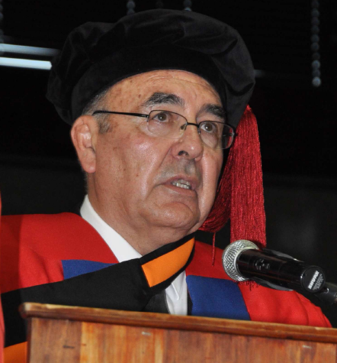
The long walk to excellence in higher education and training:
The struggle of racists
and comrades!
Prof Kalie Strydom
Valedictory Lecture
October 2010

Slide 2
Purpose of the lecture
Provide perspectives on politics in higher education and training (HET)
Share examples explaining the meaning of excellence in HET
Practically illustrate a realistic and relevant approach to medium of instruction at UFS in striving for excellence

Slide 3
Politics in Higher Education and Training (HET)
The long walk, struggle of comrades/racists – the issue of politics
No worthwhile contribution to HET without understanding and acknowledging politics
The systems level

Slide 4
Educational pyramid
HE (university)
sector
Intermediate College Sector
(FET in the UK, TAFE in Australia
Community colleges in the USA, etc.)
After 9-12 years of schooling.
Basic Education (School sector)
(9-12 Years of schooling)

Slide 5
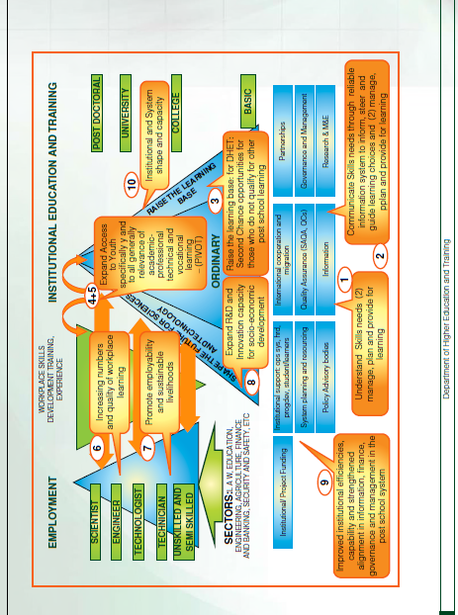
DHET Strategic plan 2010-2015

Slide 6
The systems level
Why could we as higher educationists not persuade the new democratically elected government to create a successful education and training pyramid with a strong intermediate college sector in the nineties?
What was the politics like in the early and late nineties about disallowing the acceptance of the successful pyramid of education and training?
Why do we only now in the latest DHET strategic planning 2010 – 2015 have this successful pyramid as a basis for policymaking and planning?

Slide 7
The institutional level
Explosive racial situations
Examples vary from:
  the indoctrination and prejudice that is continued within most homes, churches and schools;
  mass media full of murder, rape, corruption;
  political parties skewing difficult issues for indiscrete political gain;
  to frustrating non-delivery in almost all spheres of life which frustrates and irritates everyone, all feeding racial stereo typing and prejudice.

Slide 8
Political Battlegrounds
Universities in South Africa are increasingly becoming the battlegrounds for political gain which creates a polarised atmosphere on campus and crowds out the moderate middle ground, thereby subverting the role and function of the university within a specific context, interpreted globally and locally.

Slide 9
Contributions of Higher Educationists
“What is politics?
  It is the management of conflicts, alliances and balances of power without resort to war – not simply between individuals (as in a family or some other group) but in society as a whole. It is the art of living together, within a single State or city (polis, in Greek) with others whom we have not chosen, to whom we feel no particular attachment and who, in many respects, are rivals rather than allies.
  This supposes shared power, and a struggle for that power. It supposes government, and changes of government.
  It supposes conflicts (albeit governed by rules), compromises (albeit provisional), and eventually agreement on how to resolve disagreements.
  Without politics, there would be only war and that is what it must prevent in order to exist.
  Politics begins where war ends”

Slide 10
Equity and Excellence
Why not about equity comrades and racists? Any answer from my side to this question on the relationship between equity and excellence in South Africa will need another valedictory lecture probably in heaven, but at least I am prepared to say that I think that there is an overemphasis on equity due to political correct pressure that endangers excellence in higher education and training.

Slide 11
The University as an Institution
Through comparative literature review and research, re-conceptualise the university as an institution in a specific context.
  This entails carefully considering environment and the positioning of the university leading to a specific institutional culture and recognising the fact that institutional cultures are complicated by many subcultures in academe (faculties) and student life (residences/new generations of commuter students).
  These subcultures often tend to develop outside the institutional cultures.
  Not even mentioning the myriad of communication channels that are needed and must be maintained often under the most difficult circumstances to make progress towards excellence in a university requires a deep honest understanding of these complexities.

Slide 12
Governance in HET
Balancing legitimacy and effectiveness.
Leading along two dimensions: getting work done and engaging people.
Differentiating between formal university structures and the functions of universities as they adapt and evolve.
Bridging the divergence between cultural and operational imperatives of the bureaucratic and professional sides of the university.

Slide 13
Excellence in Higher Education Studies
Understanding glocal (global & local) pressures, trends, issues and challenges in higher education (including politics): the object of our study;
Understanding the implications of the present expansion of higher education in relation to our field of study and research;
Understanding the limitations of our thematic higher education authority;
Understanding the necessity of one outstanding association or society for studies and research in higher education (networking).

Slide 14
The Essential Task of a University
As already mentioned the re-conceptualization of the university as an institution is of importance, but without compromising
  the essential responsibility of a university, that is to create, deliver, and apply knowledge.
  Striving to be an excellent university in South Africa, universities should have the added responsibility of assuring the public good – sustaining the best in our society and equipping it for the future.

Slide 15
Excellence in the HET system
Has higher education and training got market value, made a marked economic impact on earning differentials and indicated clearly that we have productivity growth by taking stock of human capital: by the powerful combination of contribution of an educated workforce to “adoption and rapid diffusion of new technologies.”
The public good or civic benefits should also be expected from universities and should be part of educational attainment and have a strong positive effect on civic engagement within universities.

Slide 16
Branding of the UFS
Core values should be:
  Students and learning
  Opportunity and Inclusiveness
  Scholarship and Research
  Community and Connectivity
  Partnership and Service
  Integrity and Stewardship

Slide 17
Characteristics of HET in South Africa
The demand overload of policies and planning without necessary resources.
National, regional/local and higher education and training institutional policies and planning alignment constrained by unstable politics, inadequate leadership, resources and infrastructure .
The delicate, but necessary relationship between internationalisation and regionalisation are not well understood. Traditional academic values tend to reward internationalisation only.
Top-down – bottom-up percolating process of planning not supported.

Slide 18
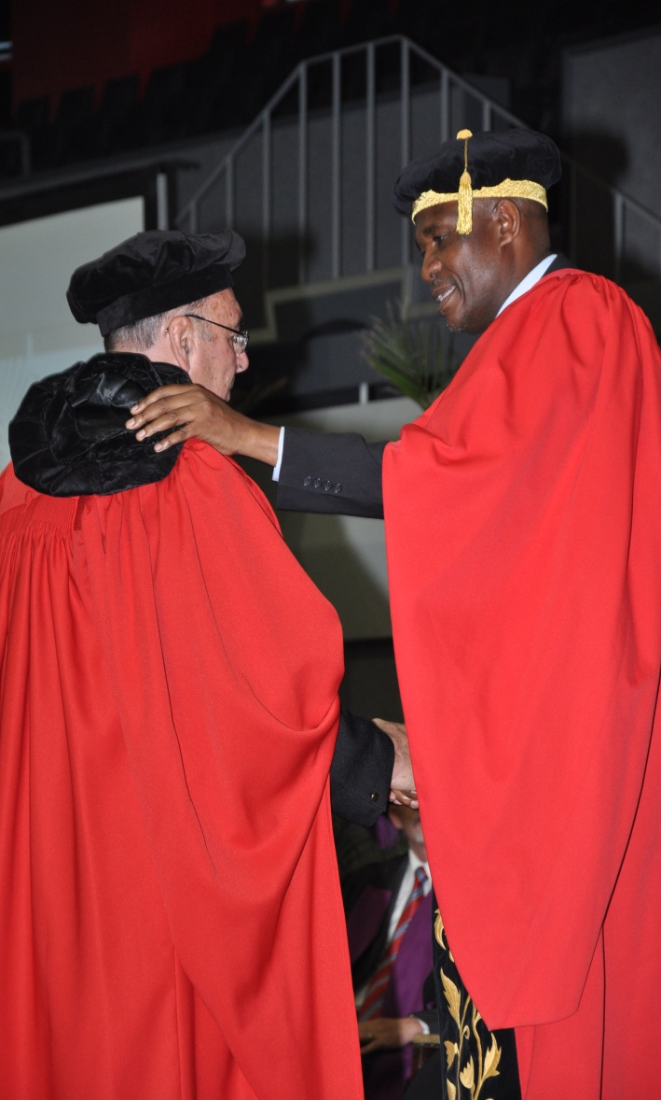
Earning Trust
Finally I am pleading with Covey, 2006 that we as comrades and racists urgently find common ground to start building the one thing that is common to every individual (higher educationist), relationship, team, family, organization, nation, economy, and civilization throughout the world – one thing which, if removed, will destroy the most powerful government, the most successful business, the most thriving economy, excellent higher education and training, the most influential leadership, the greatest friendship, the strongest character, the deepest love.

Slide 19
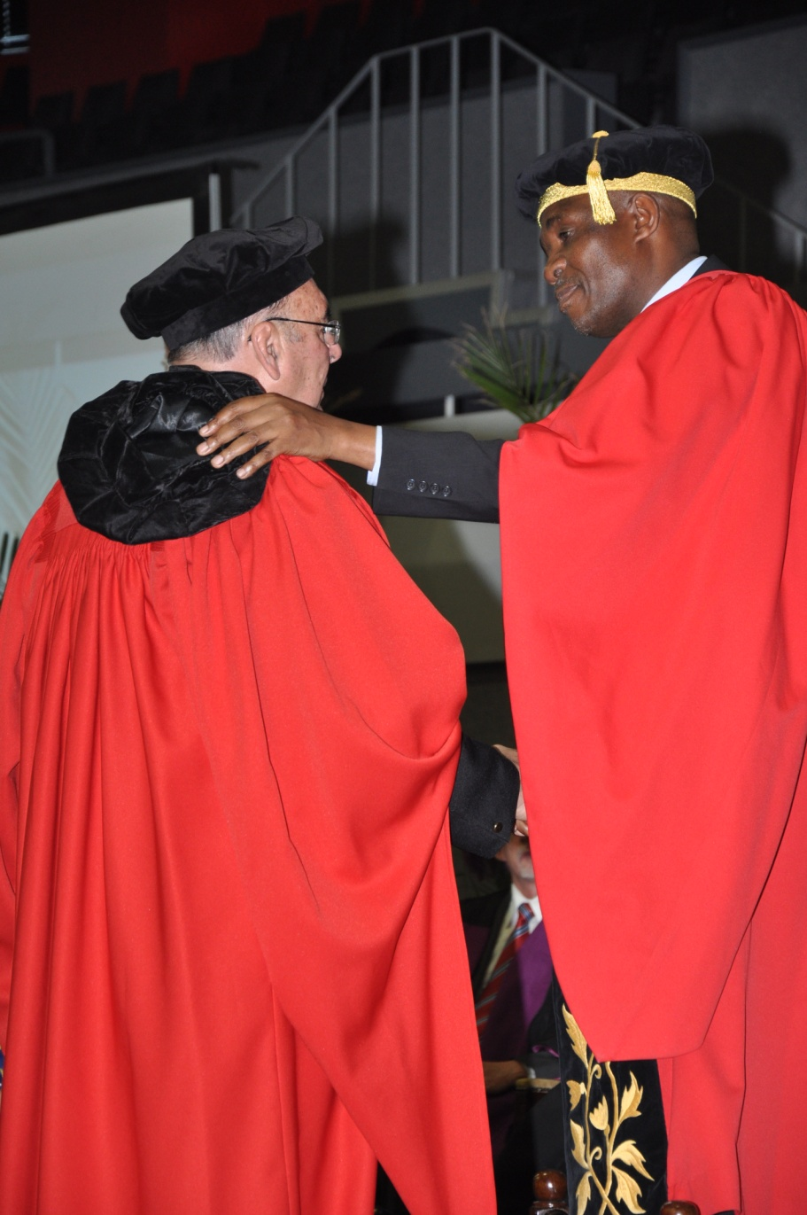
Thank you
On the other hand, if developed and leveraged, that one thing has the potential to create unparalleled success and prosperity in every dimension of life. Yet, it is the least understood, most neglected, and most underestimated possibility of our time.

